Slide 1
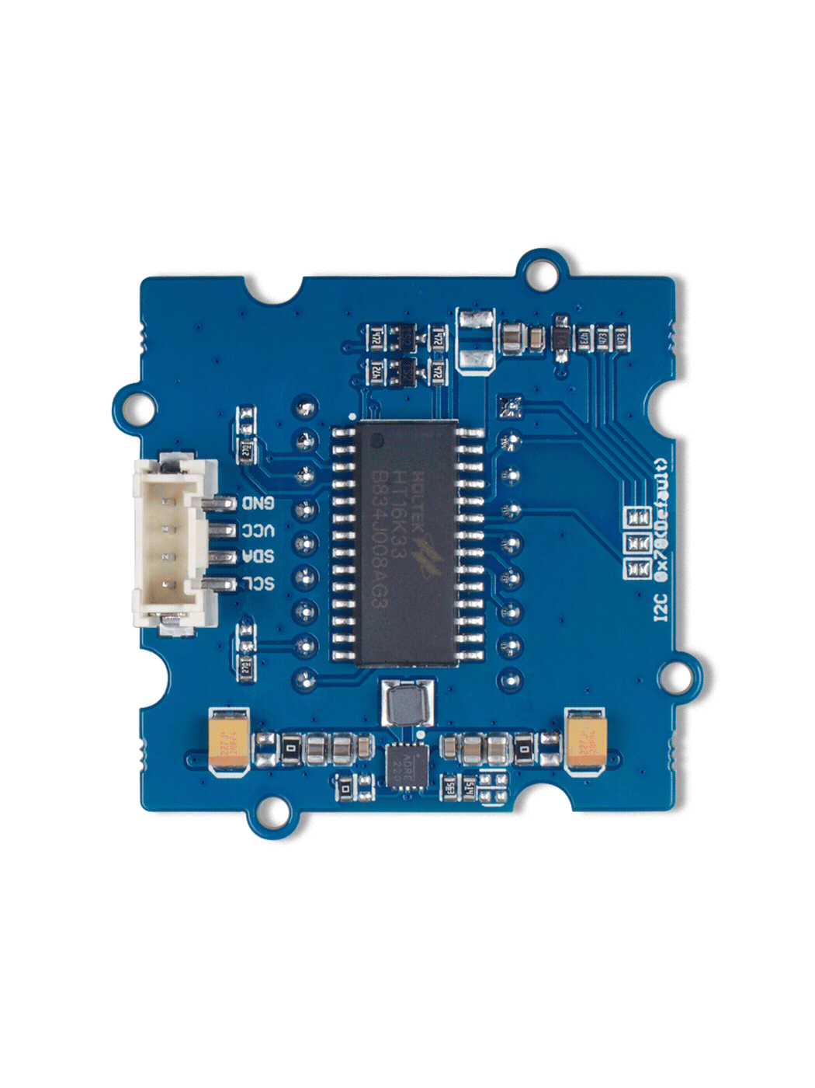





The default address is 0x70.
There are three pairs of pads.
When disconnect all the pad pairs,
the address is 0x70;
when you connect all the pad pairs,
the address turns to 0x77.
A2
A2
A1
A1
A0
A0
Deafault
0x70
Optional
0x77
GND: connect this module to the system GND
VCC: you can use 5V or 3.3V for this module
SDA: serial data of I2C
SCL: serial clock of I2C
HT16K33 driver chip

