Slide 1
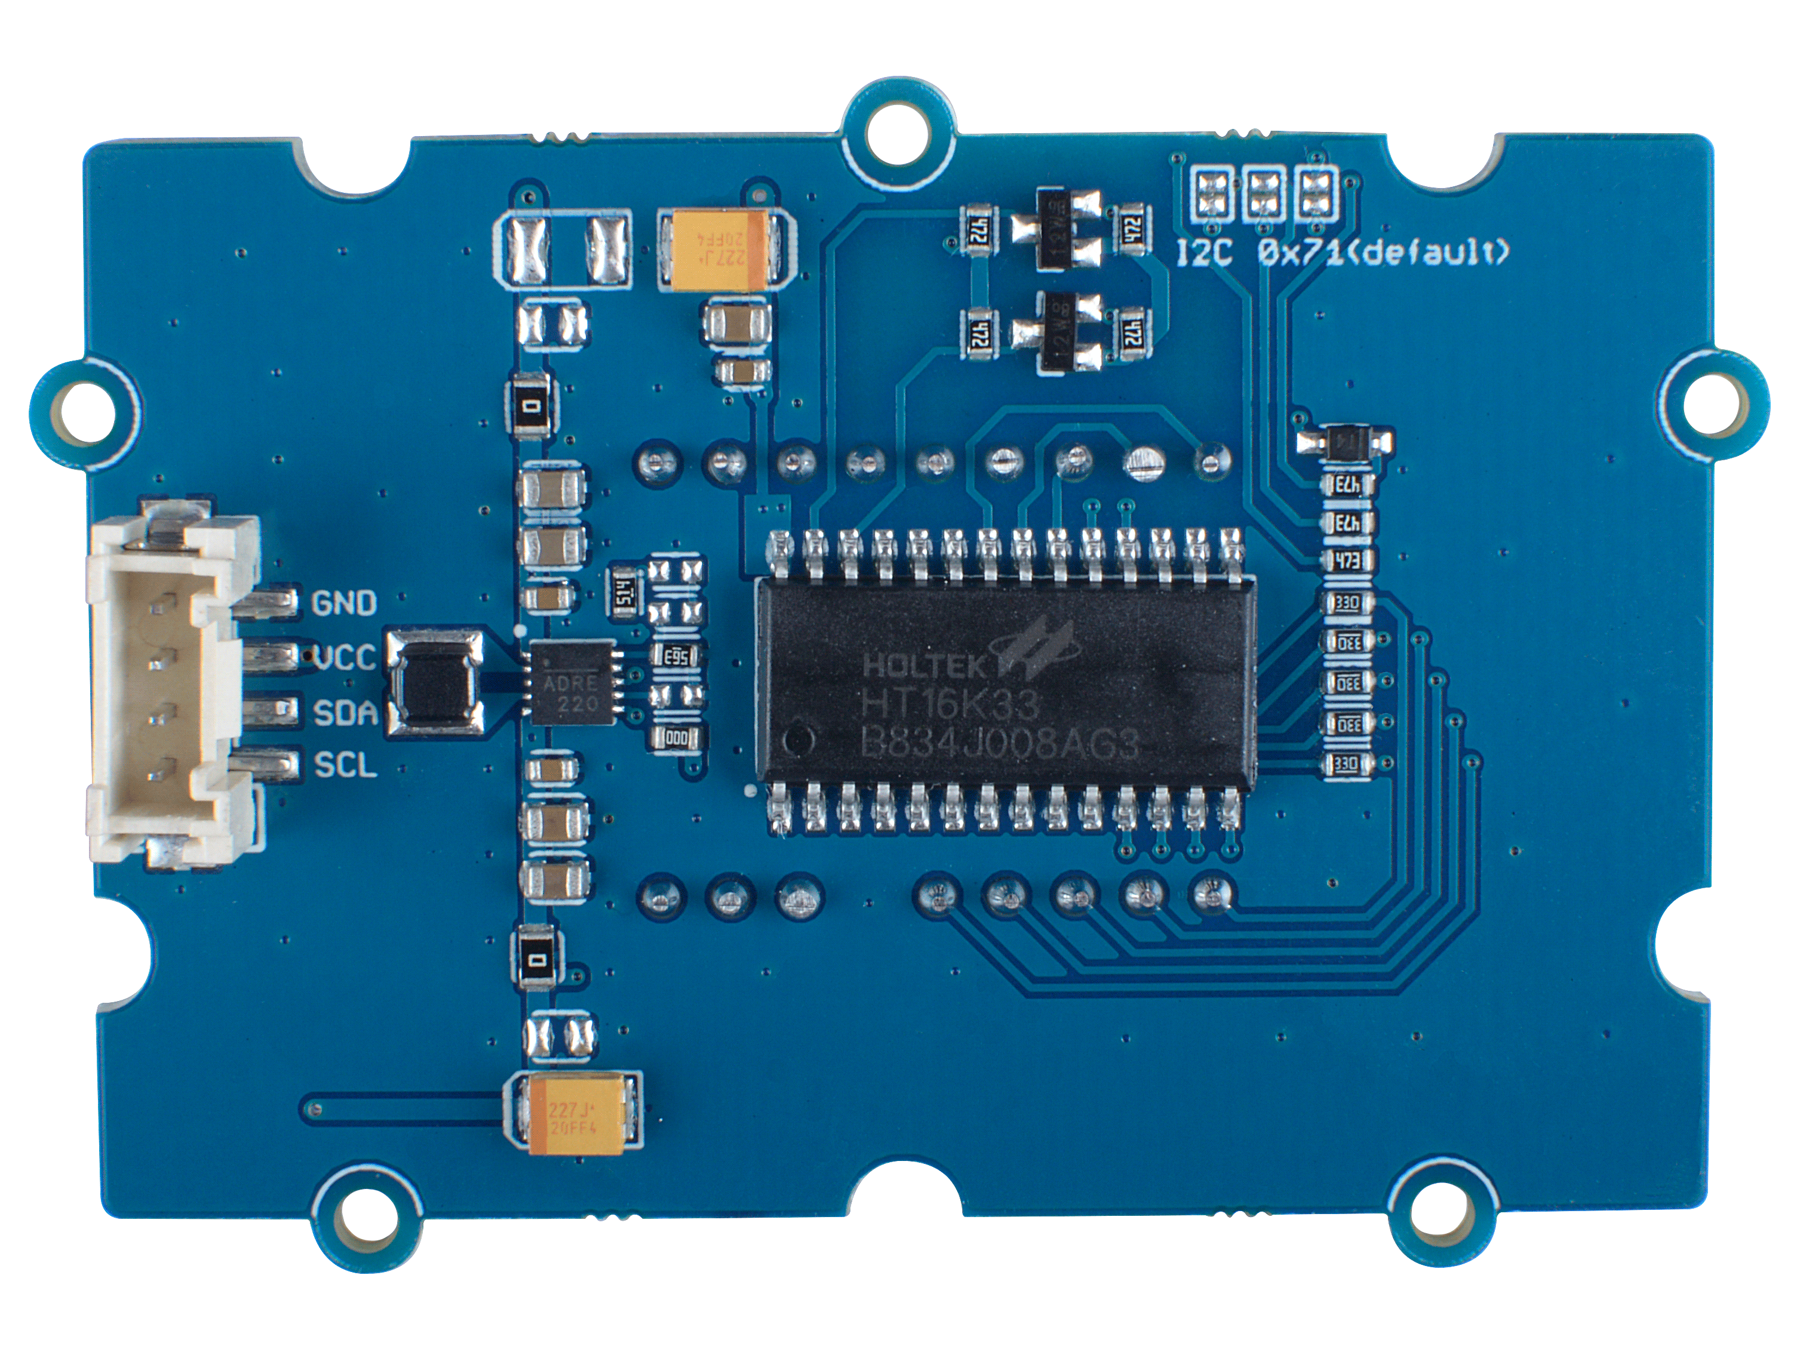





A0
A1
A2
A0
A1
A2
Deafault
0x71
Optional
0x77
The default address is 0x71.
There are three pairs of pads.
When disconnect all the pad pairs,
the address is 0x70;
when you connect all the pad pairs,
the address turns to 0x77.
GND: connect this module to the system GND
VCC: you can use 5V or 3.3V for this module
SDA: serial data of I2C
SCL: serial clock of I2C
HT16K33 driver chip

