Slide 1
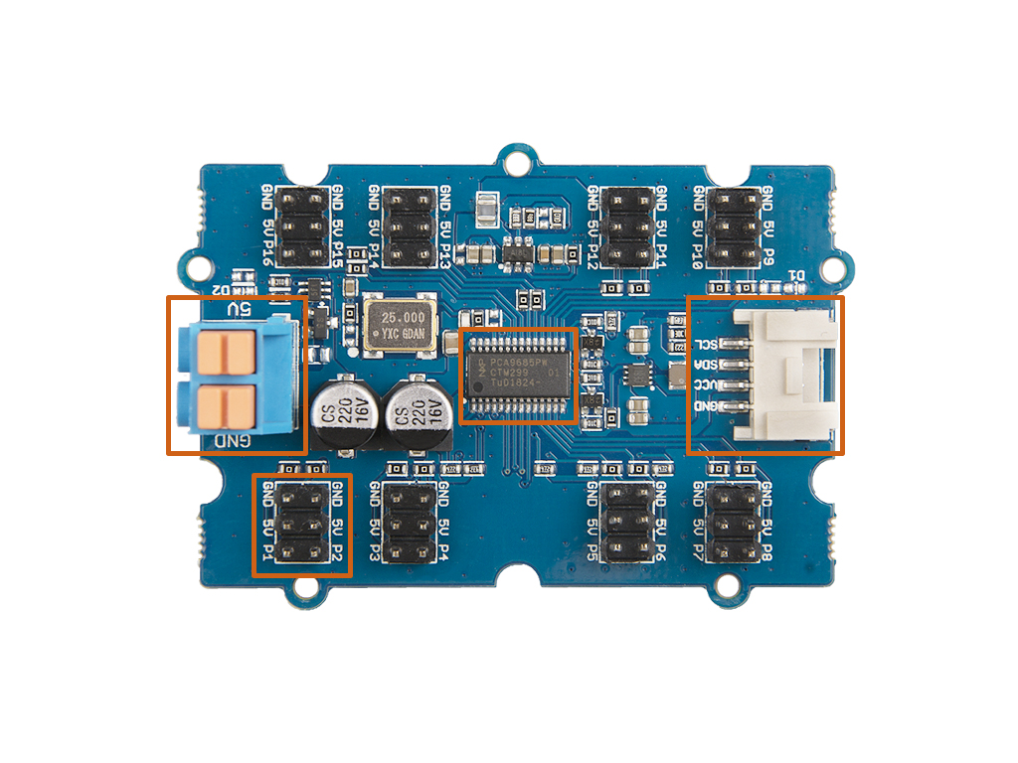
Power
In
I2C
PCA9685
PWM Out

Slide 2
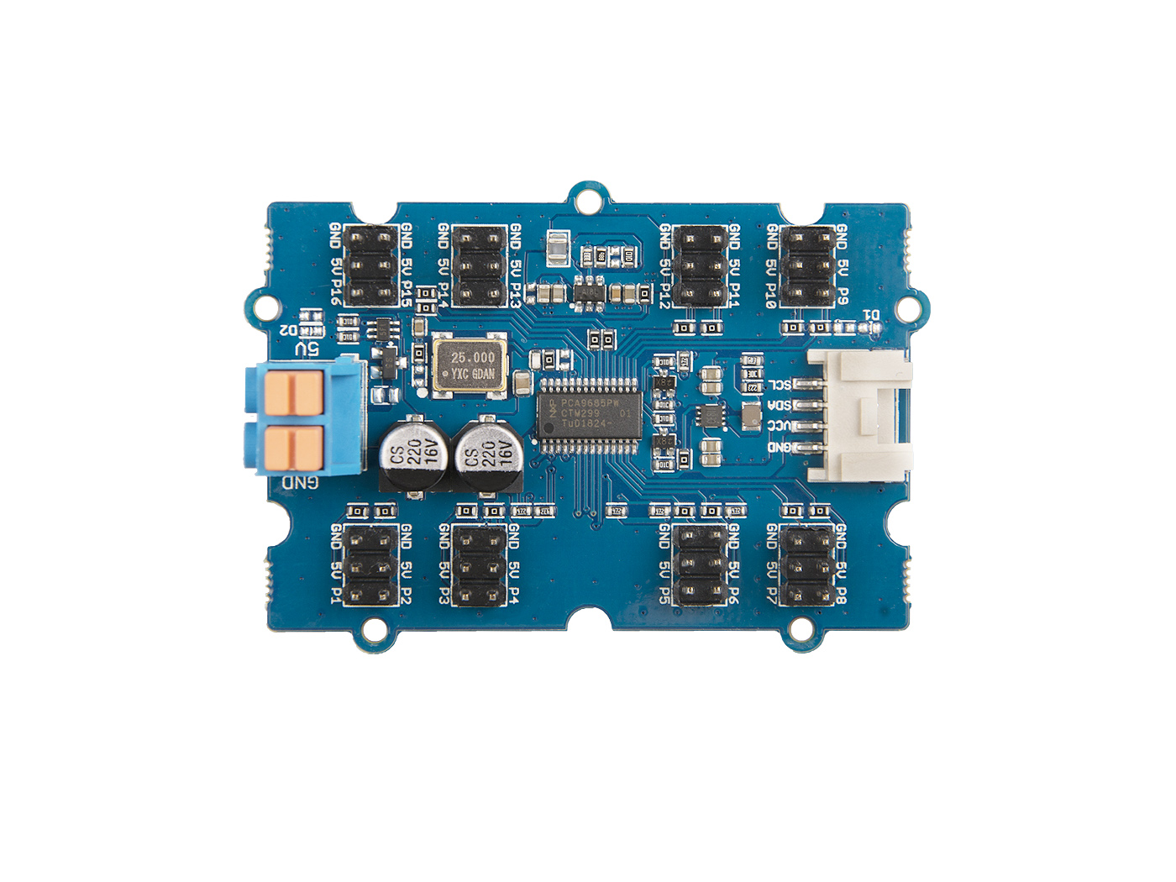


Slide 3

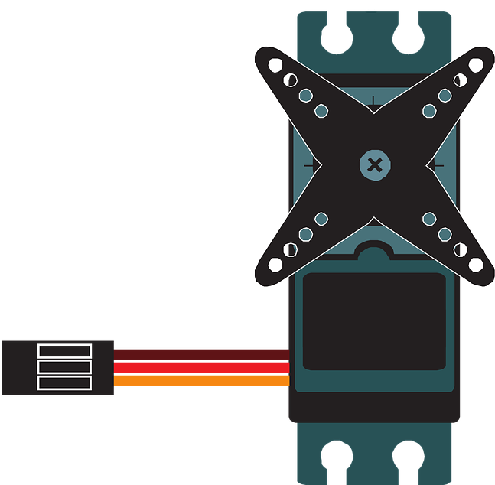

Slide 4
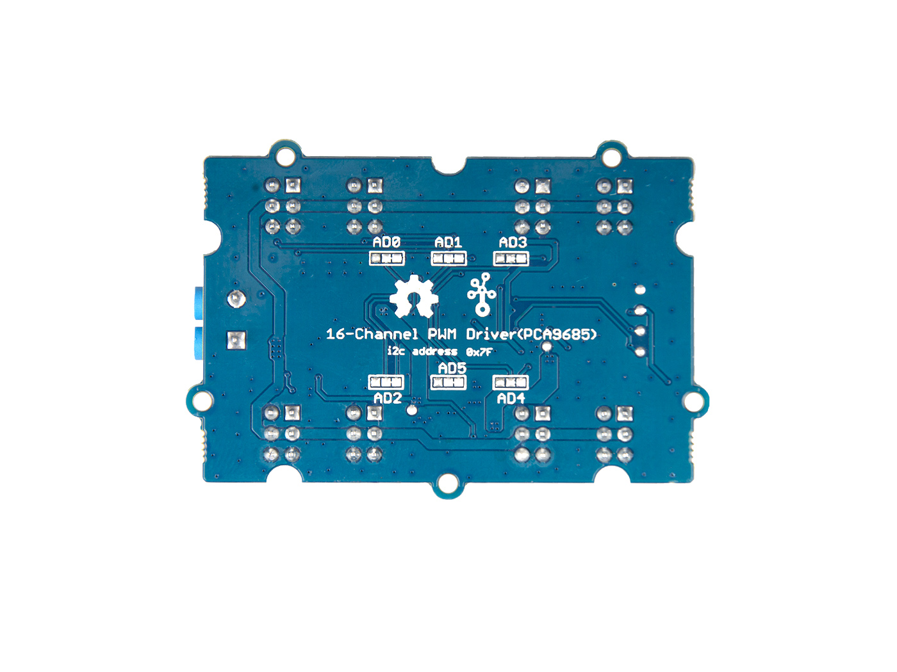
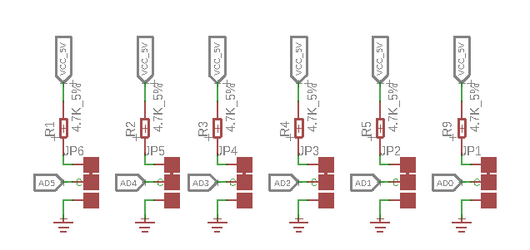
AD0
AD1
AD3
Default Address
0x7F
AD2
AD5
AD4

