Slide 1
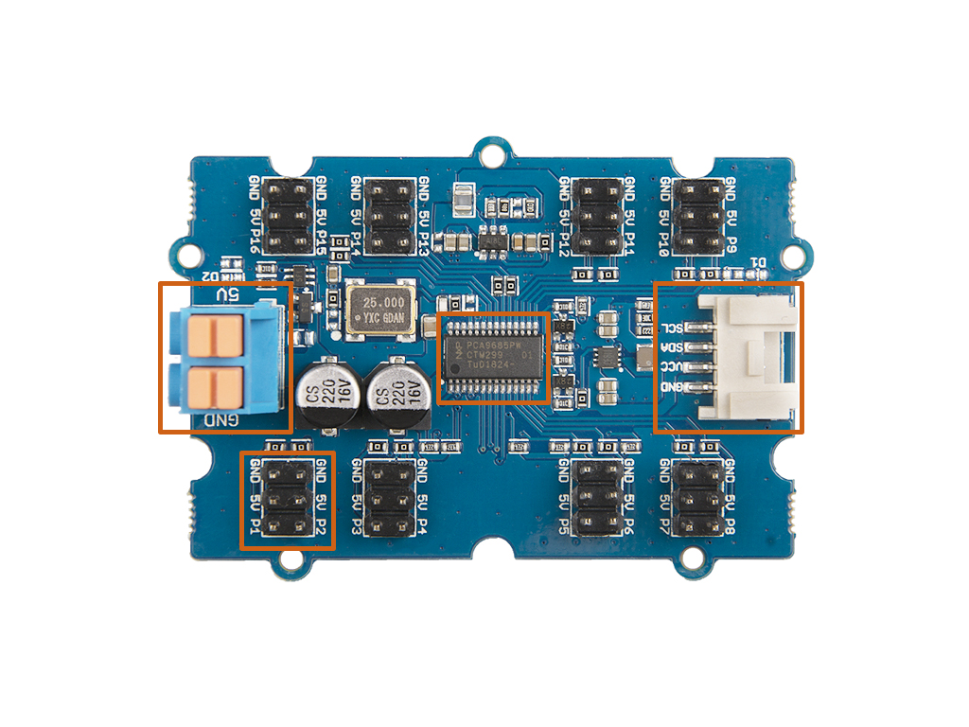
Power
In
I2C
PCA9685
PWM Out

