Slide 1
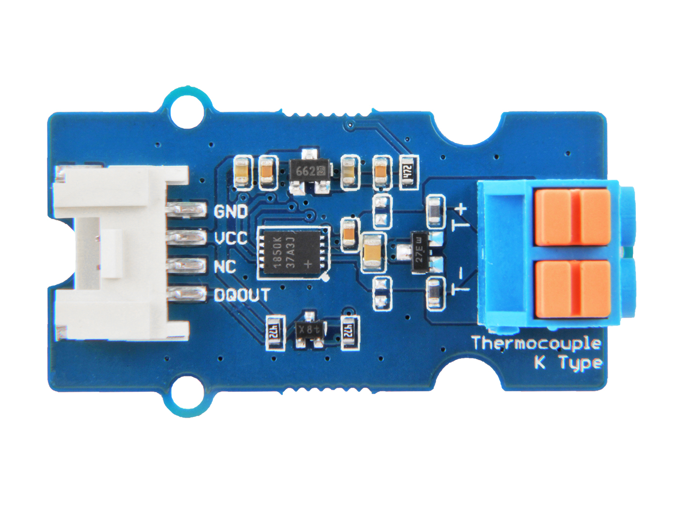






GND: connect this module to the system GND
VCC: you can use 5V or 3.3V for this module
NC: not connected
DQOUT: data Input/Output. open-drain 1-Wire interface pin.
T+: Thermocouple Input, positive pole.
T -: Thermocouple Input, negative pole

Slide 2
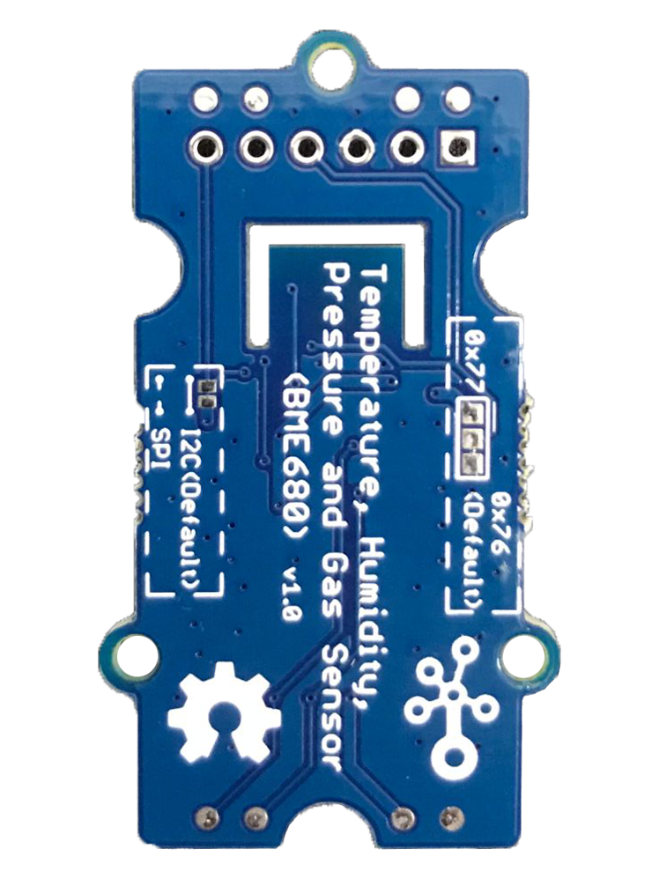
SPI
I2C
Default
0x76
Default
0x77
SPI

Slide 3
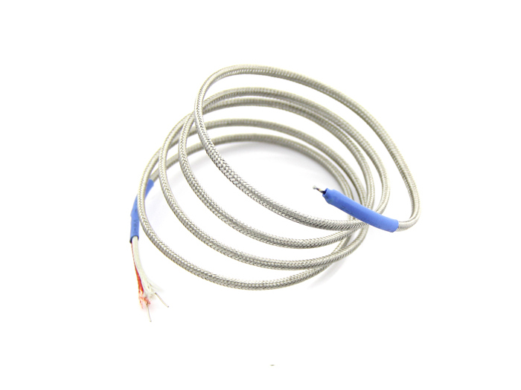
T+
•
Chromel
•
Hot Junction
T-
•
Alumel

