Slide 1
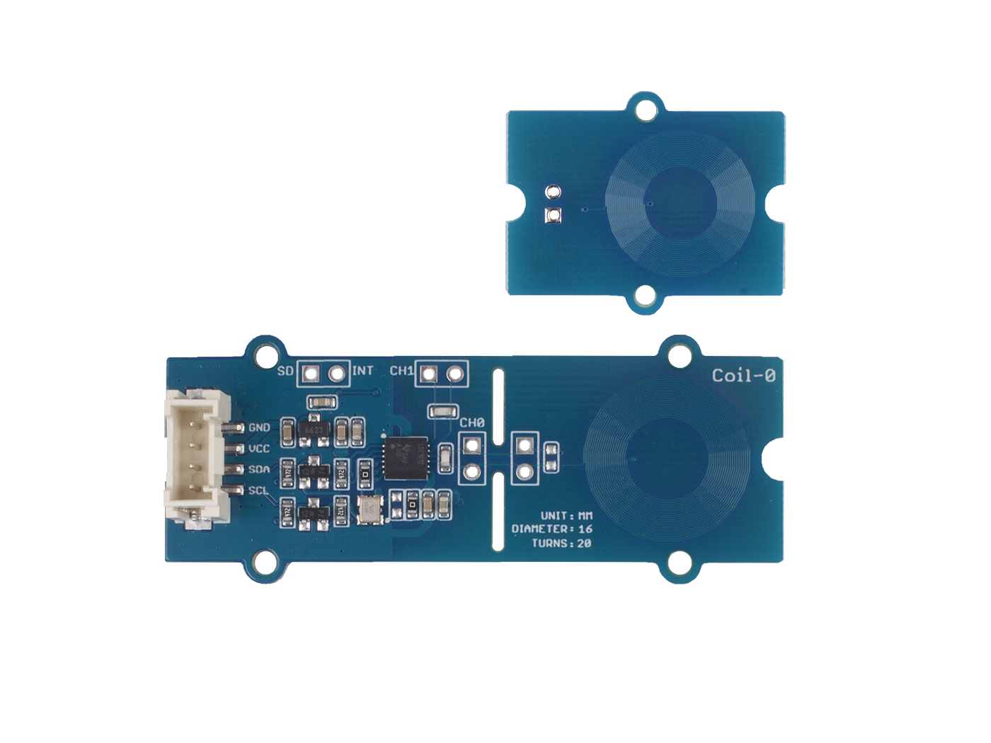





GND: connect this module to the system GND
VCC: you can use 5V or 3.3V for this module
SDA: I²C serial data
SCL: I²C serial clock
Two channel circular coil, the sensor section

Slide 2
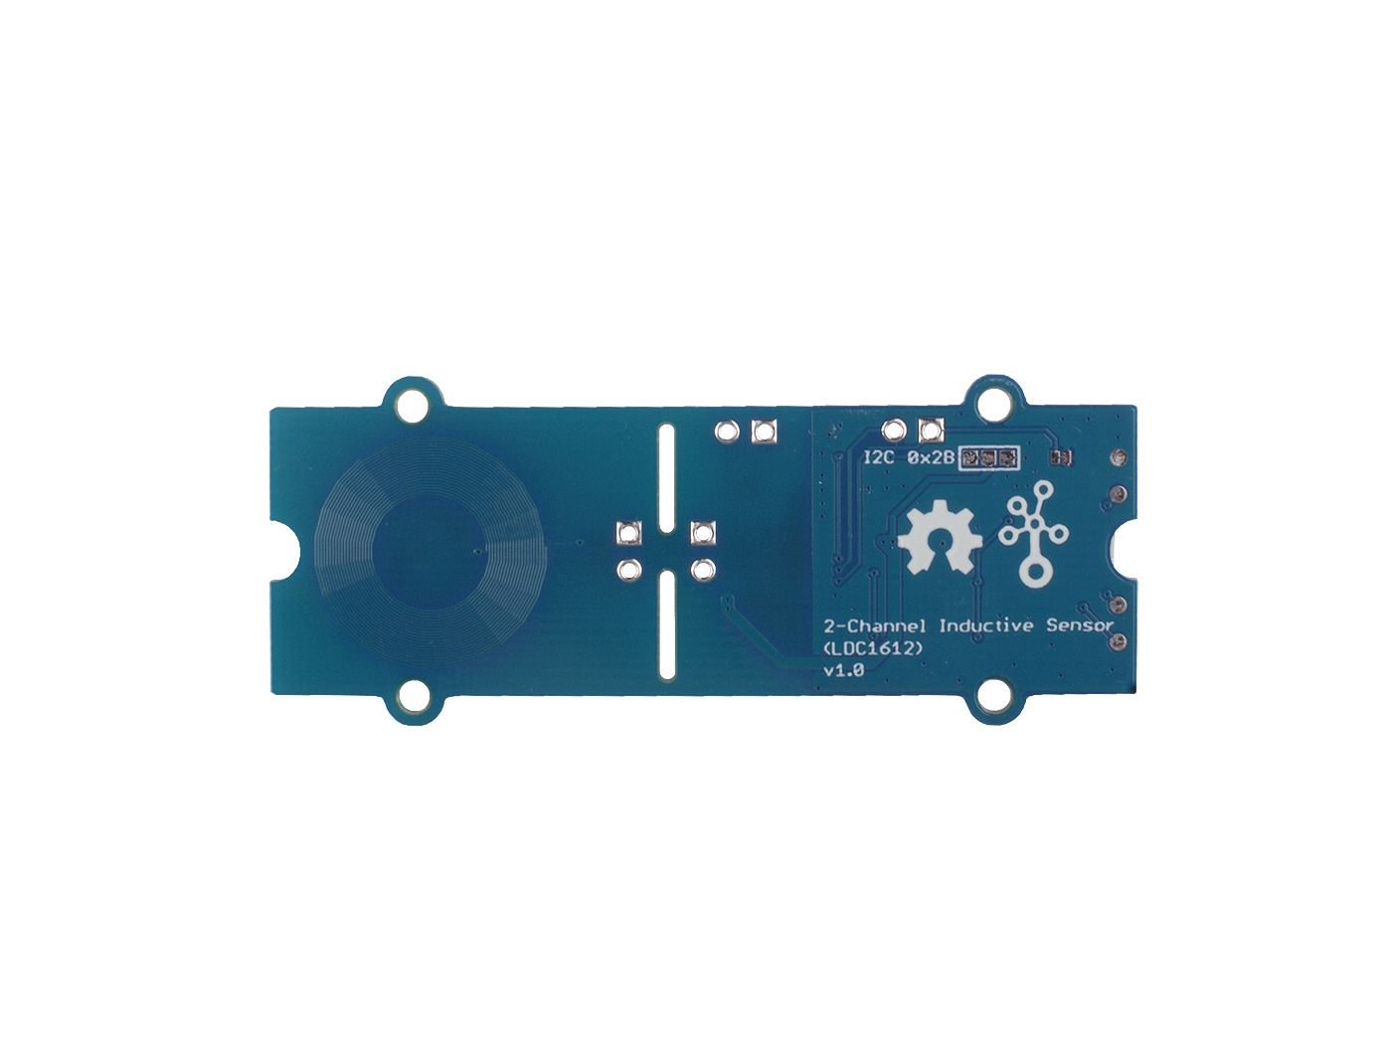
Optional
0 x 2A
Default
0 x 2B

