Slide 1
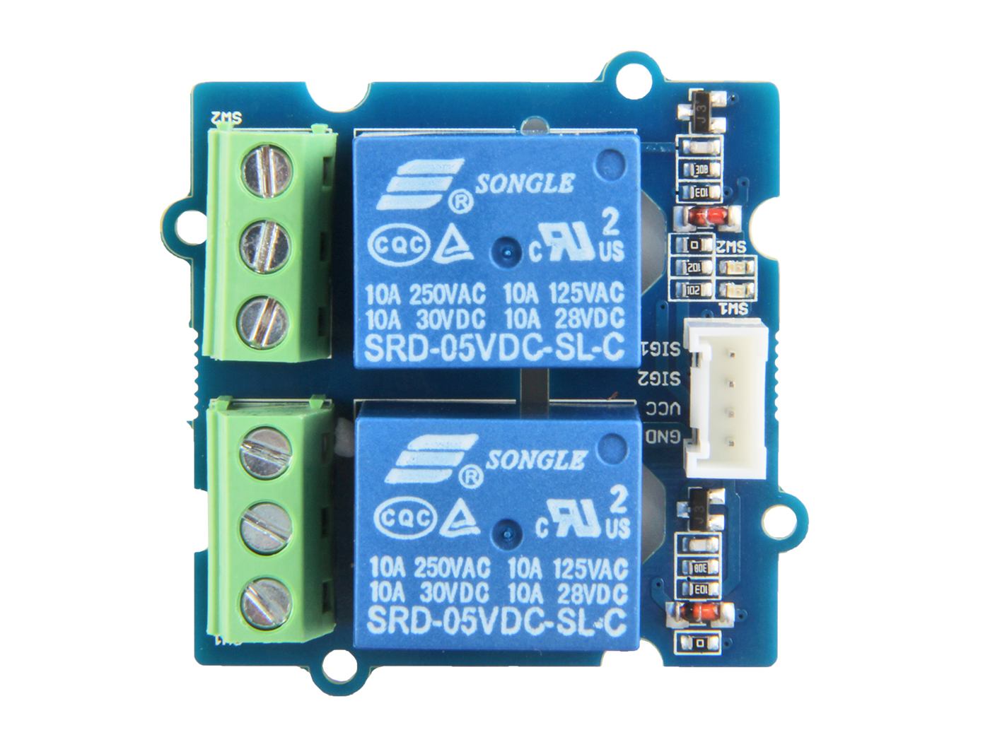










Switch 1
Switch 2
GND: connect this module to the system GND
VCC: you can use 5V or 3.3V for this module
SIG2: contral signal of swith2, high-NC2/low-NO2 SIG1: contral signal of swith1, high-NC1/low-NO1
NC1: one throw of switch1
COM1: controlled by SIG1, connected to NC1 or NO1
NO1: the other throw of swicth1
NC2: one throw of switch2
COM2: controlled by SIG2, connected to NC2 or NO2 NO2: the other throw of swicth2

