Slide 1
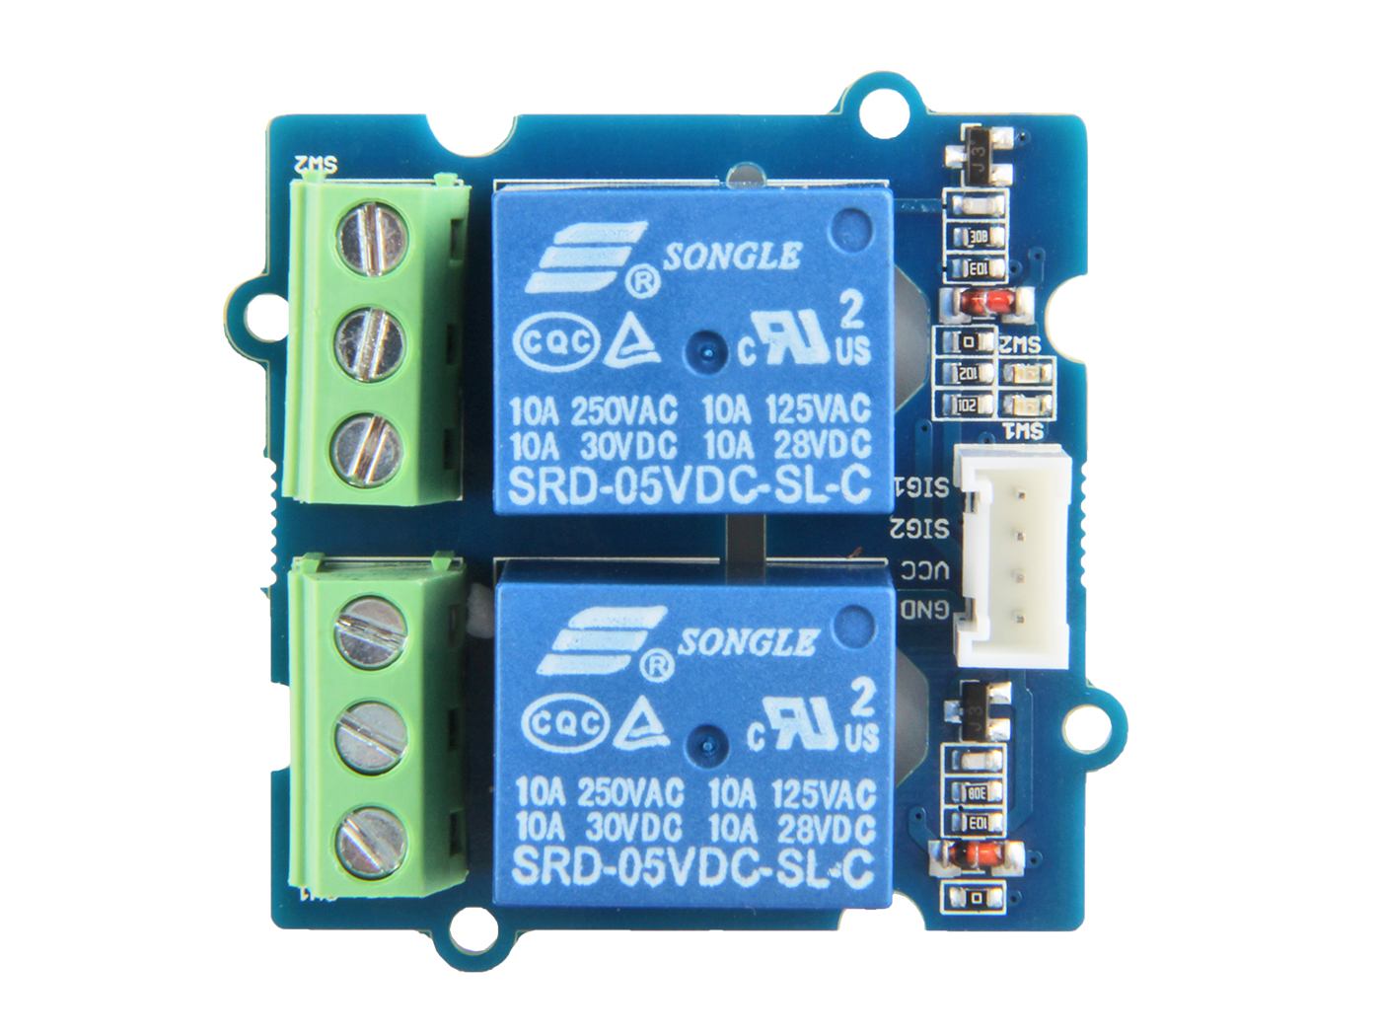










Switch 1
Switch 2
GND: connect this module to the system GND
VCC: you can use 5V or 3.3V for this module
SIG2: contral signal of swith2, high-NO2/low-NC2 SIG1: contral signal of swith1, high-NO1/low-NC1
NC1: one throw, connected to COM1 by default
COM1: controlled by SIG1, connected to NC1 or NO1
NO1: the other throw of swicth1
NC2: one throw, connected to COM2 by default
COM2: controlled by SIG2, connected to NC2 or NO2 NO2: the other throw of swicth2

