Slide 1




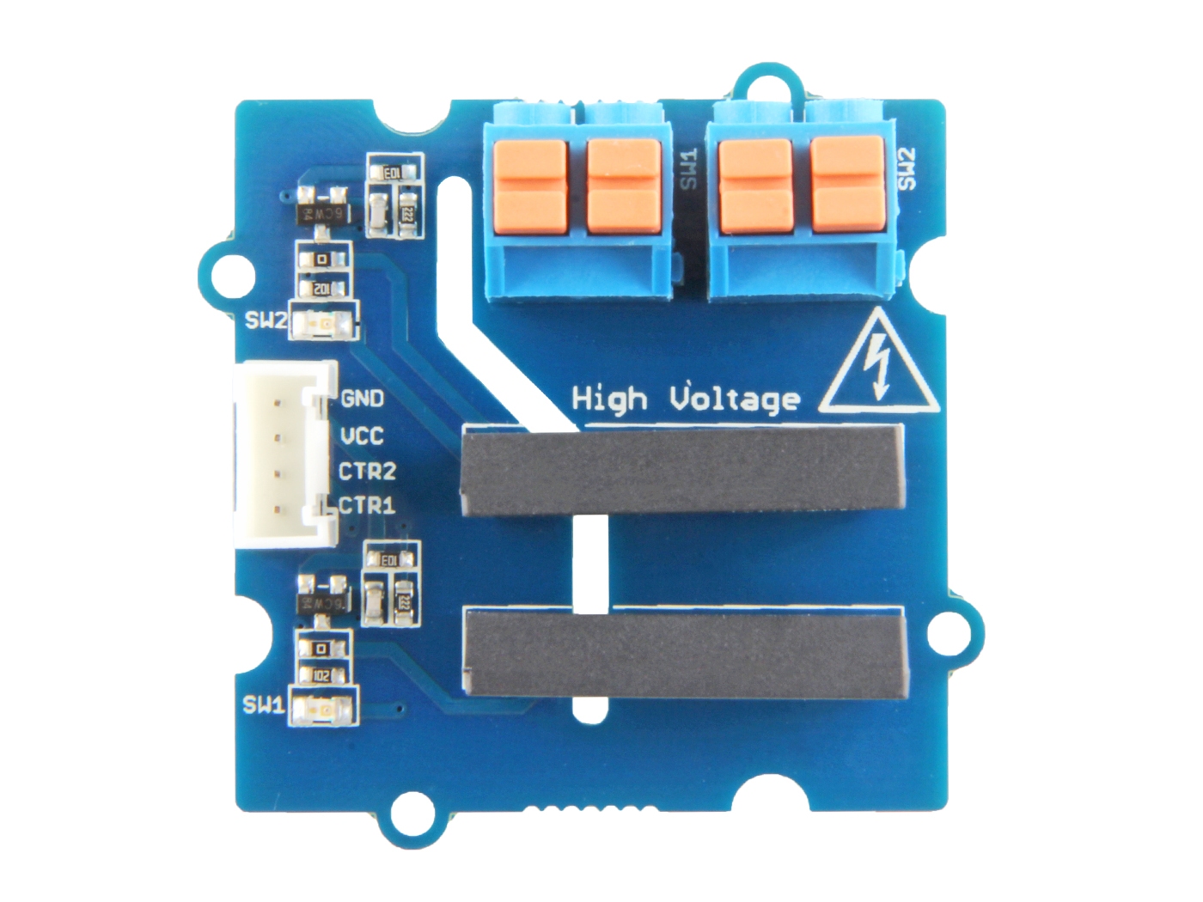




Switch 1
Switch 2
Load 2: one port of switch1 to connect to the load wire
Load 1: the other port of switch1 to connect to the load wire
Load 2: one port of switch2 to connect to the load wire
Load 1: the other port of switch2 to connect to the load wire
GND: connect this module to the system GND
VCC: you can use 5V or 3.3V for this module
CTR2: input control signal for switch2
CTR1: input control signal for switch1

