Slide 1
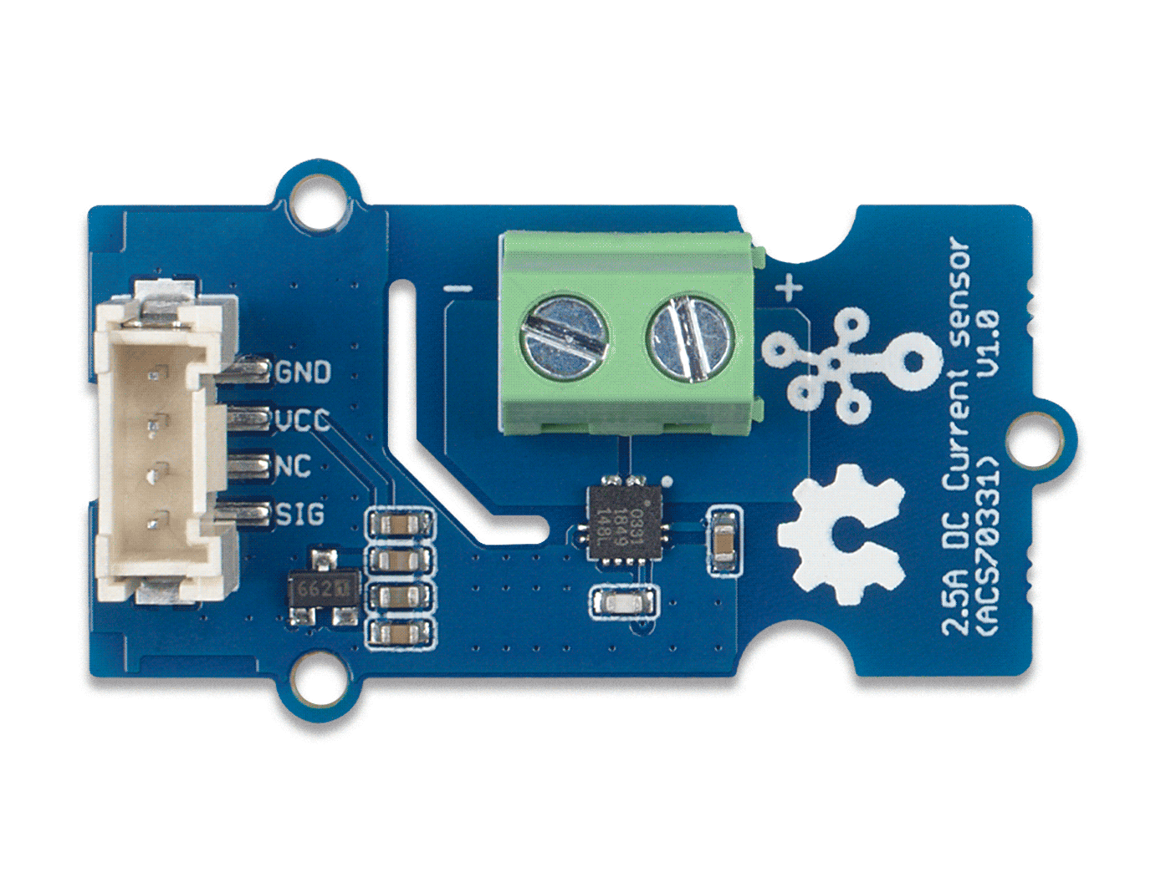






ACS70331 Chip
GND: connect this module to the system GND
VCC: you can use 5V or 3.3V for this module
NC: not connected
SIG: analog output, output the current value to the MCU
Low side of current sensor
High side of current sensor

