Slide 1

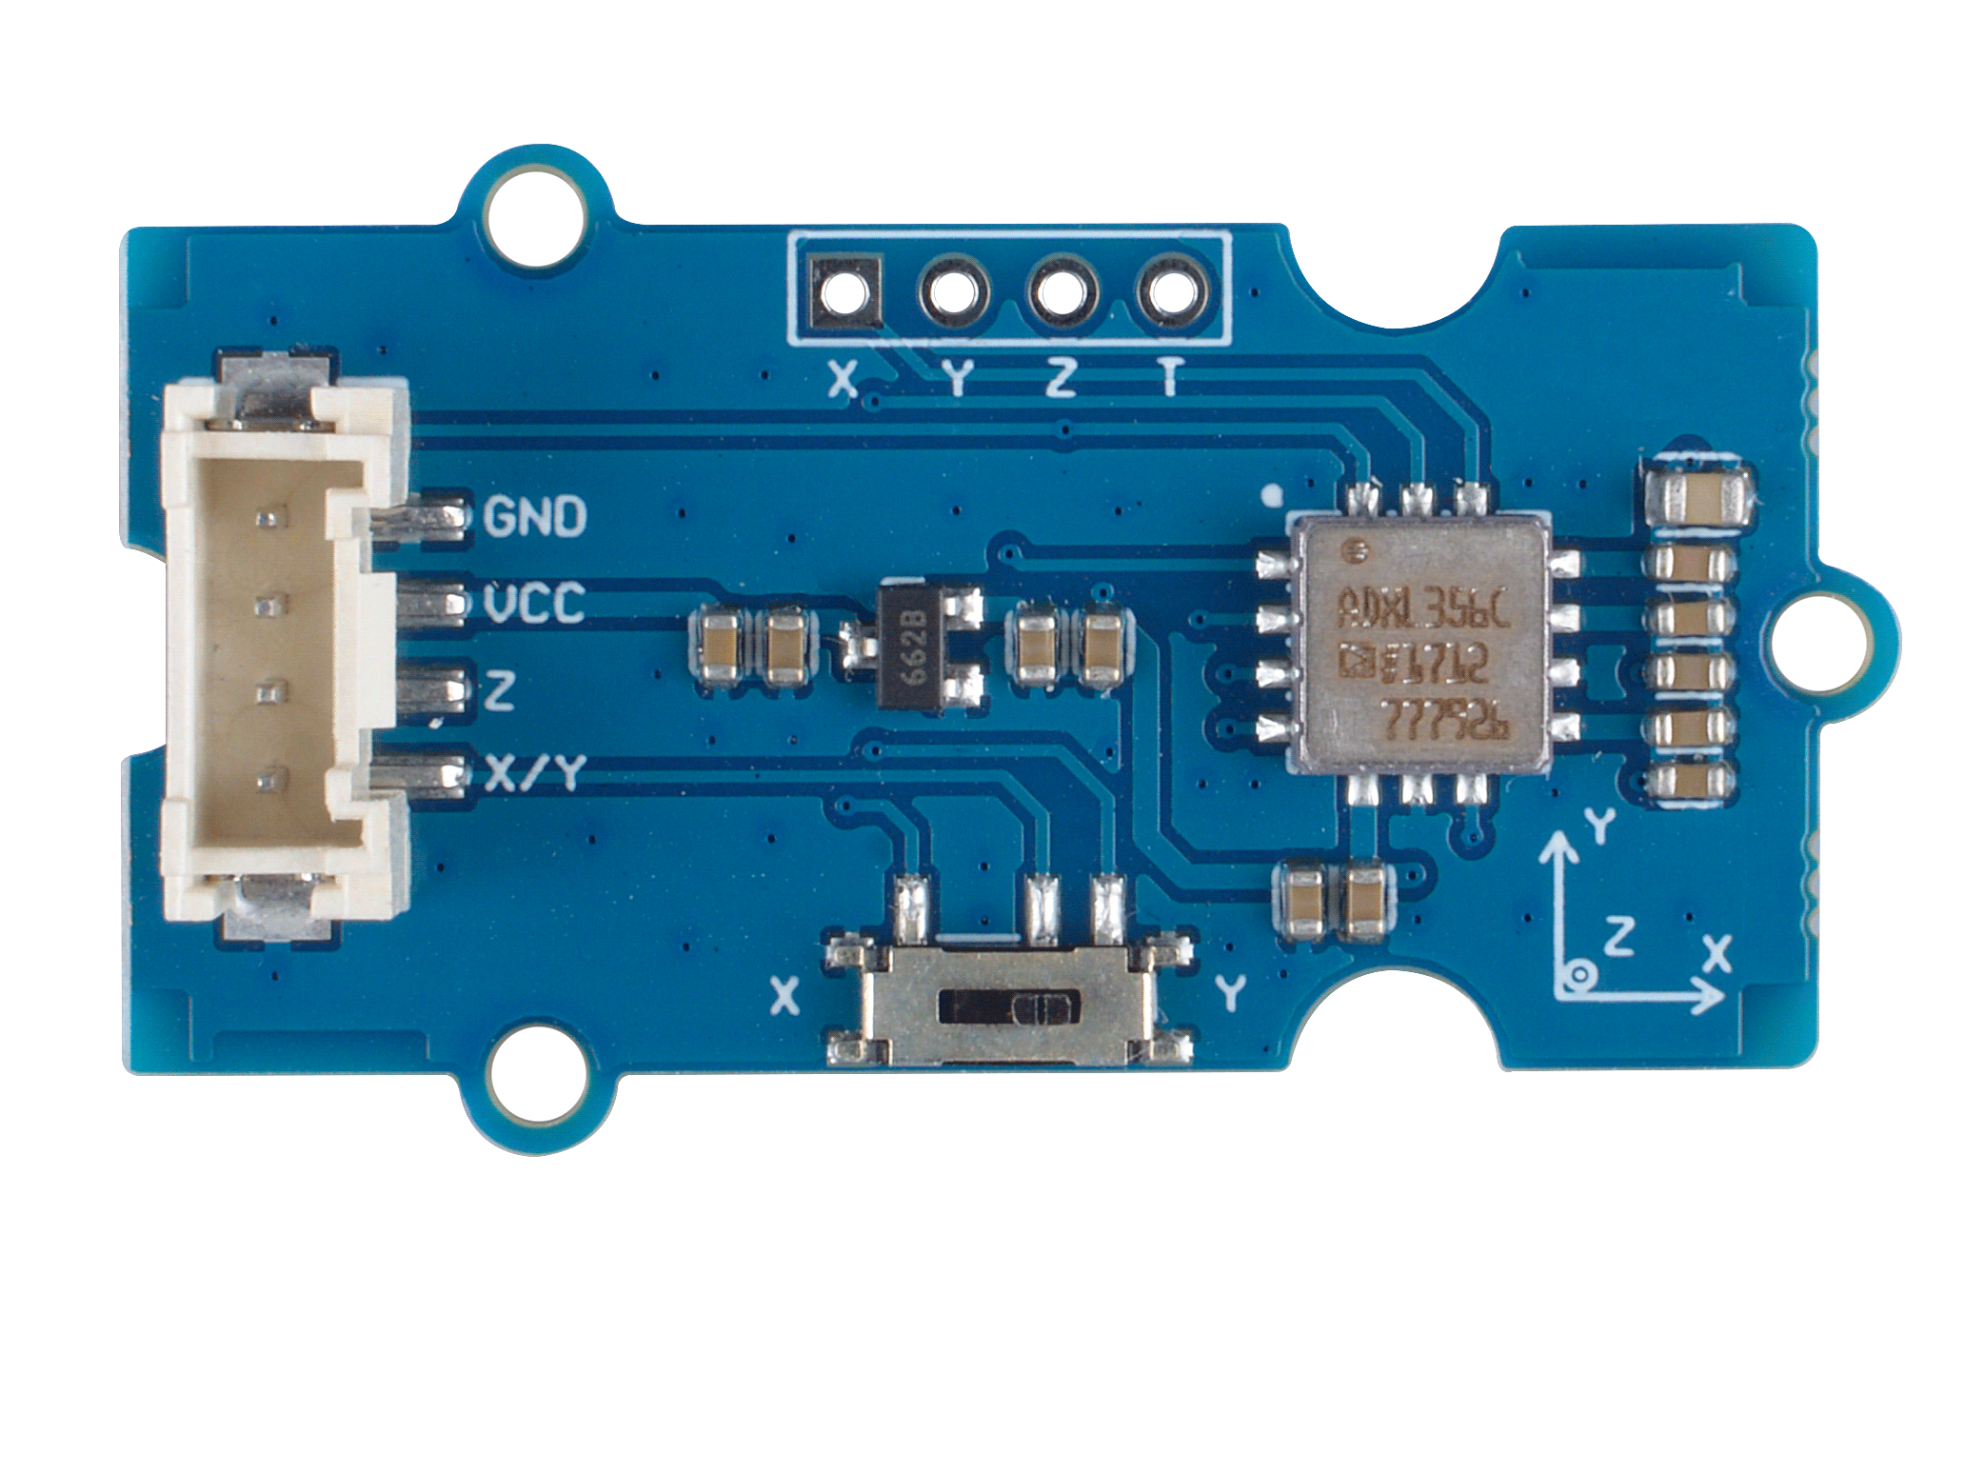





ADXL356C
GND: connect this module to the system GND
VCC: you can use 5V or 3.3V for this module
Z: Z-axis analog data output
X/Y: X-axis or Y-axis analog data output
4 Pin Output:
X/Y/Z axis analog data output,
Temperature output
Switch: switch X/Y output

Slide 2
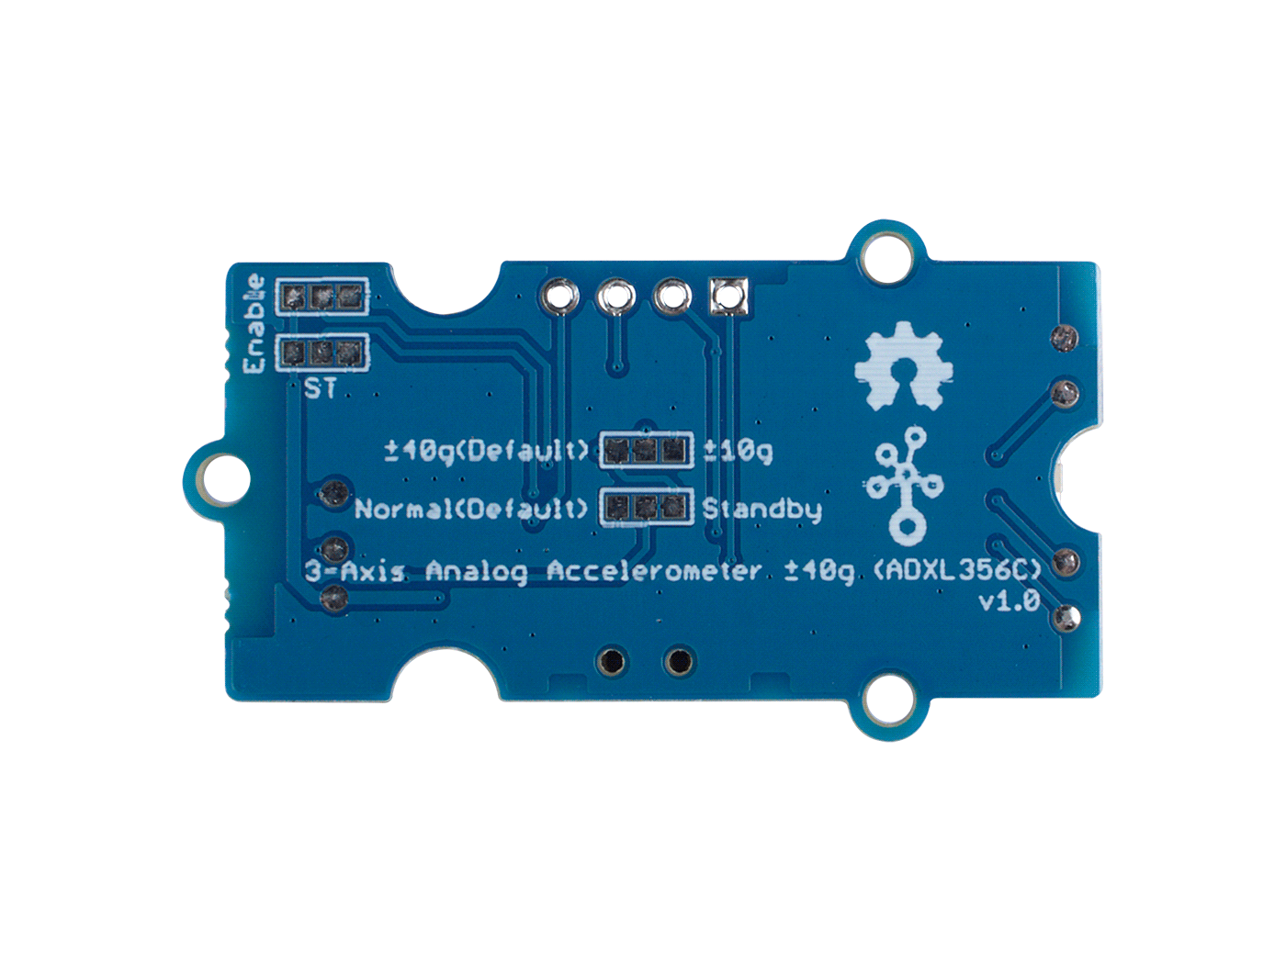
±10g Measurement Range
(Optional)
±40g Measurement Range
(Default)
Standby Mode
(Optional)
Normal Work Mode
(Default)

