Slide 1
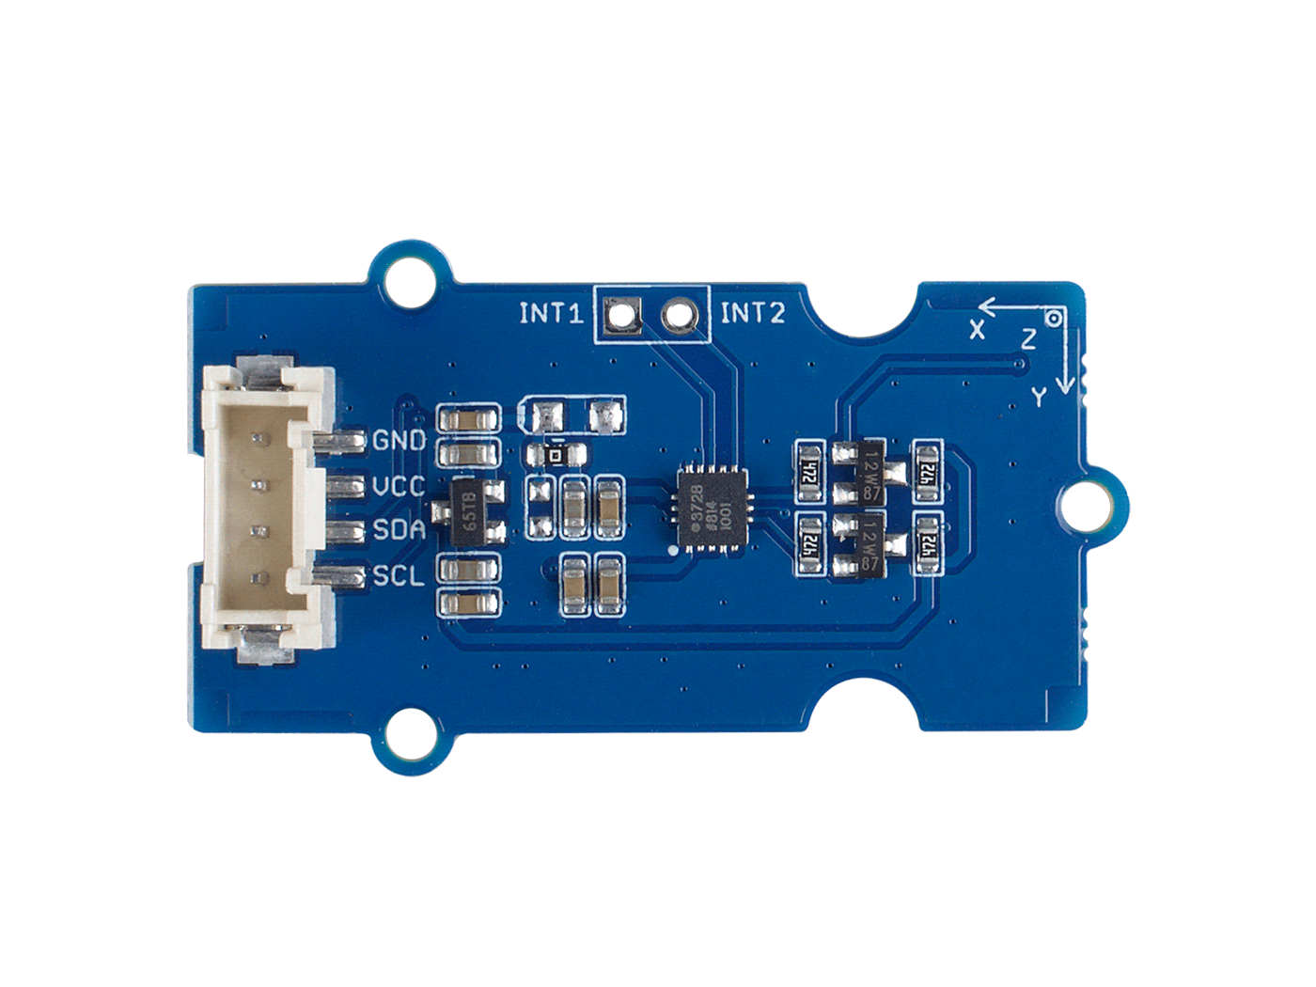





ADXL372
GND: connect this module to the system GND
VCC: you can use 5V or 3.3V for this module
SDA: serial data of I2C
SCL: serial clock of I2C
Interrupt Output: two channel interrupt output

Slide 2
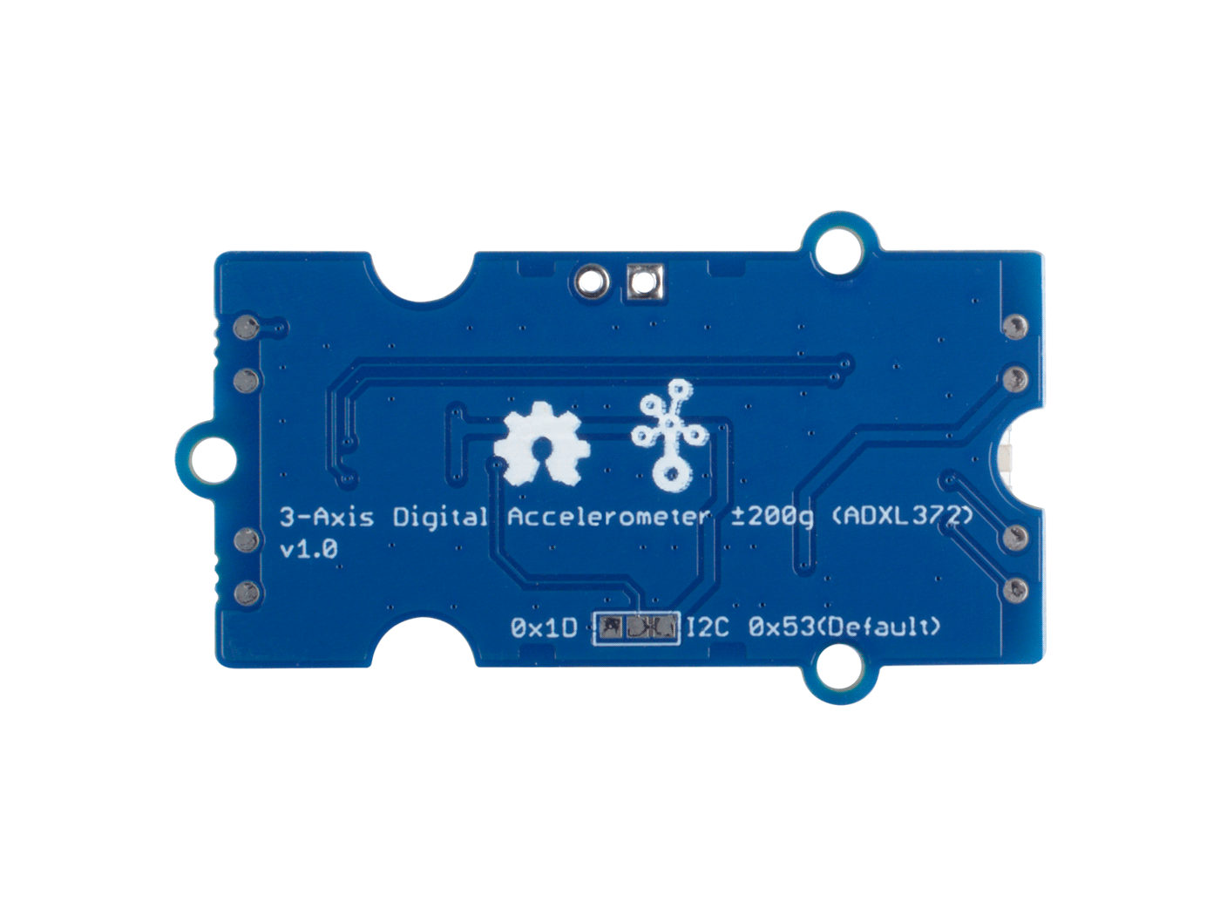
I2C Address 0x53
(Default)
I2C Address 0x1D
(Optional)

