Slide 1
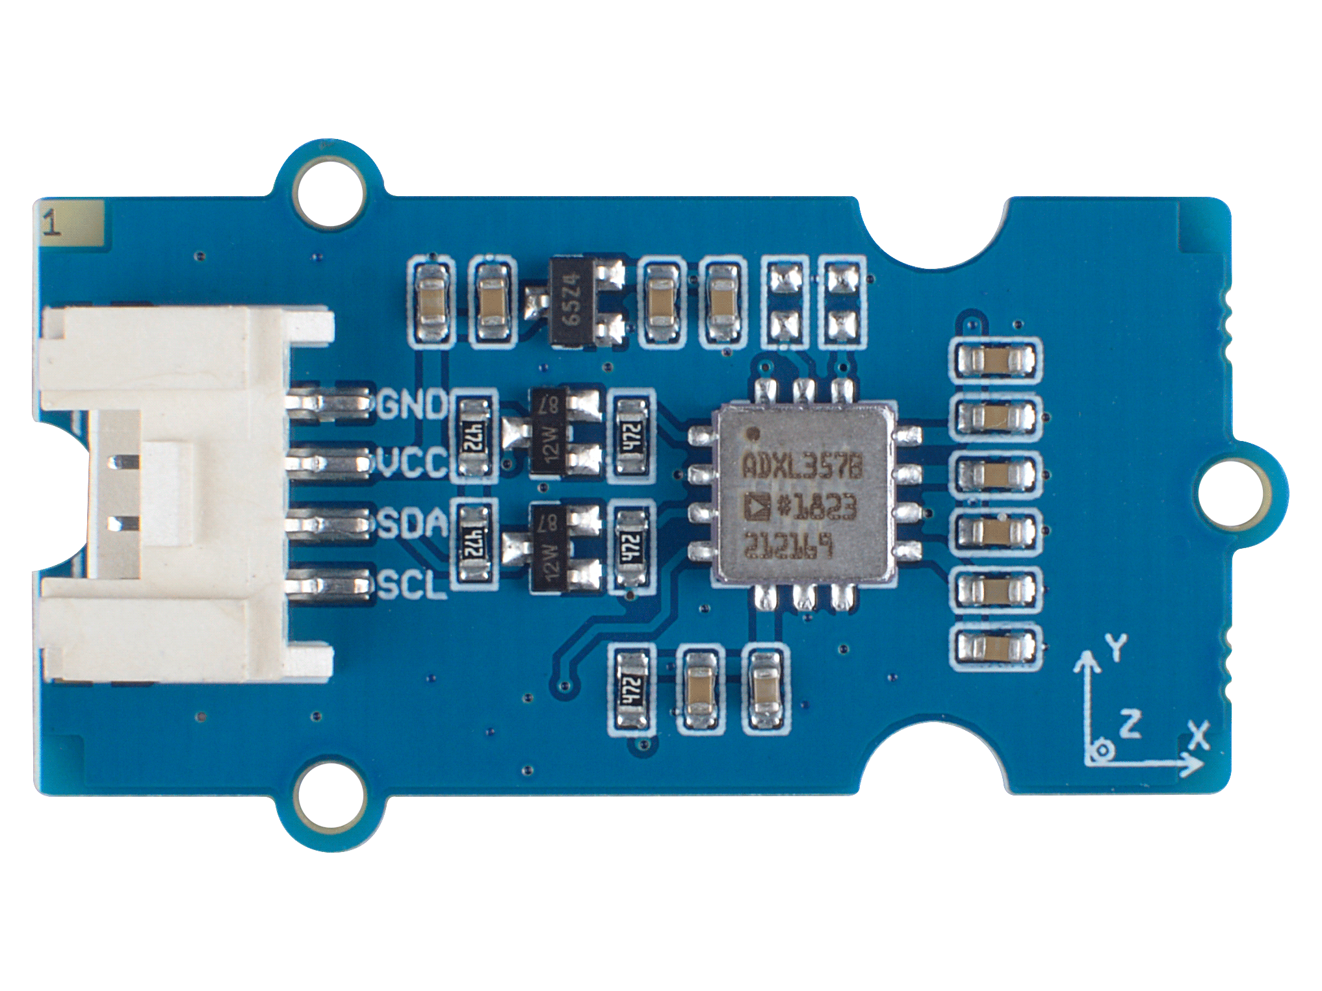




ADXL 357 CHIP
GND: connect this module to the system GND
VCC: you can use 5V or 3.3V for this module
SDA: I²C serial data
SCL: I²C serial clock

Slide 2
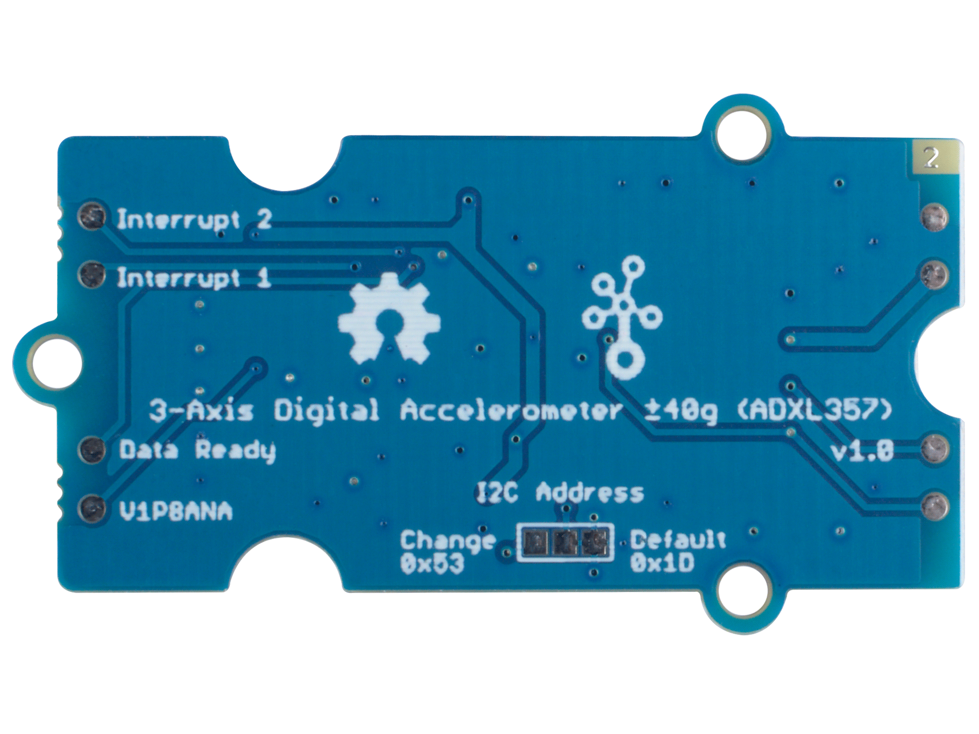
Interrupt2 output: default high
Interrupt1 output: default high
Data Ready:
default low, output a high
level indication signal after
each transfer is completed
V1P8ANA:
Internal analog reference voltage, can be used to confirm whether it is related to power supply ripple when the test data error is large
I2C Address 0x1D
(Default)
I2C Address 0x53
(Optional)

