Slide 1



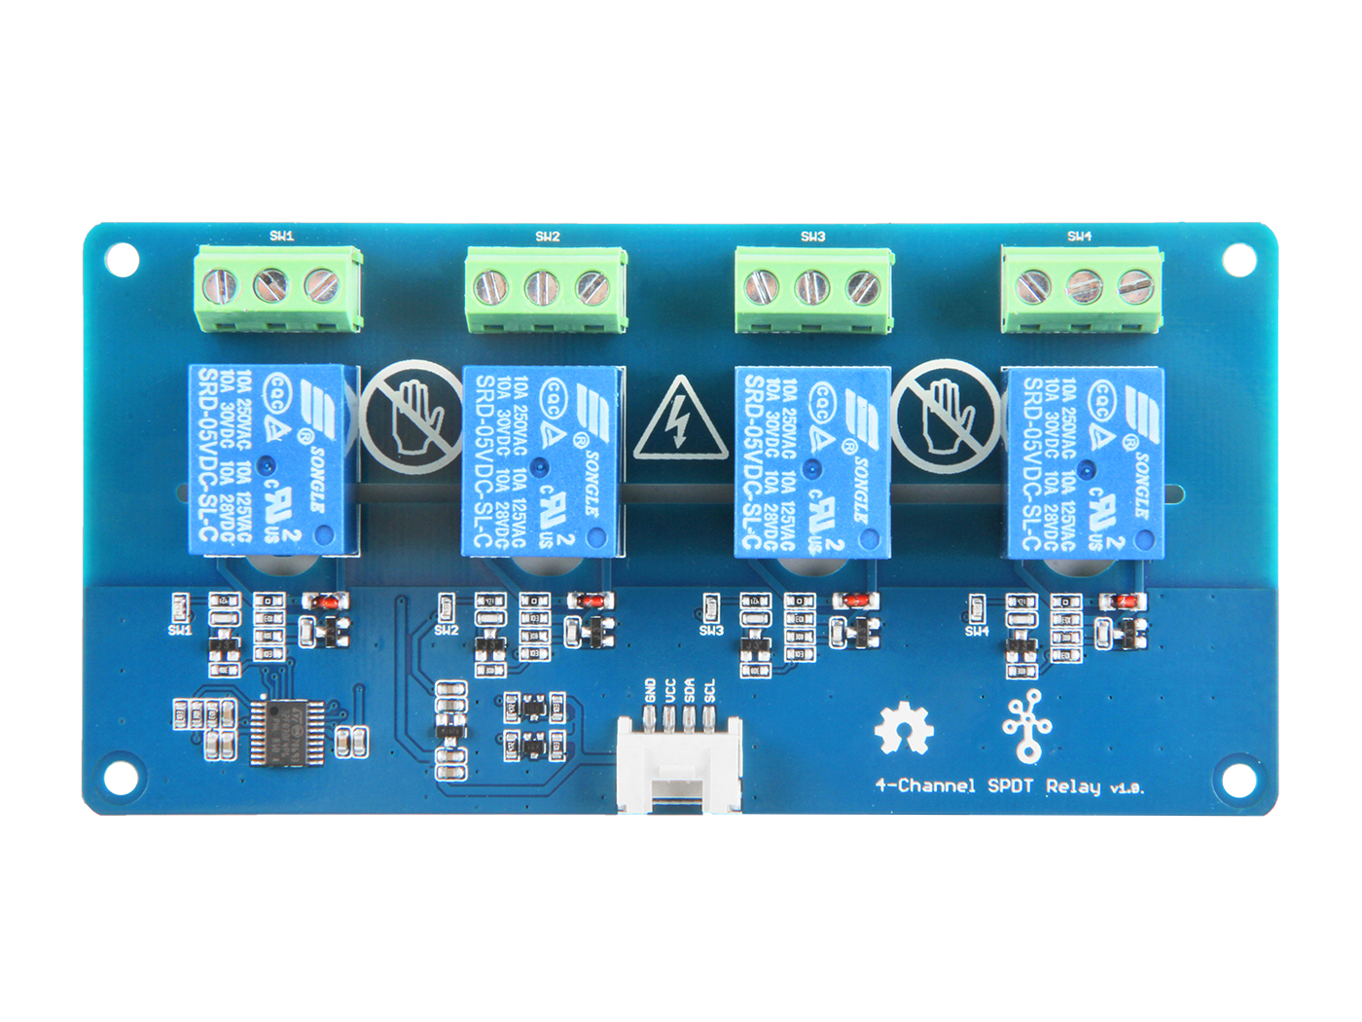




Switch 1
Switch 2
Switch 3
Switch 4
GND: connect this module to the system GND
VCC: you can use 5V or 3.3V for this module
SDA: a bidirectional input/output pin for data transmit.
SCL: a clock input pin, provide time base
NC1: one throw, connected to COM1 by default
COM1: controlled by SIG1, connected to NC1 or NO1
NO1: the other throw of swicth1

Slide 2
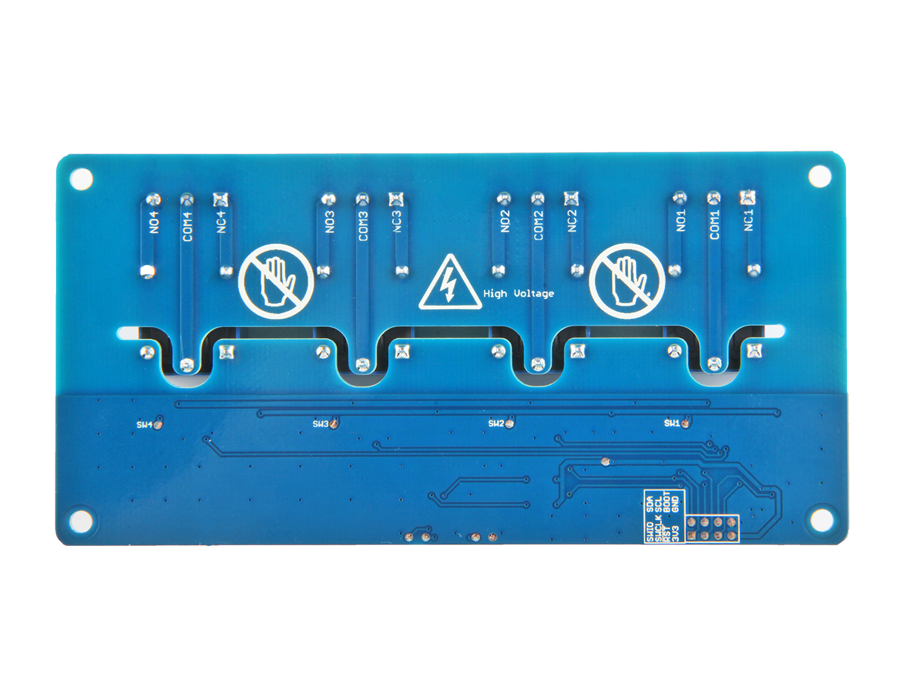
SDA SCL BOOT GND
SWIO SWCLK RST 3V3
SWCLK
SWIO
3V3
RST
SCL
SDA
3V3
BOOT
SWD Interface
GND
GND
I2C Interface

