Slide 1
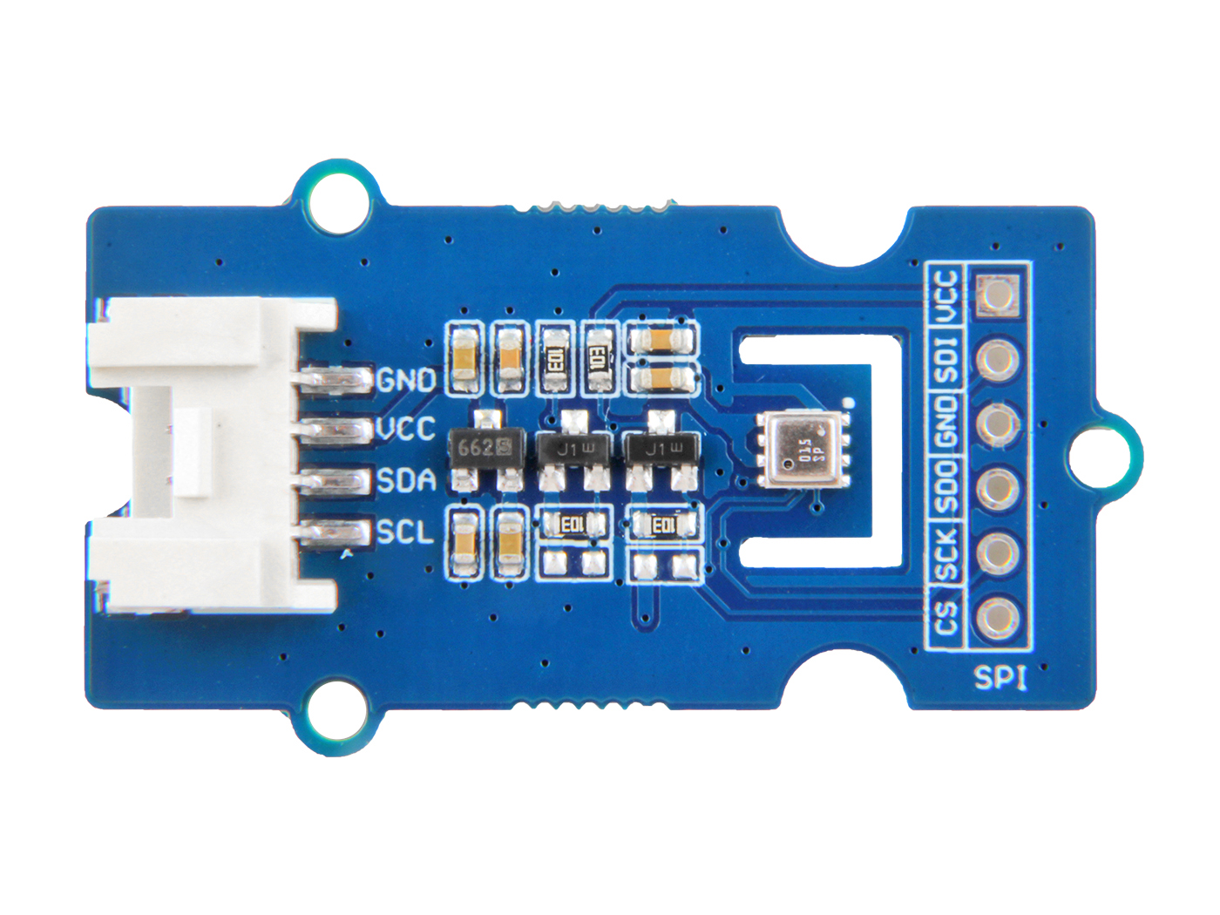










I2C
SPI
GND: connect this module to the system GND
VCC: you can use 5V or 3.3V for this module
SDA: serial data
SCL: serial clock
VCC: you can use 5V or 3.3V for this module
SDI: serial data input; data input/output in 3-wire mode
GND: connect the system GND with this module
SDO: serial data output; hi-Z in 3-wire mode
SCK: serial clock
CS: chip select, active low

Slide 2
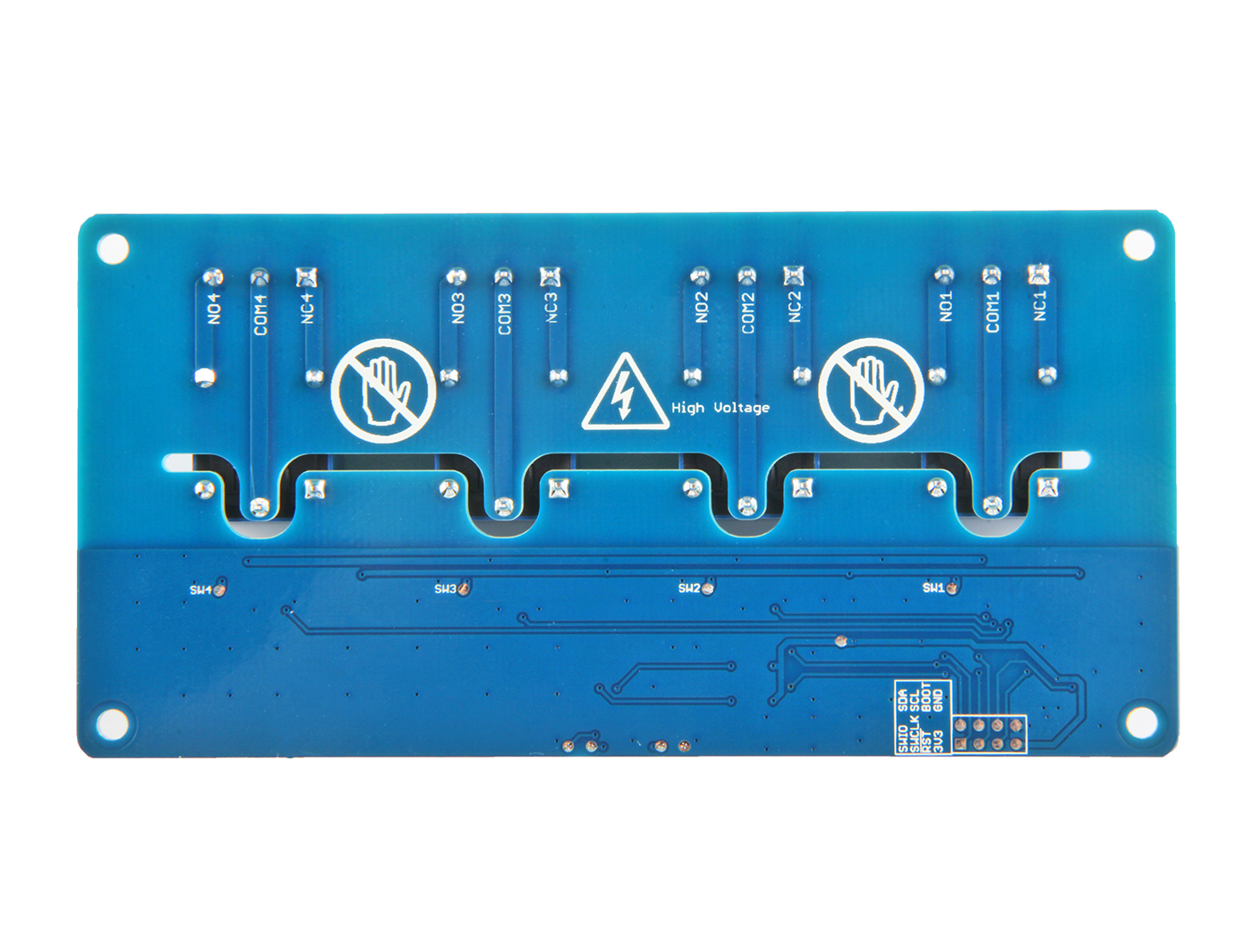
SDA SCL BOOT GND
SWIO SWCLK RST 3V3
serial data input;

