Slide 1


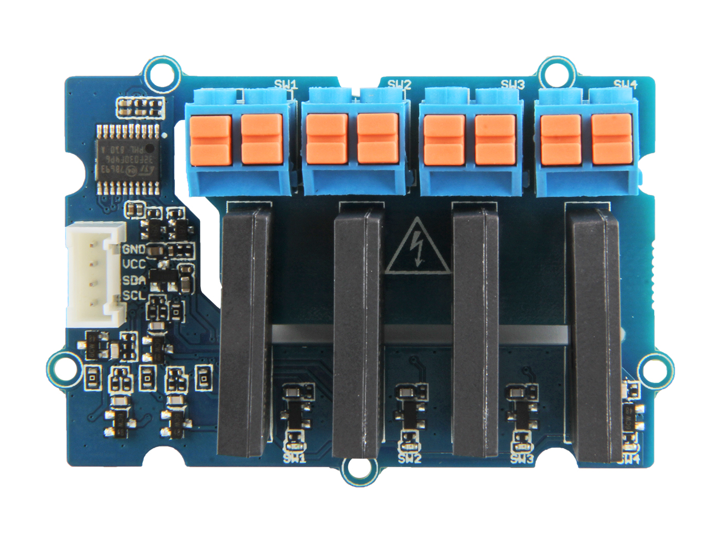




Switch 1
Switch 2
Switch 3
Switch 4
LED1
LED2
LED3
LED4
GND: connect this module to the system GND
VCC: you can use 5V or 3.3V for this module
SDA: a bidirectional input/output pin for data transmit.
SCL: a clock input pin, provide time base
LOAD2: one port of switch1 to connect to the load wire
LOAD1: the other port of switch1 to connect to the load wire

Slide 2
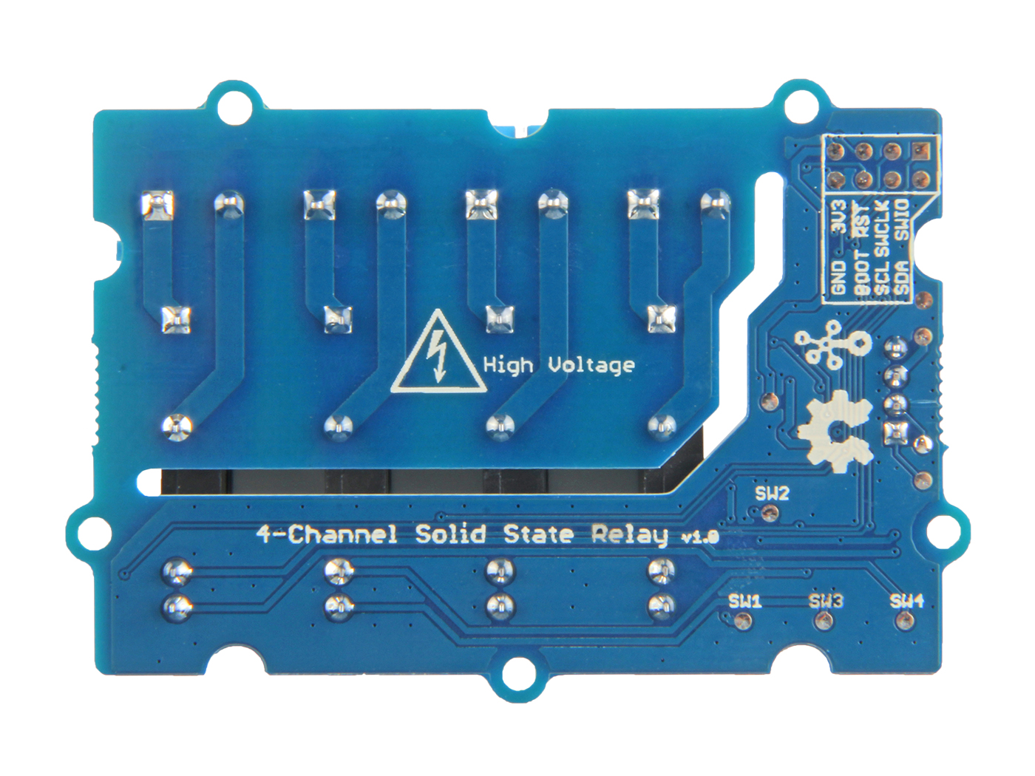
3V3 RST SWCLK SWIO
GND BOOT SCL SDA
SWCLK
SWIO
3V3
RST
I2C Interface
GND
SCL
SDA
3V3
BOOT
GND
SWD Interface

