Slide 1
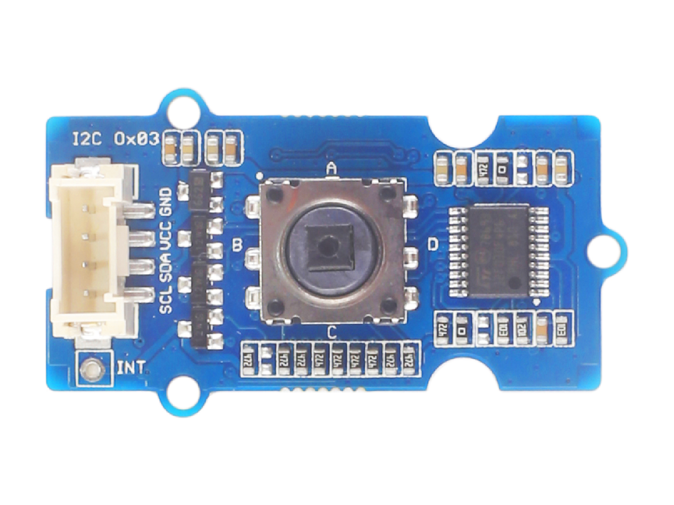










GND: 将此模块的 GND ；连接到系统 GND
VCC: you can use 5V or 3.3V for this module
SDA: I²C serial data
SCL: I²C serial clock
KEY A: default High, output Low when pressing.
KEY B: default High, output Low when pressing.
KEY C: default High, output Low when pressing.
KEY D: default High, output Low when pressing.
KEY E: default High, output Low when pressing.
Interrupt: provide the interrupt pin for customer use.

Slide 2
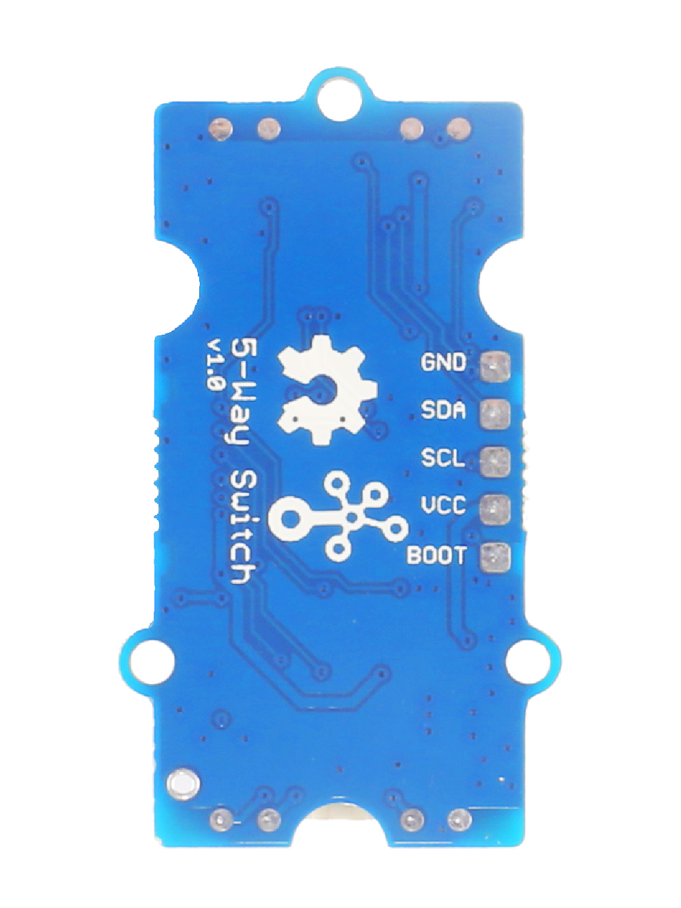
GND: connect to the system GND
SDA: I²C serial data, act as UART_RX when burning firmware
SCL: I²C serial clock, act as UART_TX when burning firmware
VCC: when you burn the firmware, VCC should be 3.3V
BOOT: need to be pulled High, when use UART mode to burn firmware

Slide 3
GND: 将此模块的 GND 连接到系统 GND 上
VCC: 您可使用 5V 或 3.3V
SDA: I²C 串行数据
SCL: I²C 串行时钟
KEY A: 默认高电平，按压时输出为低
KEY B: 默认高电平，按压时输出为低
KEY C: 默认高电平，按压时输出为低
KEY D: 默认高电平，按压时输出为低
KEY E: 默认高电平，按压时输出为低
Interrupt: 为自定义使用提供终端引脚

Slide 4
GND: 连接到系统 GND
SDA: I²C 串行数据，烧写固件时起到 UART_RX 的功能
SCL: I²C 串行时钟，烧写固件时起到 UART_TX 的功能
VCC: 烧写固件时 VCC 应为3.3V
BOOT: 当使用 UART 模式烧写固件时，需被置高电平

