Slide 1
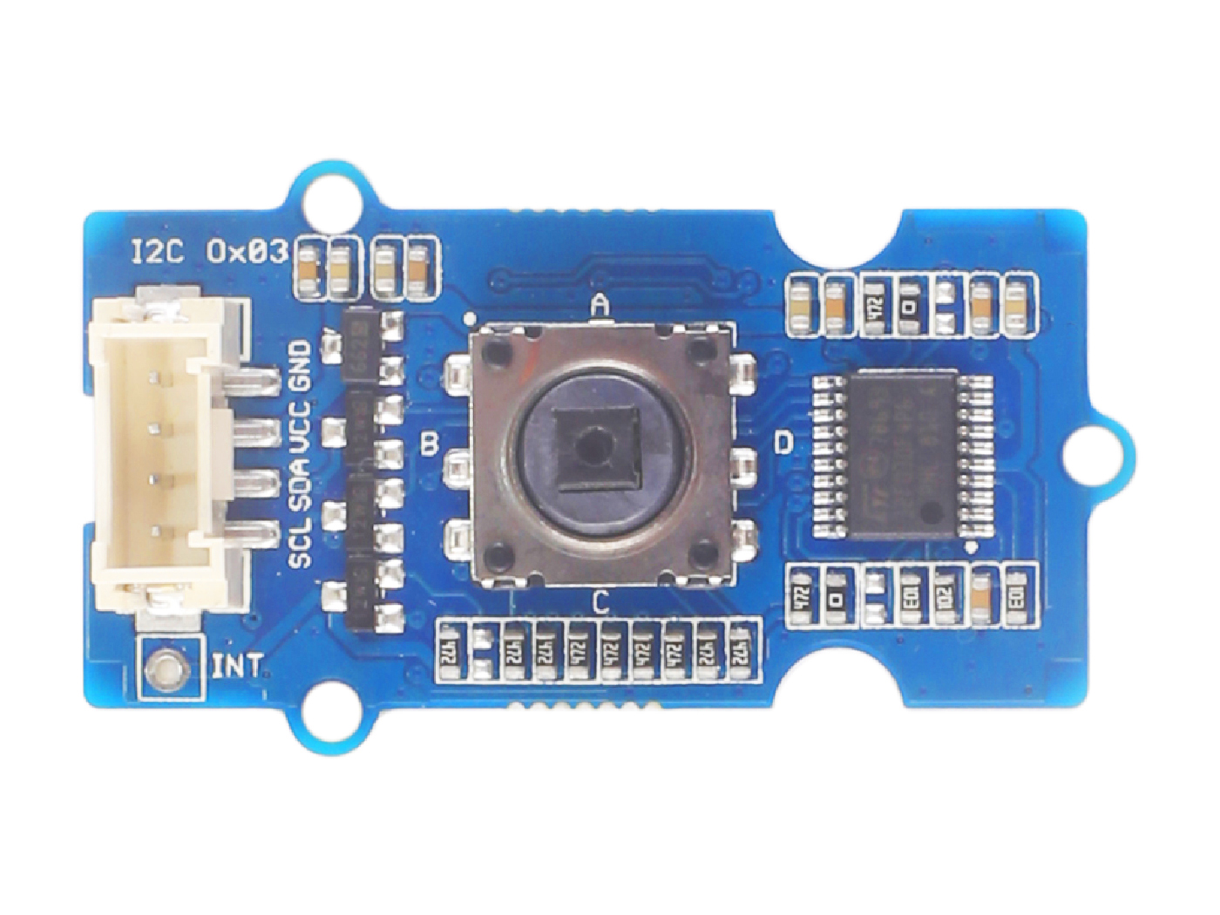










GND: connect this module to the system GND
VCC: you can use 5V or 3.3V for this module
SDA: I²C serial data
SCL: I²C serial clock
KEY A: default High, output Low when pressing.
KEY B: default High, output Low when pressing.
KEY C: default High, output Low when pressing.
KEY D: default High, output Low when pressing.
KEY E: default High, output Low when pressing.
Interrupt: provide the interrupt pin for customer use.

Slide 2
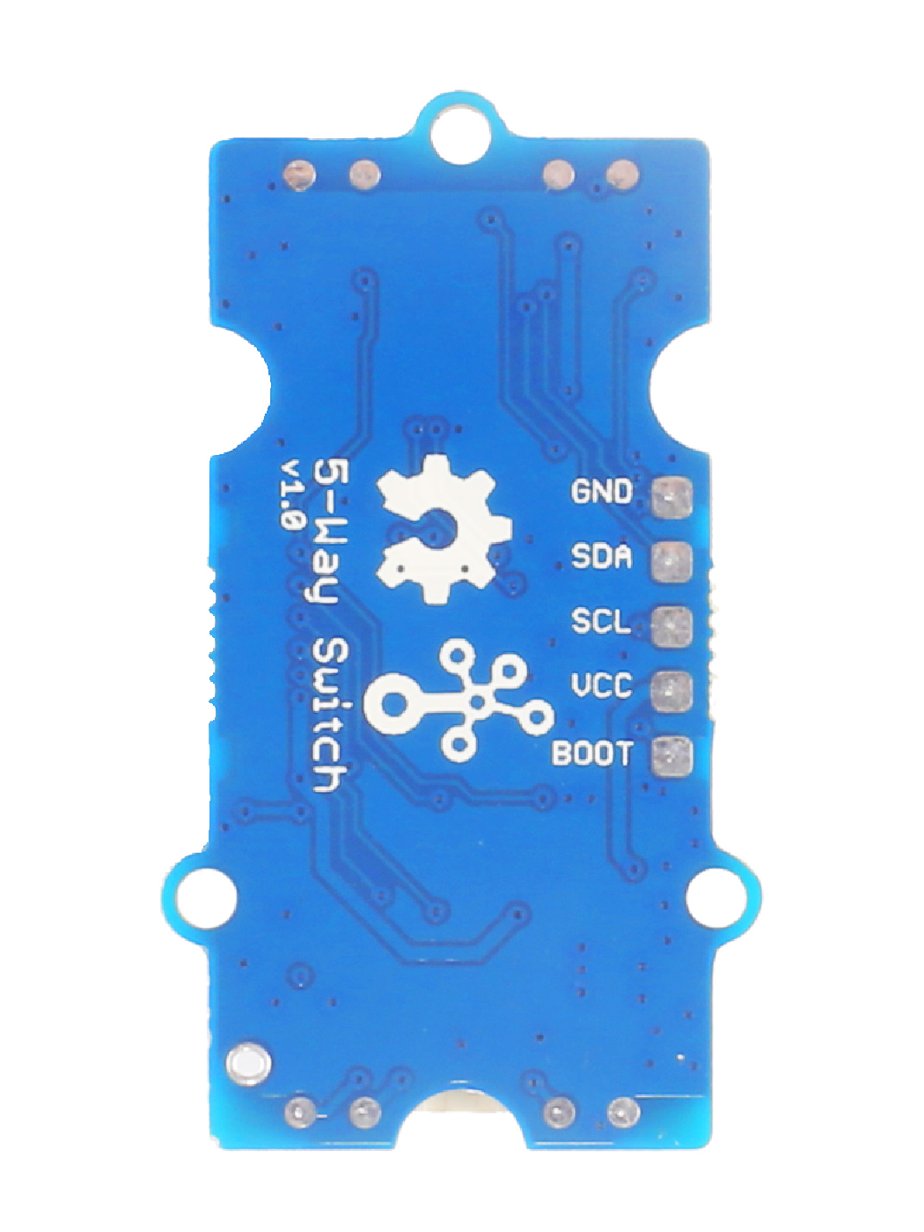
GND: connect to the system GND
SDA: I²C serial data, act as UART_RX when burning firmware
SCL: I²C serial clock, act as UART_TX when burning firmware
VCC: when you burn the firmware, VCC should be 3.3V
BOOT: need to be pulled High, when use UART mode to burn firmware

