Slide 1
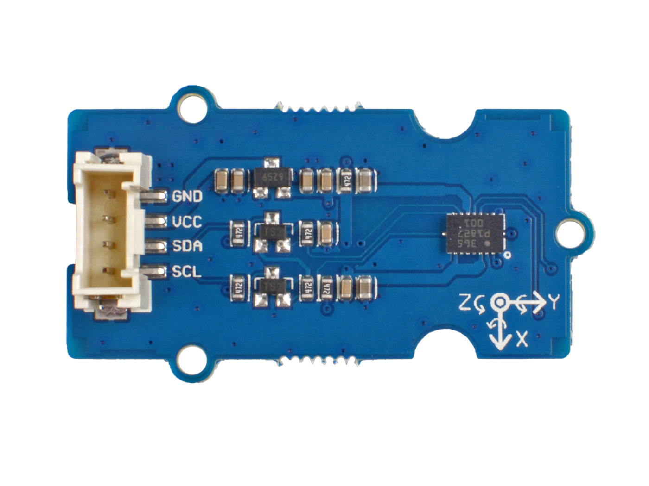





GND: connect this module to the system GND
VCC: you can use 5V or 3.3V for this module
SDA: I²C serial data
SCL: I²C serial clock
the BMI088 module

Slide 2
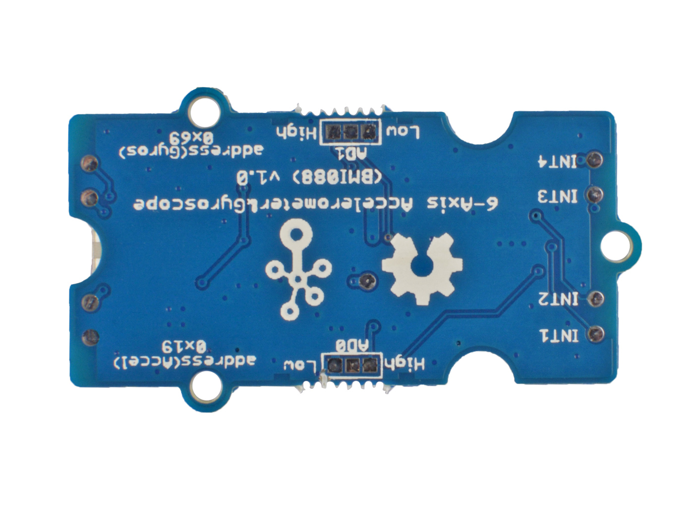
0 x 18
Optional
0 x 19
Default
0 x 69
Default
0 x 68
Optional

