Slide 1
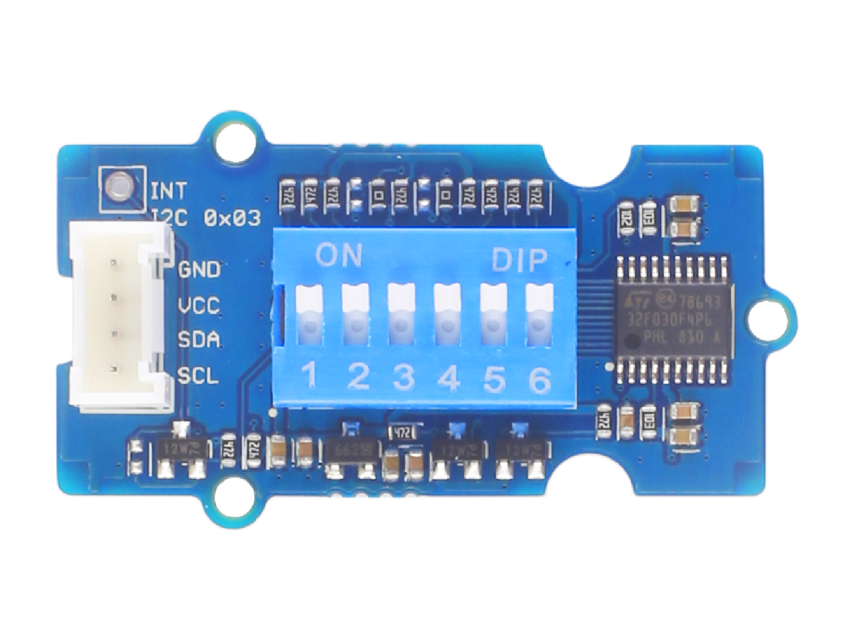










GND: connect this module to the system GND
VCC: you can use 5V or 3.3V for this module
SDA: serial data
SCL: serial clock
Switch 1: default High, become Low when turn the switch to ON
Switch 2: default High, become Low when turn the switch to ON
Switch 3: default High, become Low when turn the switch to ON
Switch 4: default High, become Low when turn the switch to ON
Switch 5: default High, become Low when turn the switch to ON
Switch 6: default High, become Low when turn the switch to ON

Slide 2
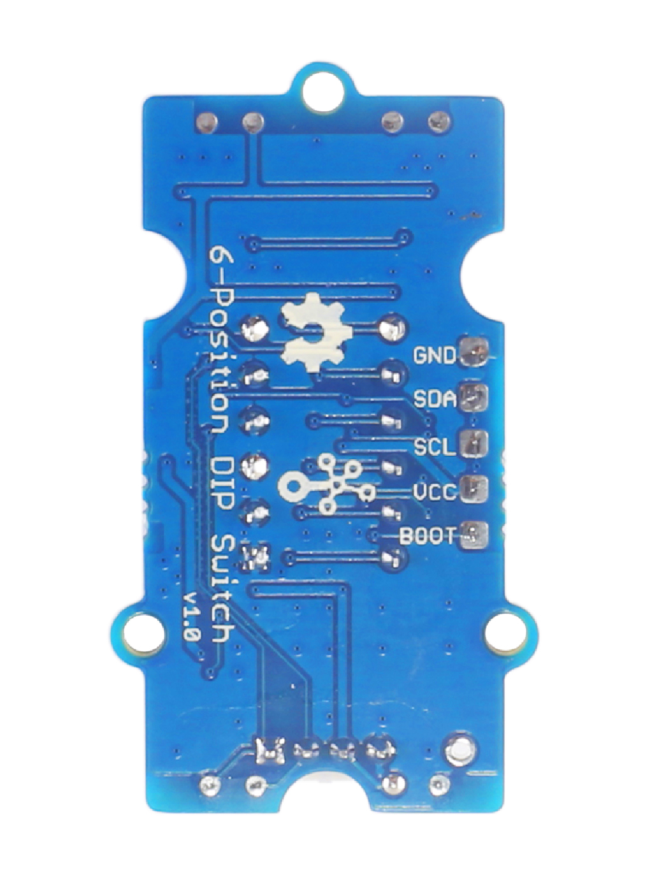
GND: connect to the system GND
SDA: I²C serial data, act as UART_RX when burning firmware
SCL: I²C serial clock, act as UART_TX when burning firmware
VCC: when you burn the firmware, VCC should be 3.3V
BOOT: need to be pulled High, when use UART mode to burn firmware
Interrupt Hole

