Slide 1
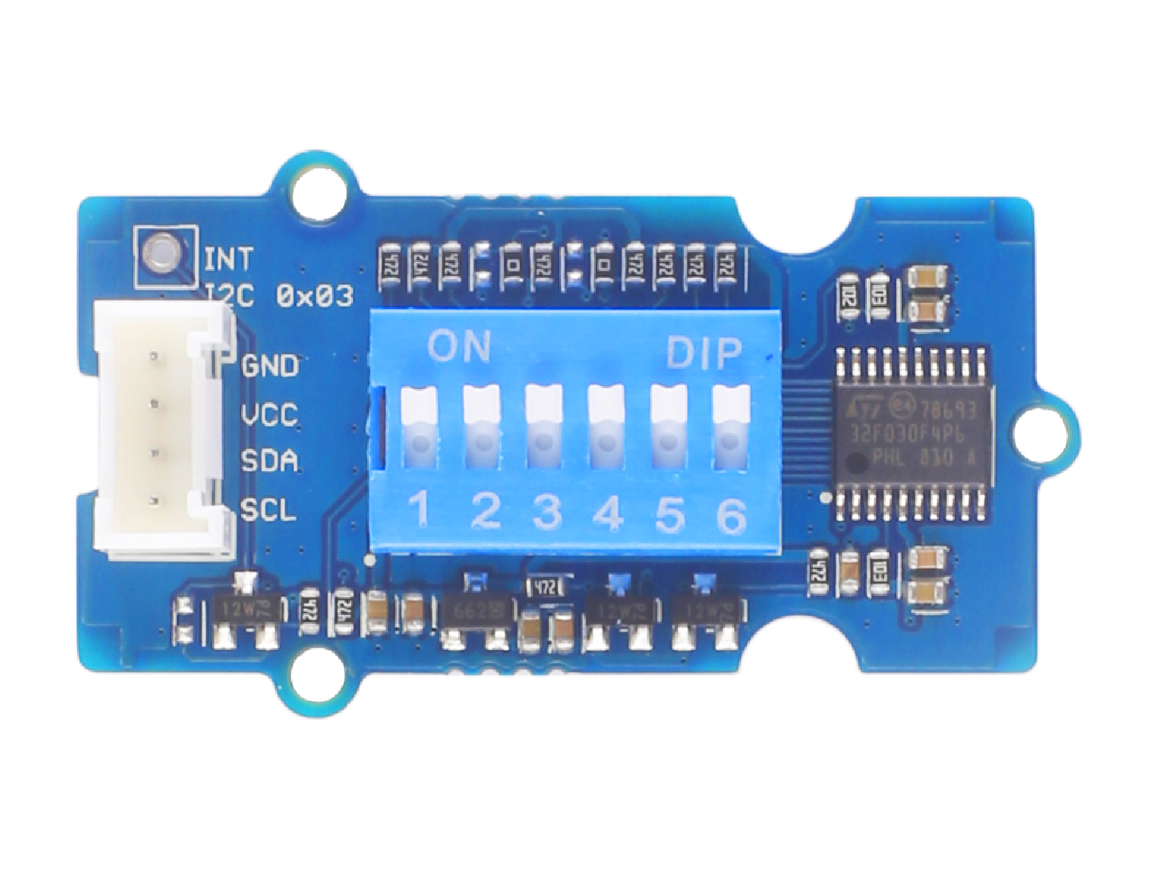










GND: connect this module to the system GND
VCC: you can use 5V or 3.3V for this module
SDA: serial data
SCL: serial clock
Switch 1: default High, become Low when turn the switch to ON
Switch 2: default High, become Low when turn the switch to ON
Switch 3: default High, become Low when turn the switch to ON
Switch 4: default High, become Low when turn the switch to ON
Switch 5: default High, become Low when turn the switch to ON
Switch 6: default High, become Low when turn the switch to ON

Slide 2
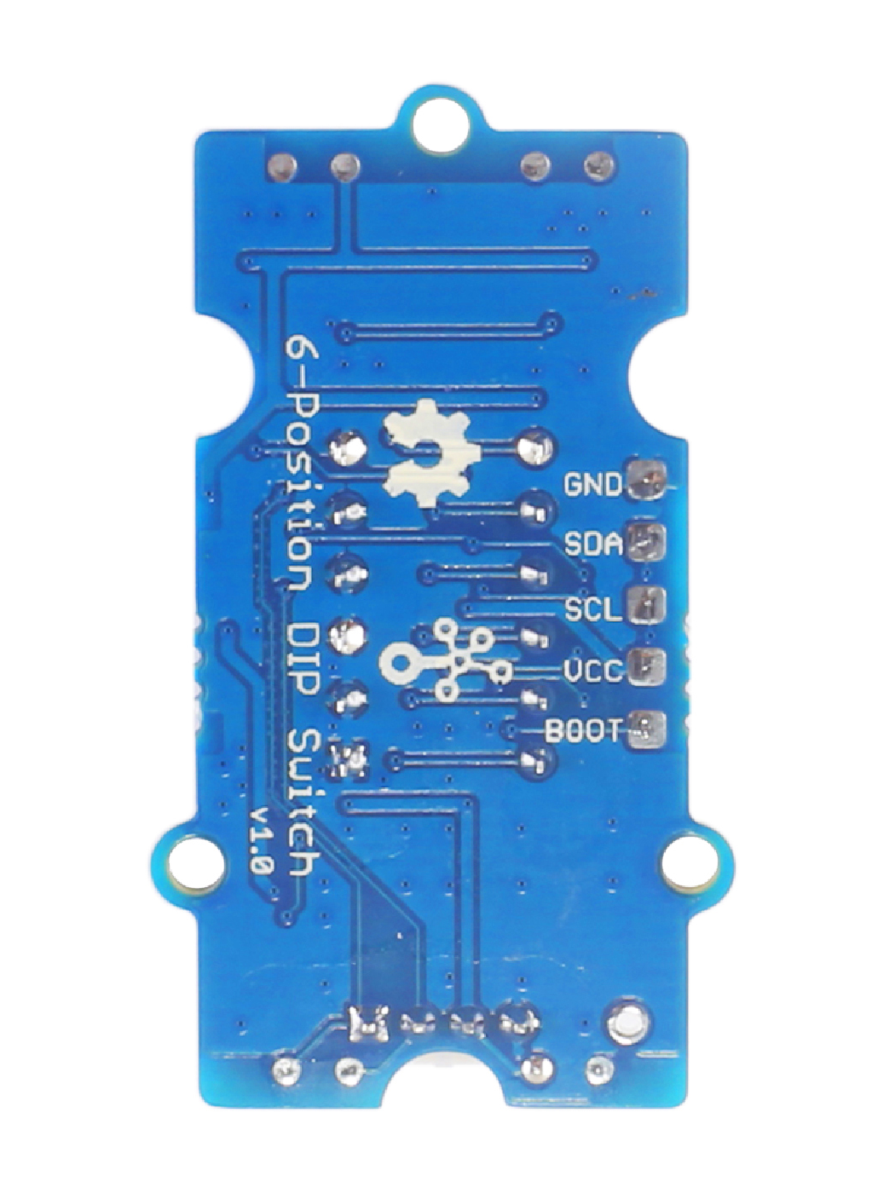
GND: connect to the system GND
SDA: I²C serial data, act as UART_RX when burning firmware
SCL: I²C serial clock, act as UART_TX when burning firmware
VCC: when you burn the firmware, VCC should be 3.3V
BOOT: need to be pulled High, when use UART mode to burn firmware
Interrupt Hole

Slide 3
GND: 将此模块 GND 连接到系统 GND
VCC: 您可使用 5V 或 3.3
SDA: 串行数据
SCL: 串行时钟
Switch 1: 默认高电平，开关打开时变低
Switch 2: 默认高电平，开关打开时变低
Switch 3: 默认高电平，开关打开时变低
Switch 4: 默认高电平，开关打开时变低
Switch 5: 默认高电平，开关打开时变低
Switch 6: 默认高电平，开关打开时变低

Slide 4
GND: 连接到系统 GND
SDA: I²C 串行数据，烧写固件时作为 UART_R
SCL: I²C 串行时钟，烧写固件时作为 UART_TX
VCC: 当您在烧写固件时，VCC 应设为 3.3V
BOOT: 使用 UART 模式烧写固件时需被置高
中断脚

