Slide 1
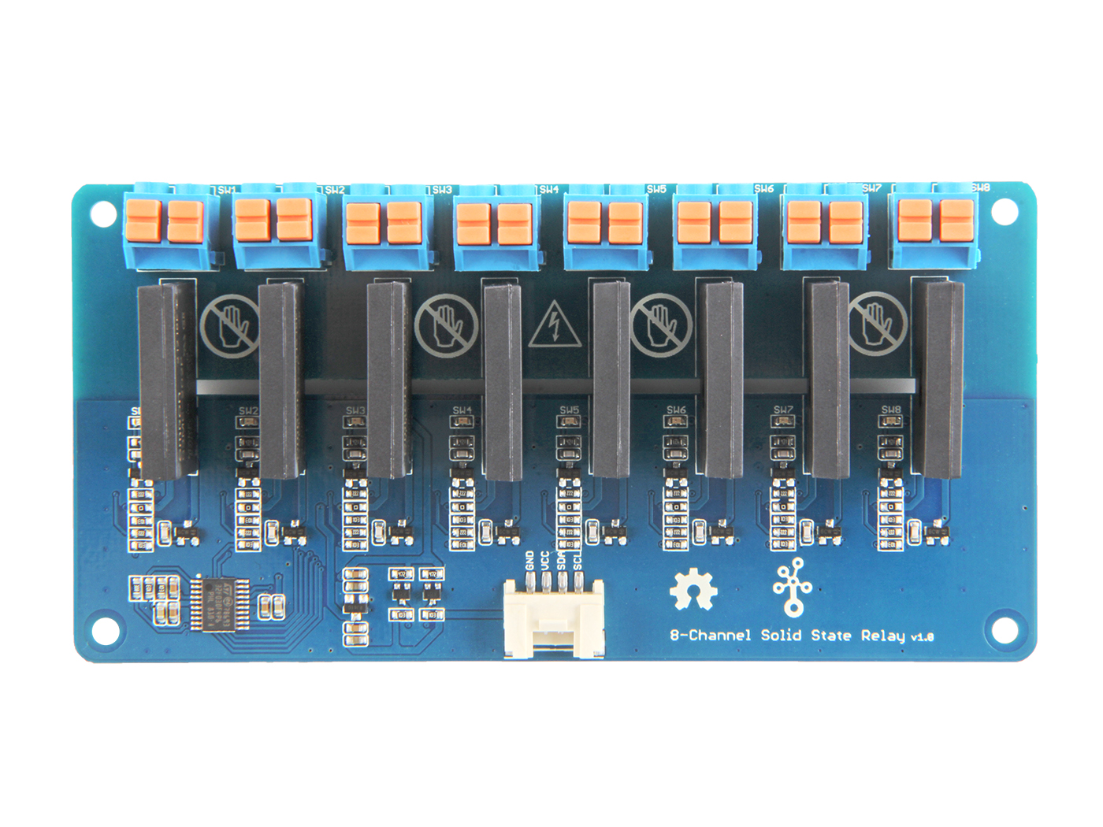






Switch 1
Sw 2
Sw 3
Sw 4
Sw 5
Sw 6
Sw 7
Sw 8
GND: connect this module to the system GND
VCC: you can use 5V or 3.3V for this module
SDA: a bidirectional input/output pin for data transmit.
SCL: a clock input pin, provide time base
LOAD2: one port of switch1 to connect to the load wire
LOAD1: the other port of switch1 to connect to the load wire

Slide 2
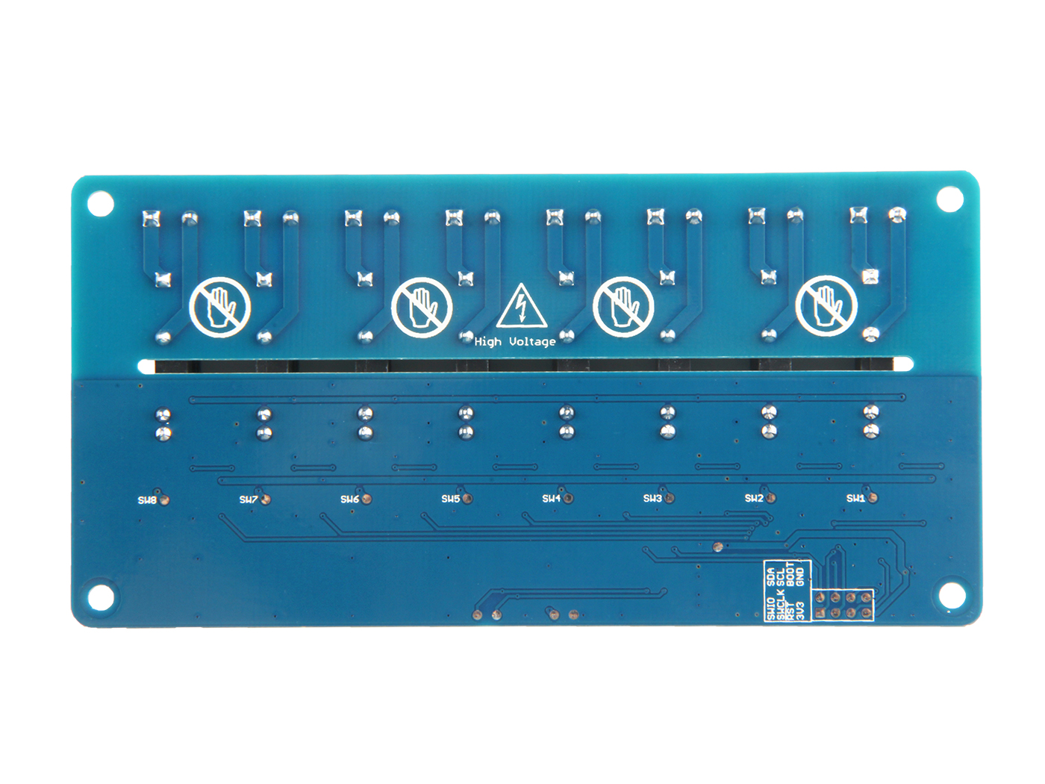
SDA SCL BOOT GND
SWIO SWCLK RST 3V3
SWCLK
SWIO
3V3
RST
SCL
SDA
3V3
BOOT
SWD Interface
GND
GND
I2C Interface

