Slide 1
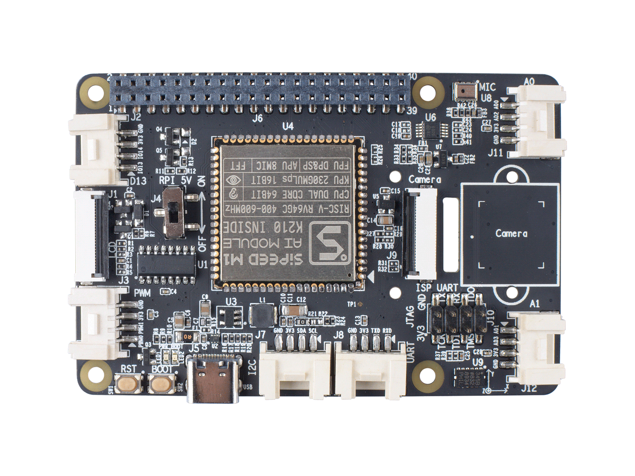
17
15
14
1
16
2
18
20
13
19
21
3
12
11
4
6
8
9
10
5
7
1: J2 , Grove , Digital IO
2: J1 , LCD Interface
3: J3 , Grove , PWM
4: SW1 , Reset Button
5: SW2 , Boot Button
6: LED1 , 3.3V LED; LED2 , Boot LED
7: J5 , USB Type C
8: J7 , Grove , I2C
9: J8 , Grove , UART
10: U9 , Accelerometers Sensor
11: J12 , Grove , ADC A1
12: J10 , 2x4 Pin Header , JTAG & ISP UART
13: J9 , Camera Interface
14: J11 , Grove , ADC A0
15: U8 , MIC
16: U6 , I2C to ADC IC
17: J6 , 2x20 Pin Socket
18: J4 , Toggle Switch for RPI 5V
19: U1 , USB to UART IC
20: U4 , Sipeed AI Module
21: Camera mounting slot

