Slide 1
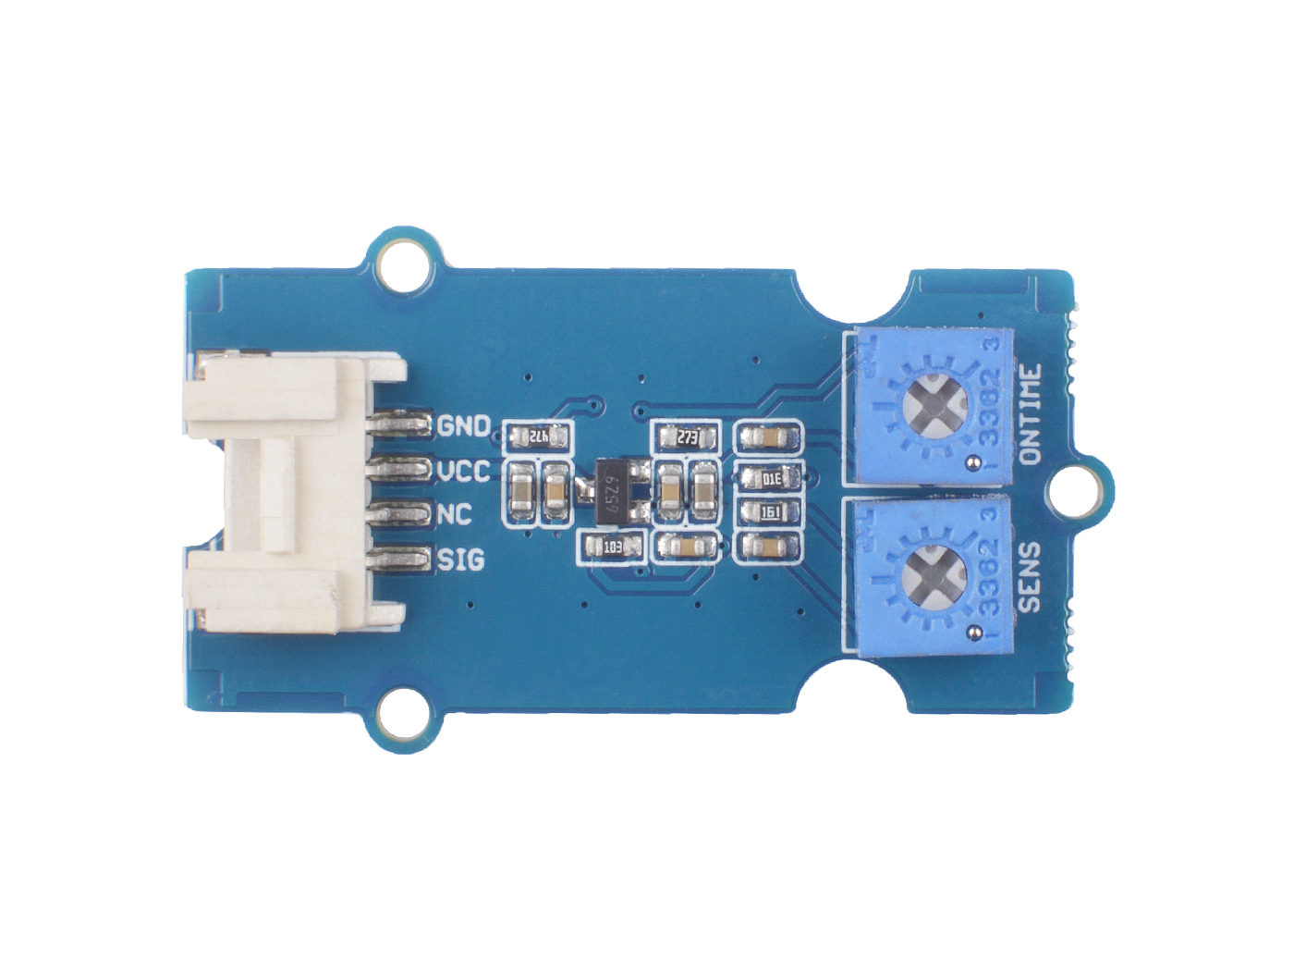






GND: connect this module to the system GND
VCC: you can use 5V or 3.3V for this module
SDA: I²C serial data
SCL: I²C serial clock
ONTIME: trigger high level output time potentiometer
SENS: detect distance potentiometer

Slide 2
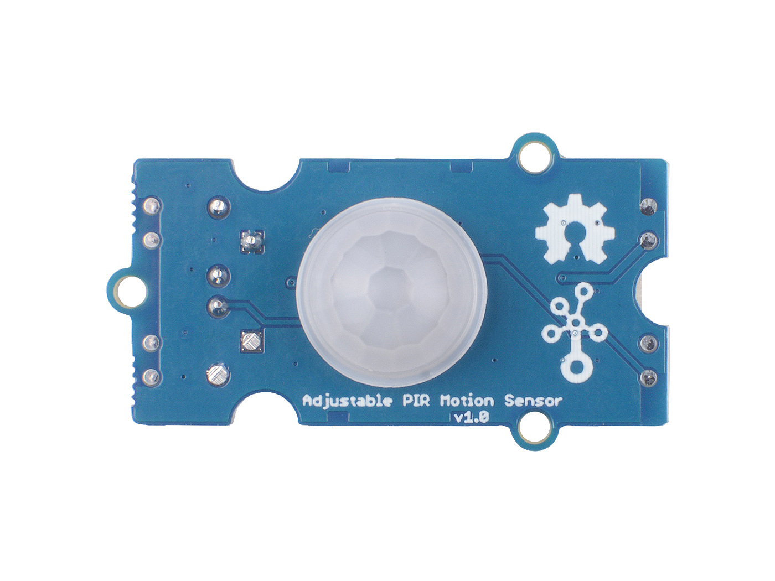
Pyroelectric Infrared Sensors
and Fresnel lens

