Slide 1
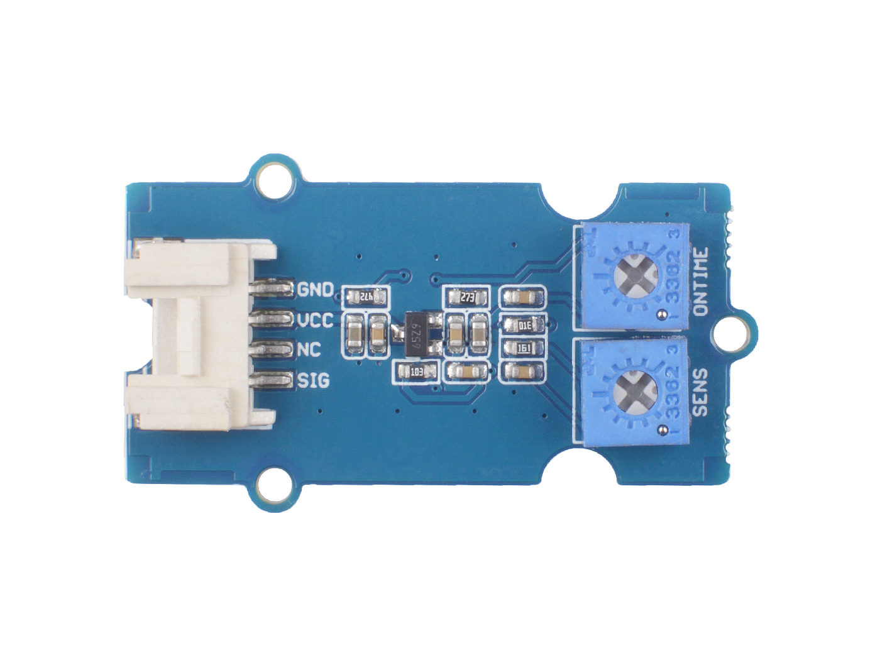






GND: connect this module to the system GND
VCC: you can use 5V or 3.3V for this module
NC: not connected
SIG: signal pin
ONTIME: trigger high level output time potentiometer
SENS: detect distance potentiometer

Slide 2
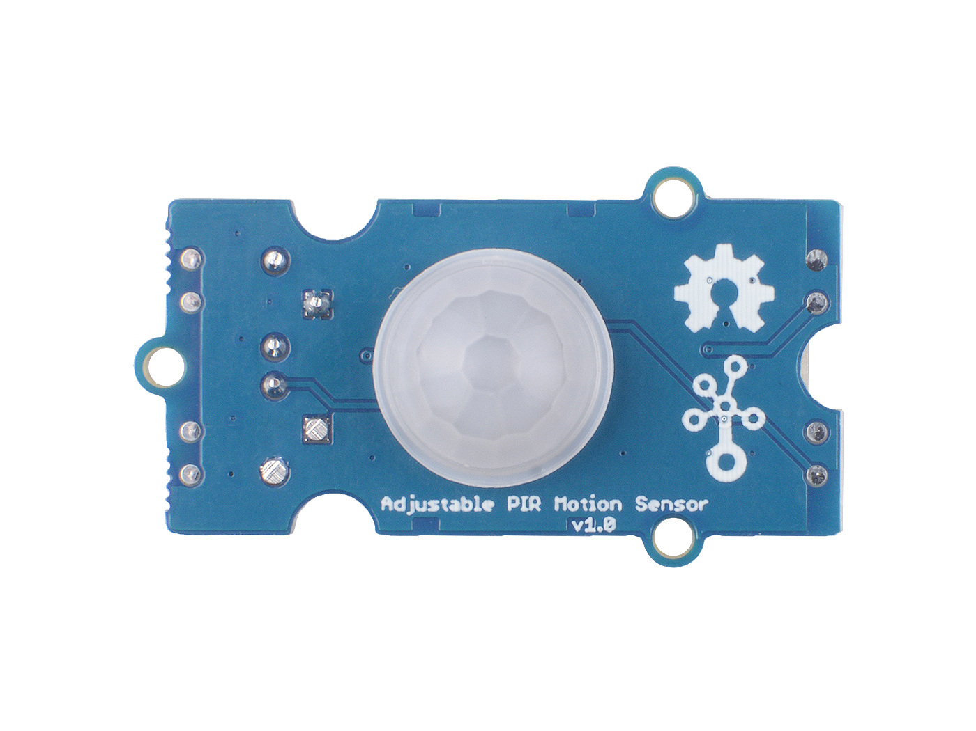
Pyroelectric Infrared Sensors
and Fresnel lens

