Slide 1
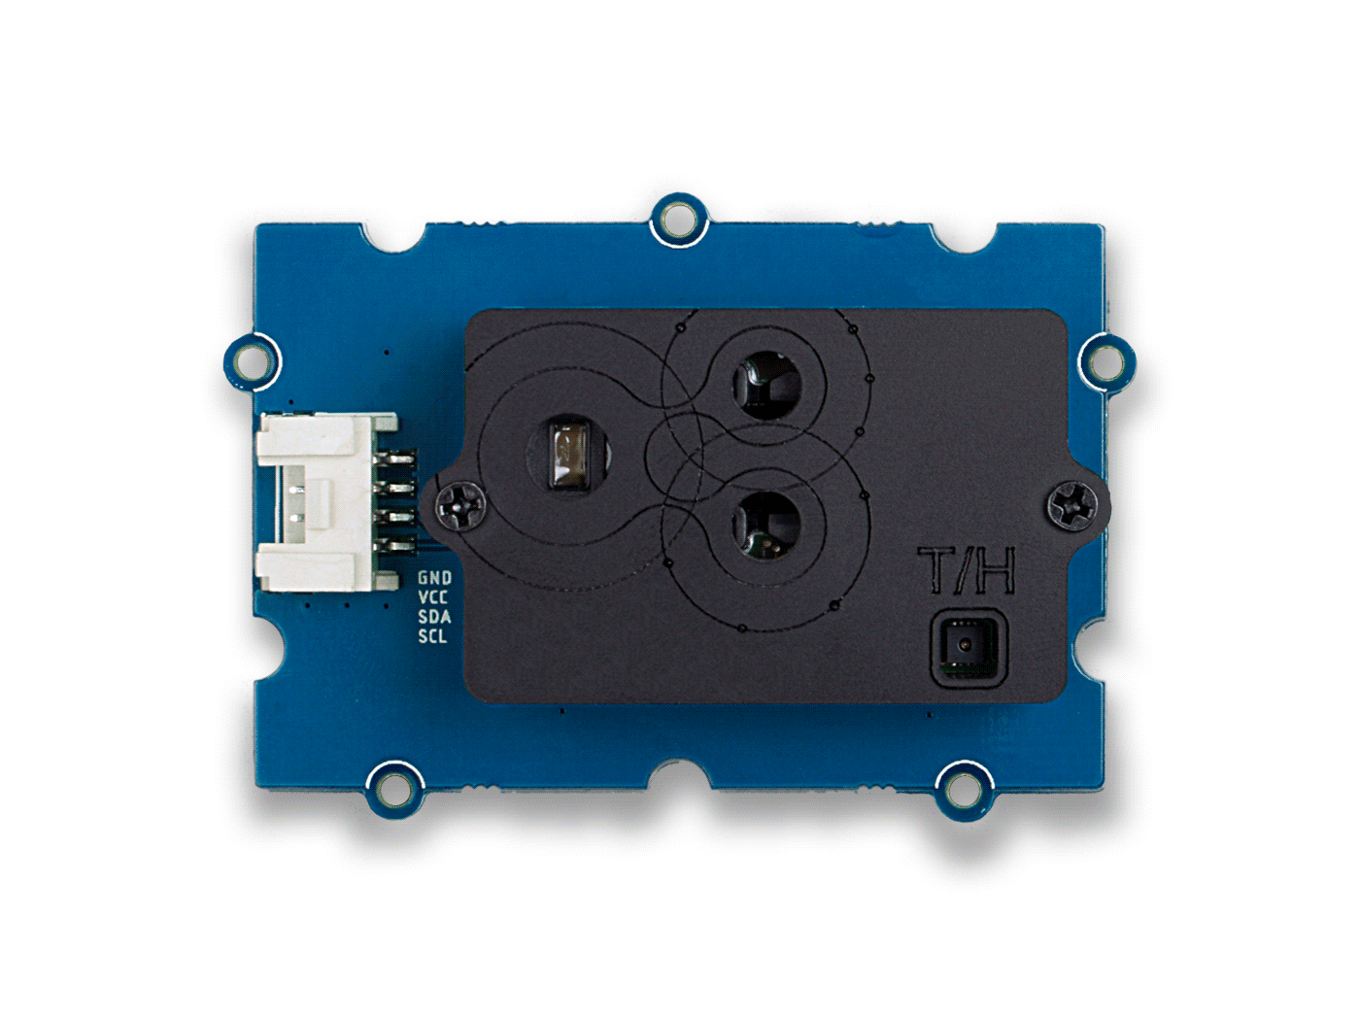







GND: connect this module to the system GND
VCC: you can use 5V or 3.3V for this module
SDA: I²C serial data
SCL: I²C serial clock
CO₂ Sensor Opening
Infrared Light Source
Temperature & Humidity Sensor Opening

