Slide 1
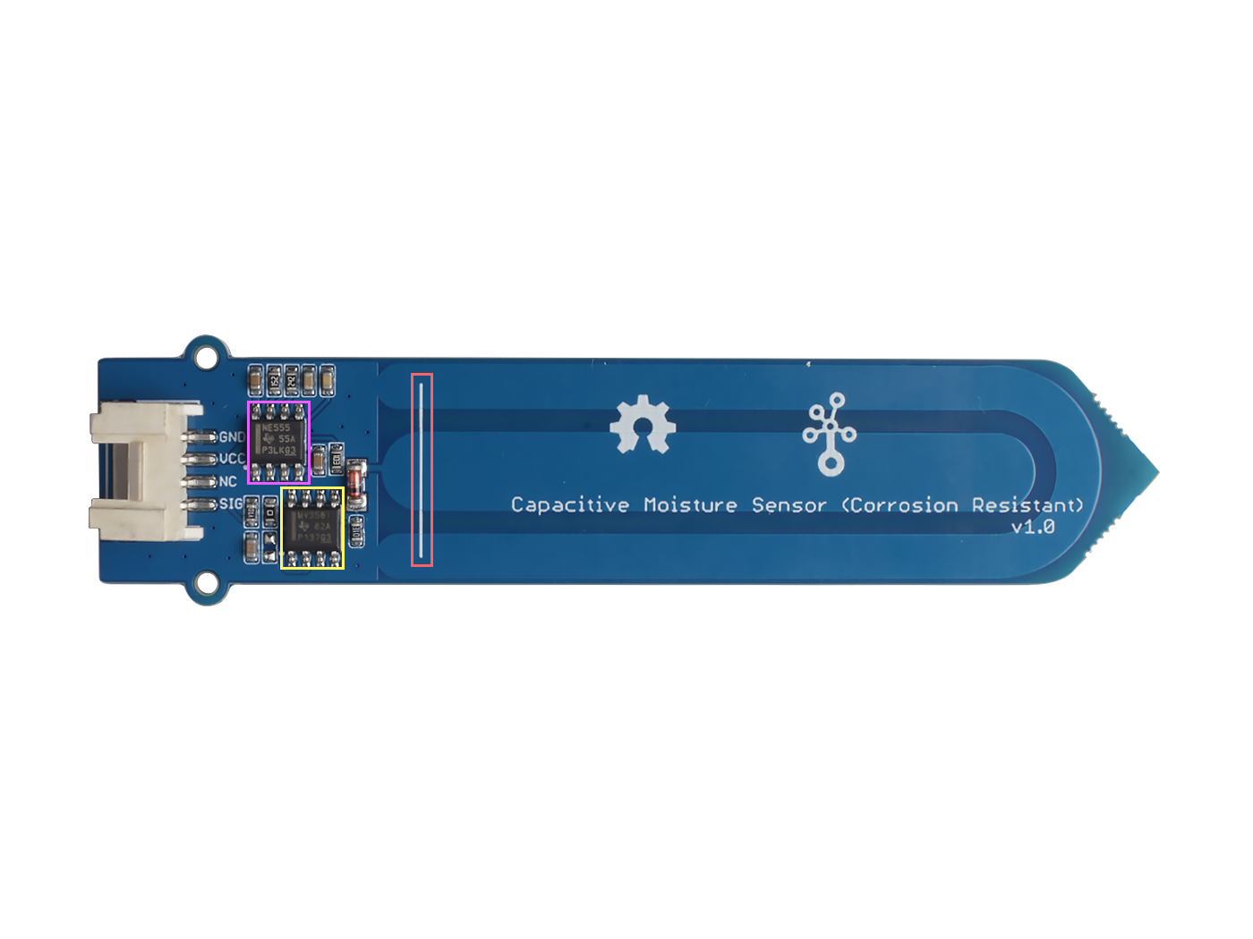







GND: connect this module to the system GND
VCC: you can use 5V or 3.3V for this module
NC: not connected
SIG: analog output
NE555DR IC
LMV358ID IC Operational Amplifier
Highest position line

