Slide 1
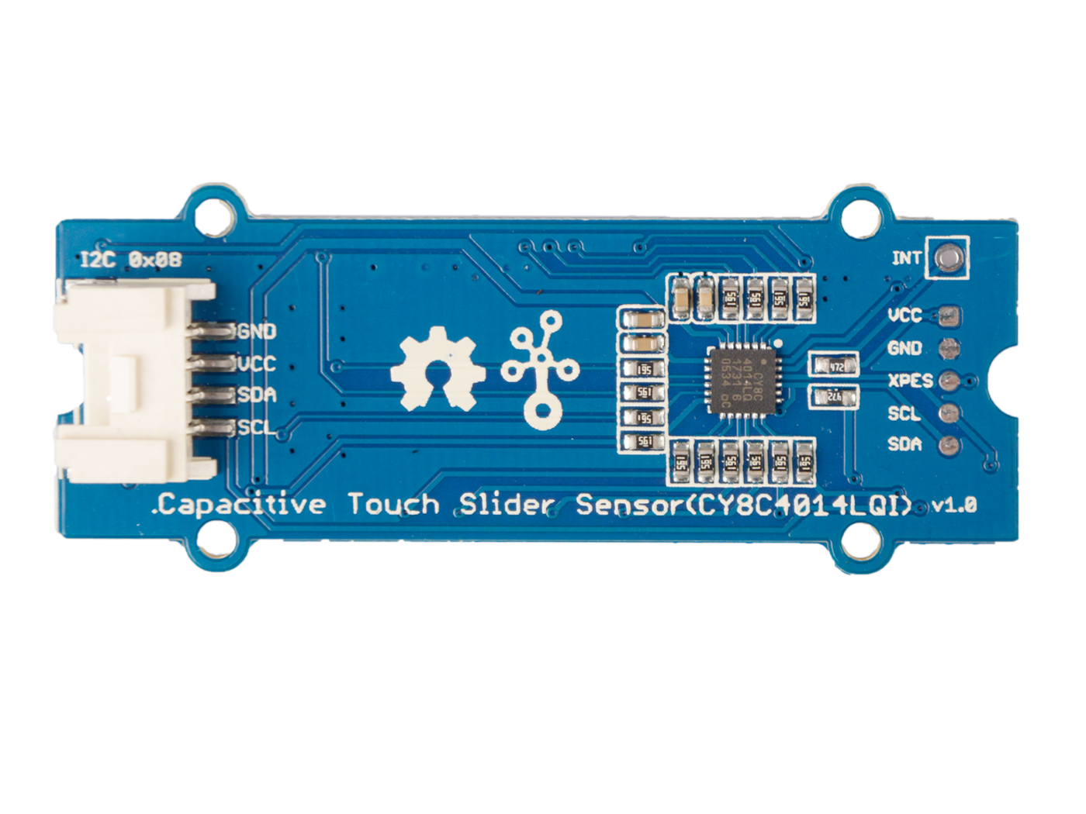










GND: connect this module to the system GND
VCC: you can use 5V or 3.3V for this module
SDA: I²C serial data
SCL: I²C serial clock
VCC: you can use 5V or 3.3V for this module
GND: connect this module to the system GND
XPES: Connect to the XRES pin, external reset I/O pin
SCL: I²C serial clock, work as SWDCLK when burn the firmware
SDA: I²C serial clock, work as SWDDATA when burn the firmware
INT: Default High, turn to low when button or slider triggered

Slide 2
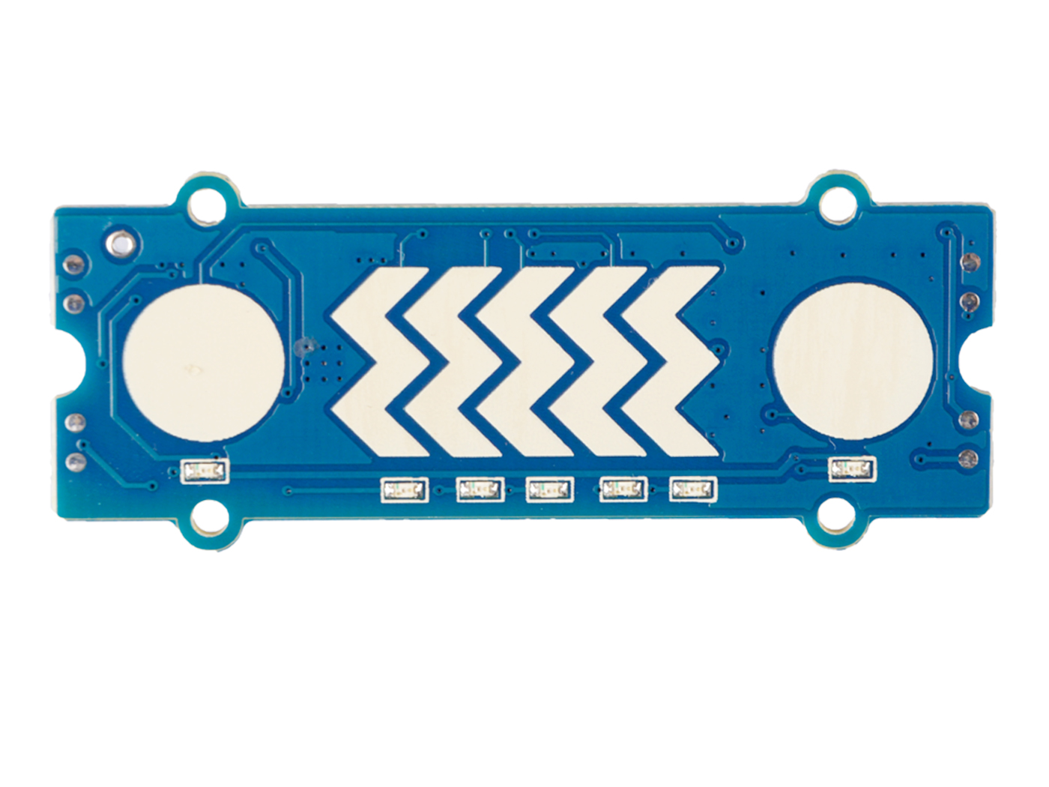
Button
Slider
Button

