Slide 1
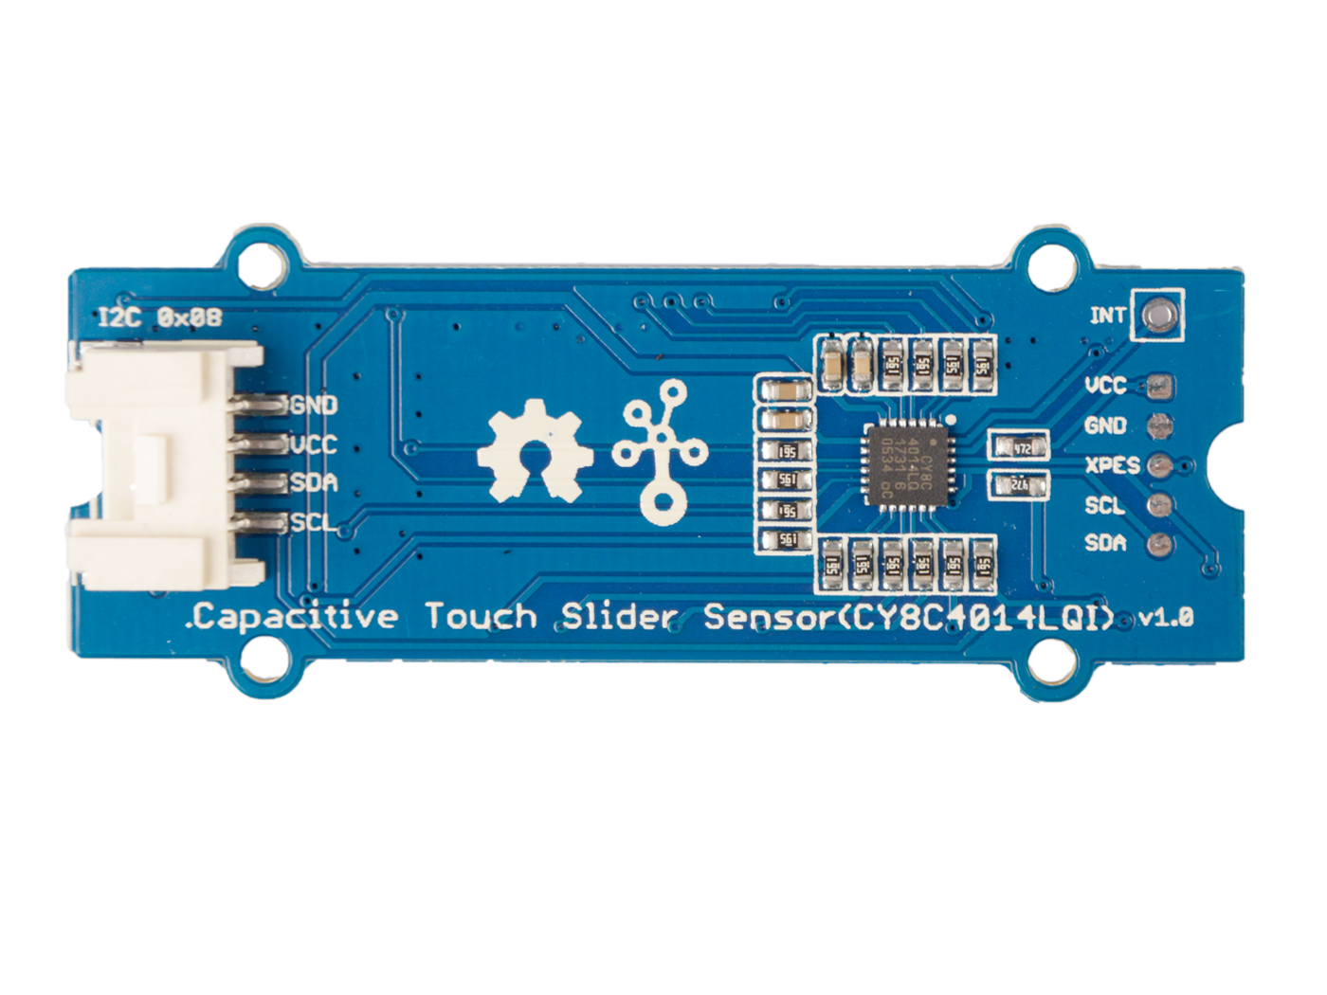










GND: connect this module to the system GND
VCC: you can use 5V or 3.3V for this module
SDA: I²C serial data
SCL: I²C serial clock
VCC: you can use 5V or 3.3V for this module
GND: connect this module to the system GND
XPES: Connect to the XRES pin, external reset I/O pin
SDA: I²C serial data
SCL: I²C serial clock

Slide 2
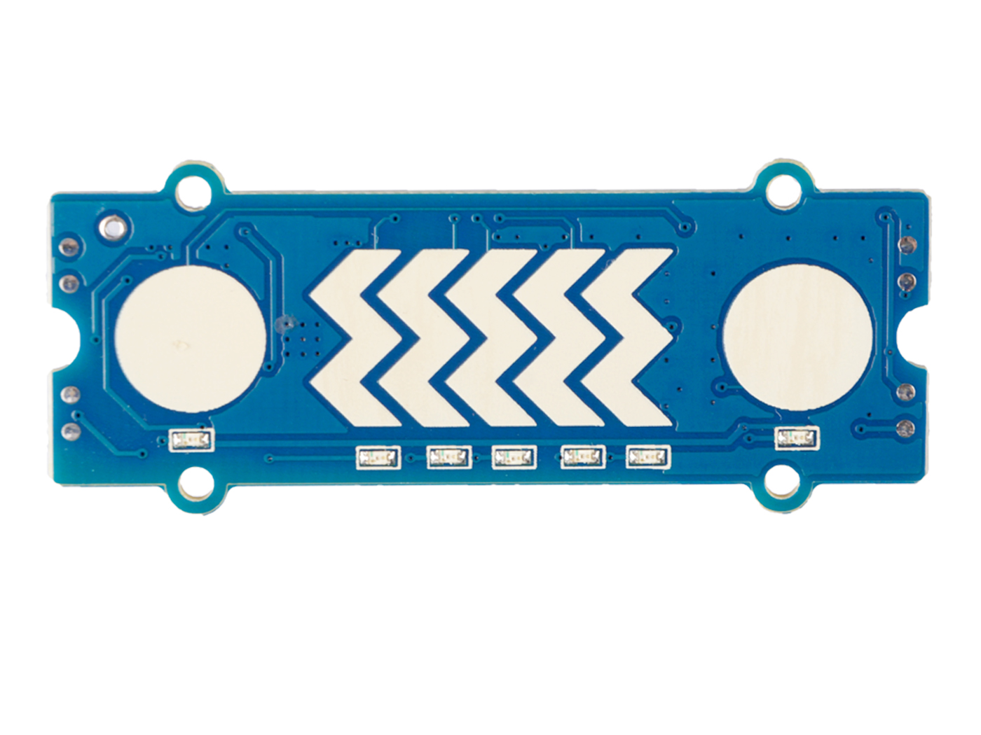
按钮
滑块
按钮

