Slide 1
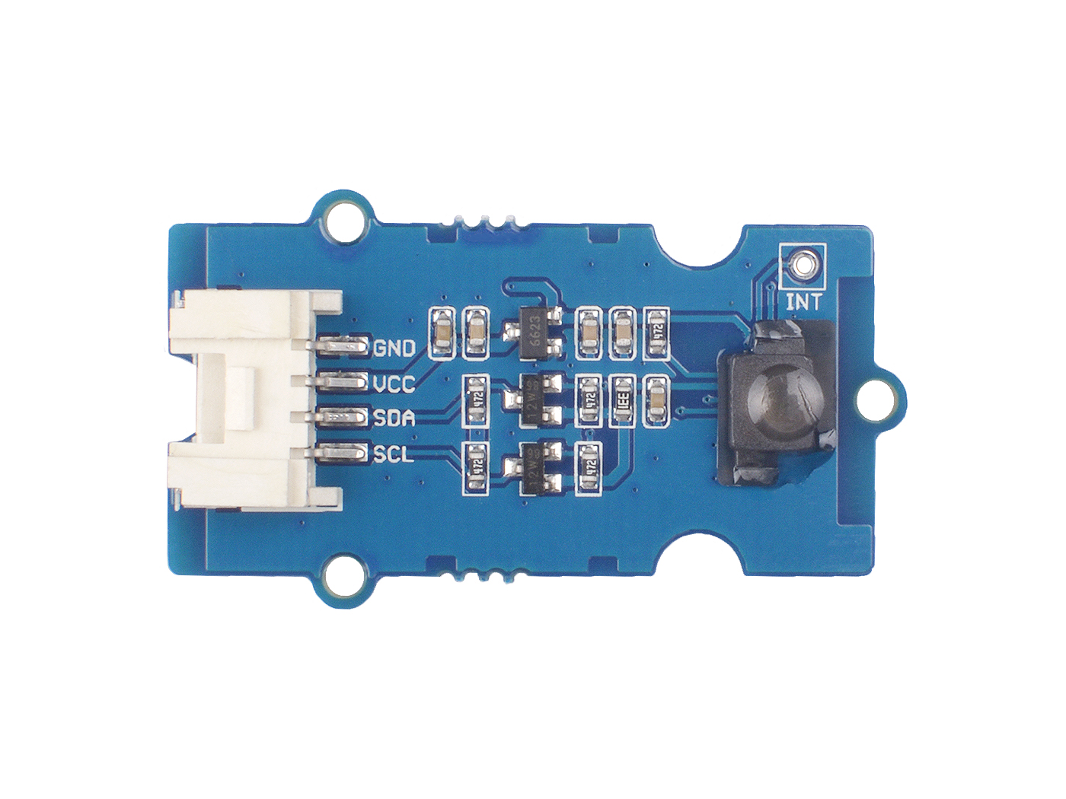






GND: connect this module to the system GND
VCC: you can use 5V or 3.3V for this module
SDA: I²C serial data
SCL: I²C serial clock
INT: connect to the INT pin of the AK9753
IR Sensor: there are four sensors under the lens

Slide 2
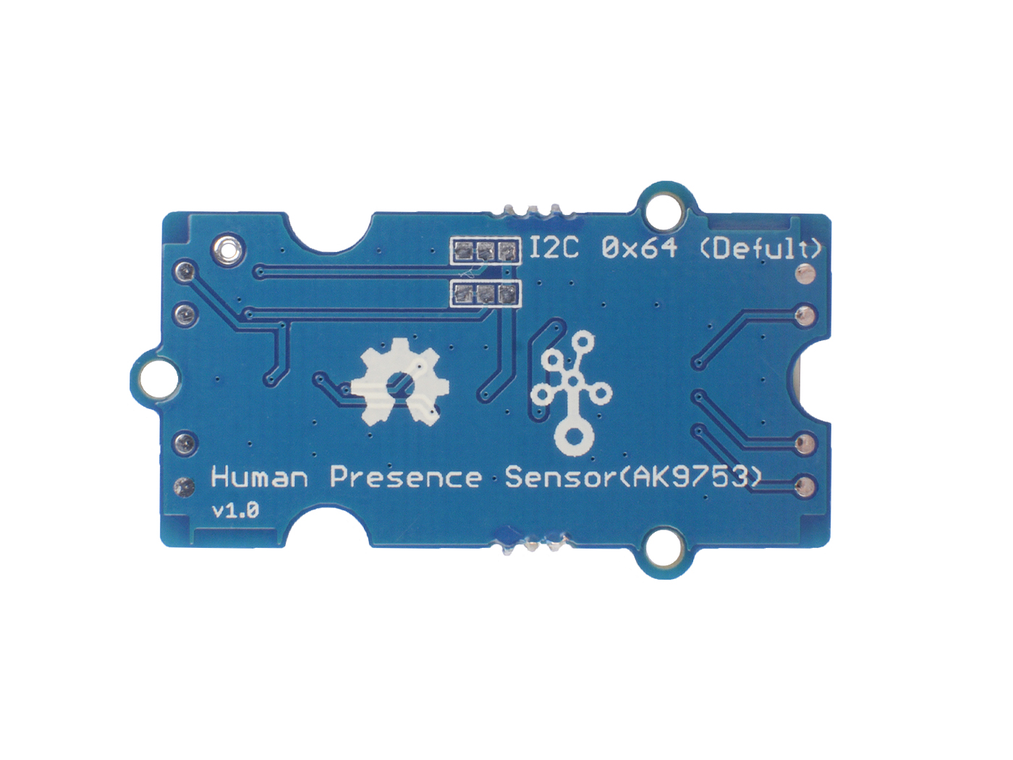
Default 0 x 64
CAD1 | CAD0 | I2C output | Slave address | Mode
L | L | Enable | 0X64 | Normal
L | H | Enable | 0X65 | Normal
H | H | Enable | 0X66 | Normal
H | H | Disable | Prohibited | Switch
CAD1
CAD0

