Slide 1


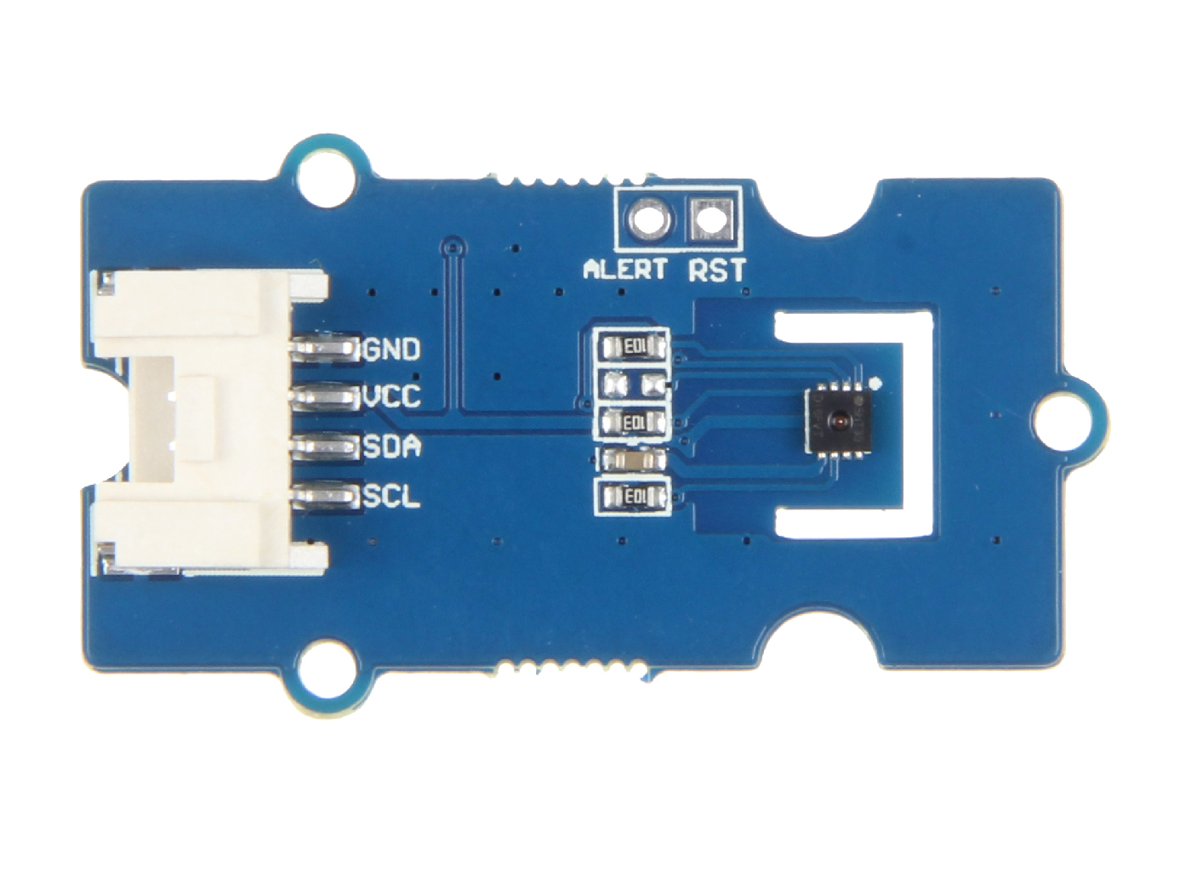




GND: connect this module to the system GND
VCC: you can use 5V or 3.3V for this module
SDA: I²C serial data
SCL: I²C serial clock
ALERT: reserved interrupt pin for customer use
RST: connect to the reset pin

Slide 2
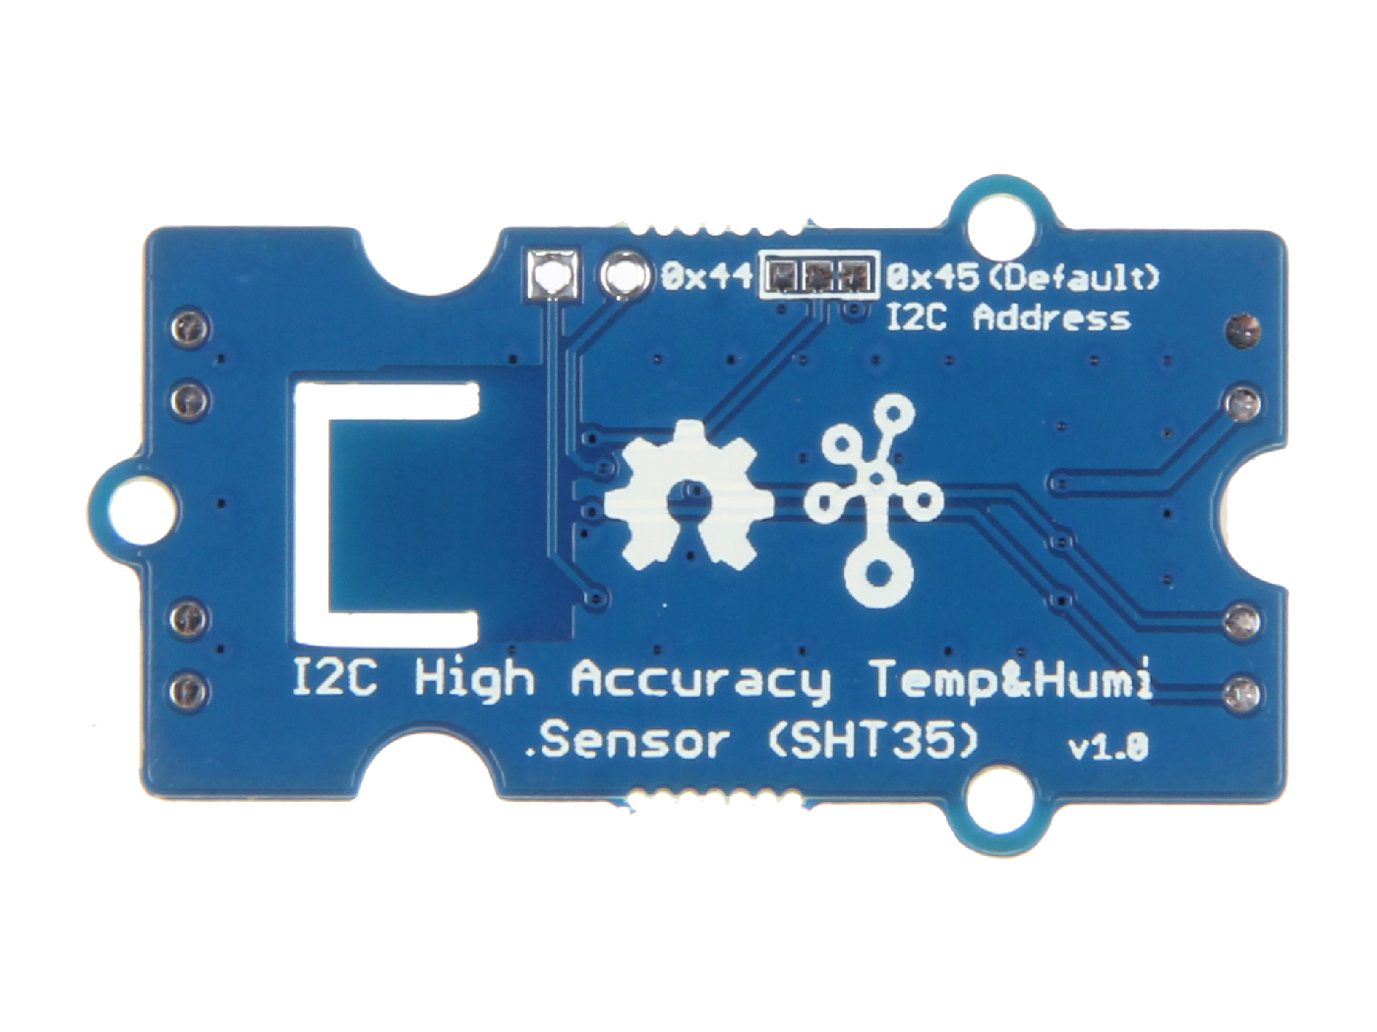
0 x 44
optional
0 x 45
default

