Slide 1
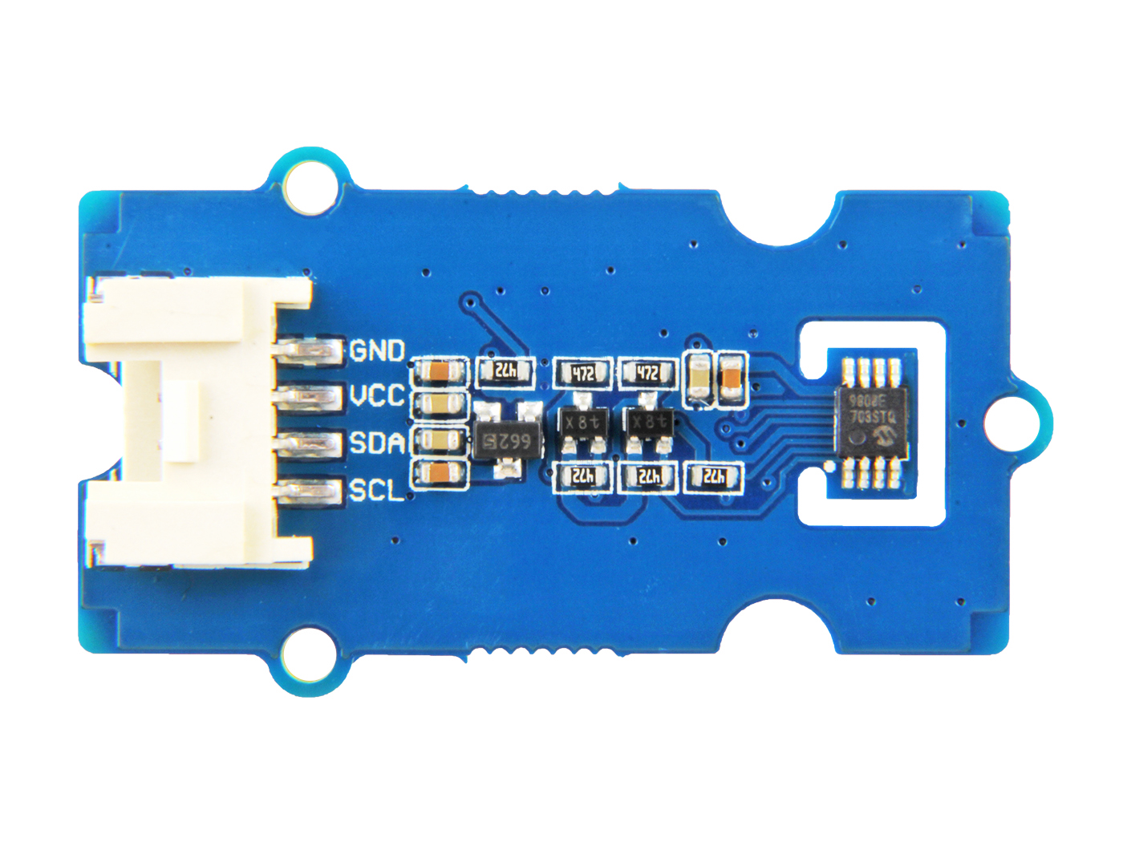




GND: connect this module to the system GND
VCC: you can use 5V or 3.3V for this module
SDA: I²C serial data
SCL: I²C serial clock

Slide 2
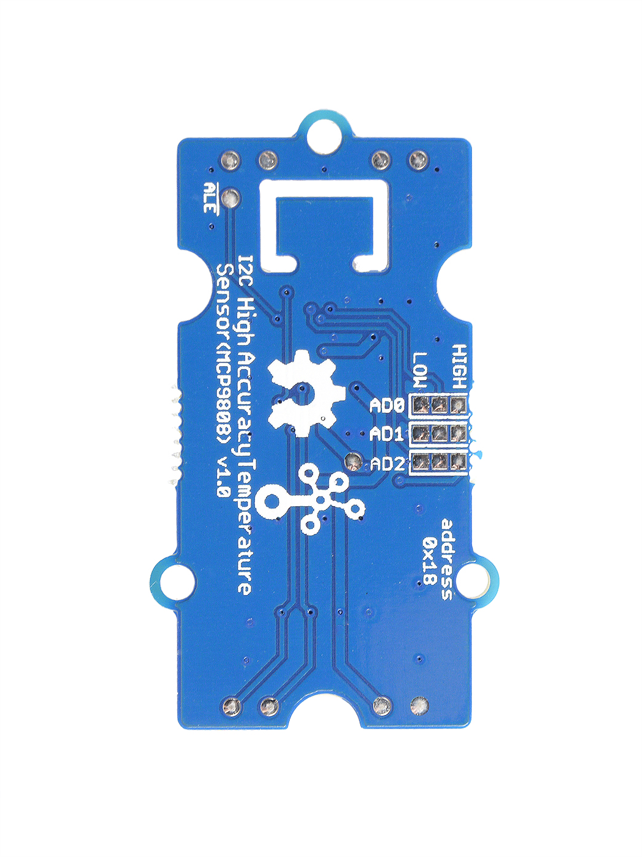
Alert
Default High
Default 000
Change e.g. 110
AD0=0
AD0=1
AD1=0
AD1=1
AD2=0
AD2=0
High-3V3
I²C Address AD0
I²C Address AD1
Low-GND
I²C Address AD2

Slide 3
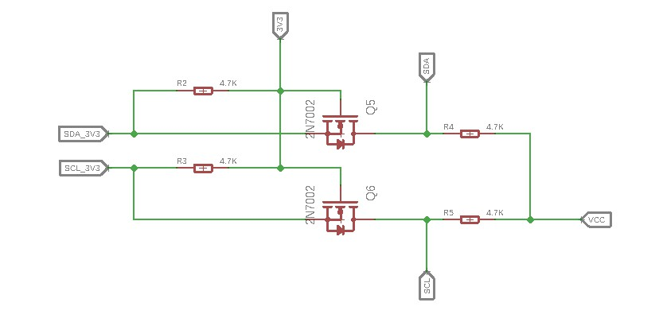
G
S
D
Part_3V3
Part_5V

Slide 4
Lower_limit
Upper_limit
Condition zone

