Slide 1
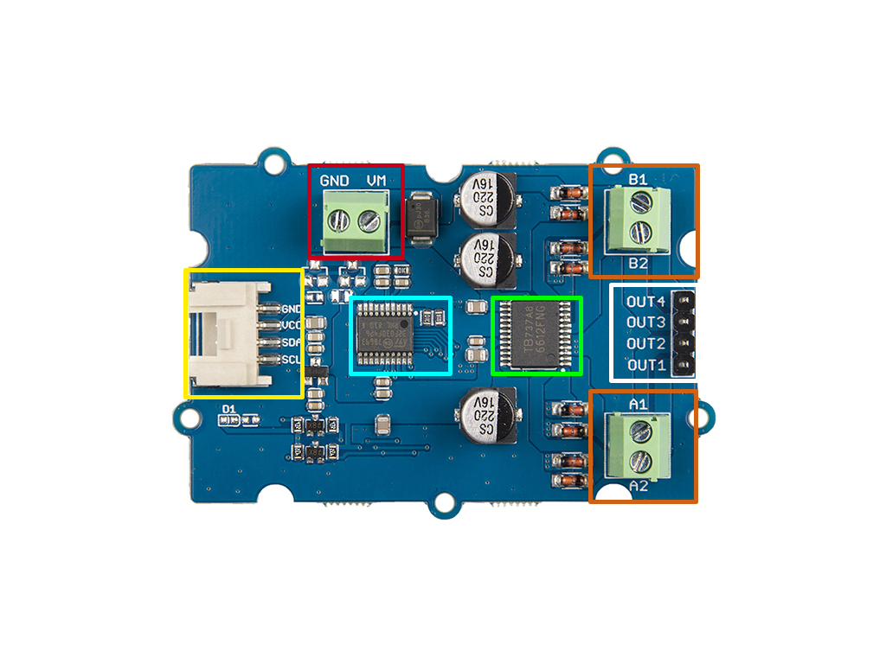
Power In
DC Motor B
I2C
Stepper
Motor
MCU
DC Motor A
TB6612FNG

Slide 2
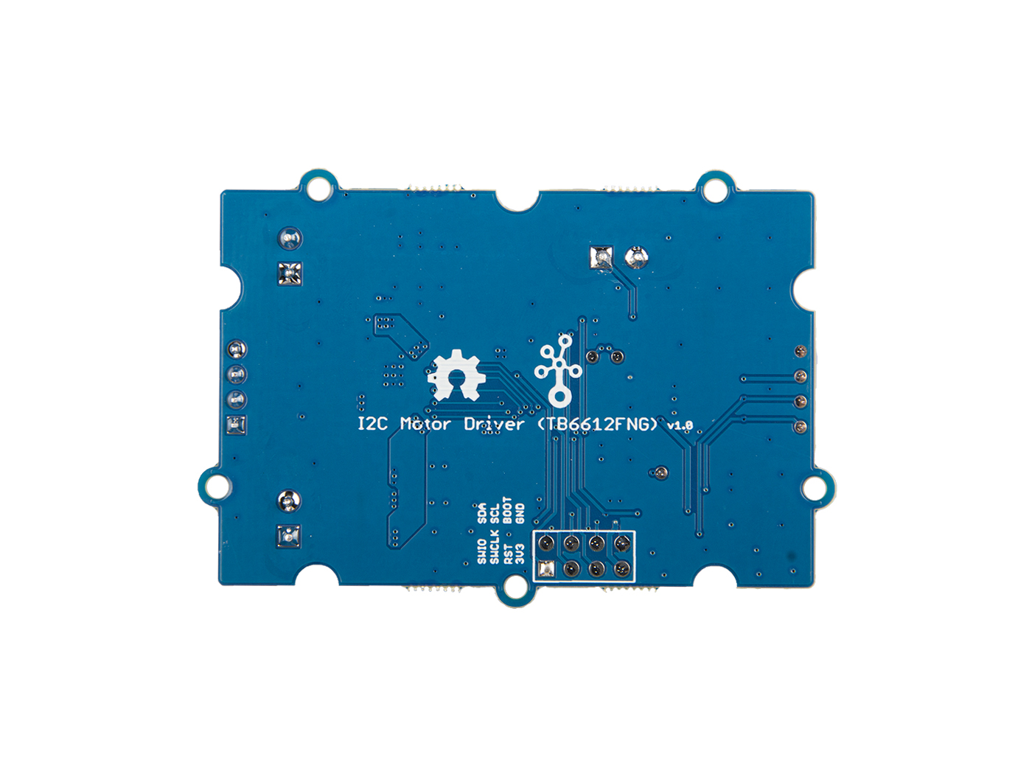
SWD

