Slide 1
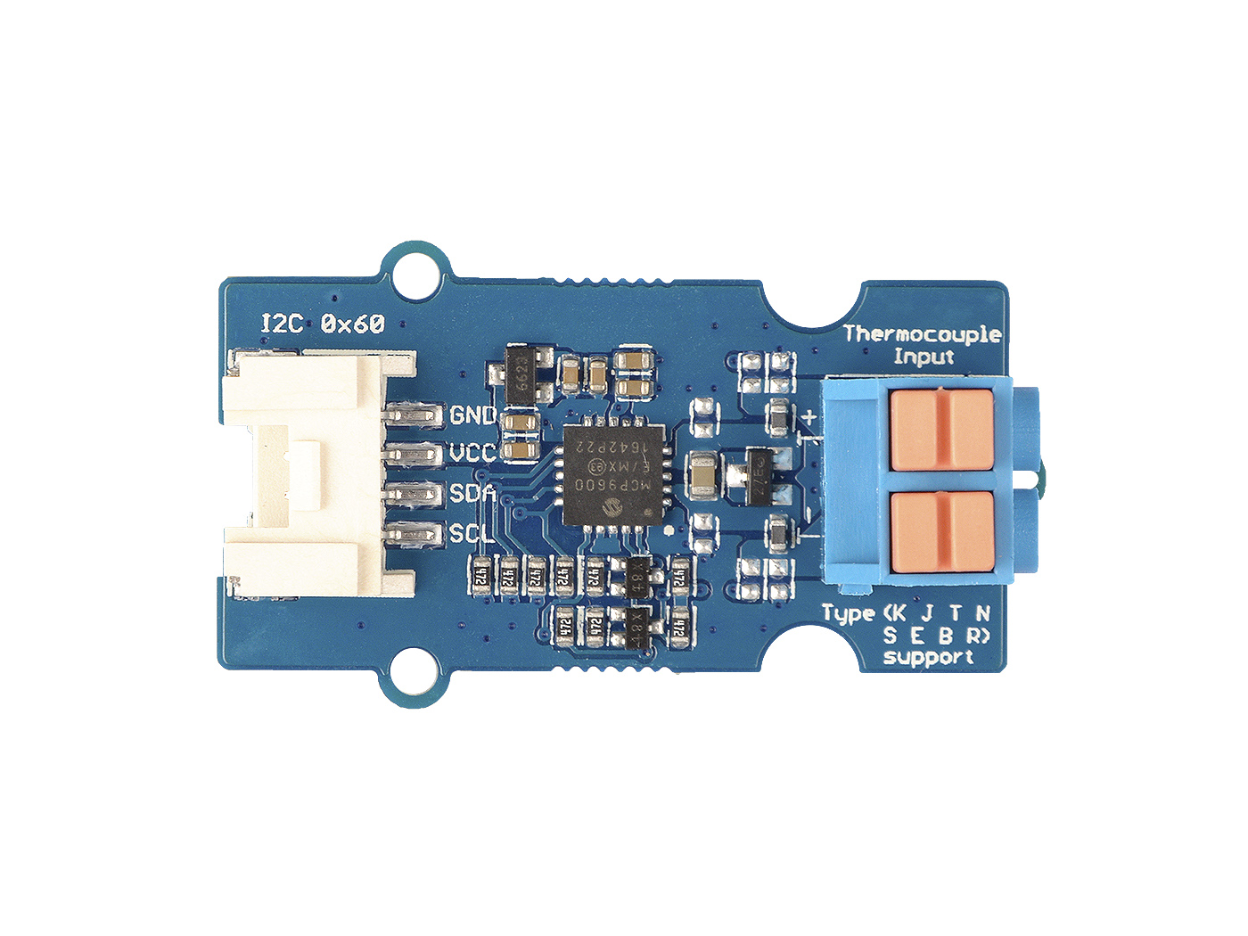






GND: connect this module to the system GND
VCC: you can use 5V or 3.3V for this module
SDA: I²C serial data
SCL: I²C serial clock
T+: Thermocouple Input, positive pole.
T -: Thermocouple Input, negative pole

Slide 2
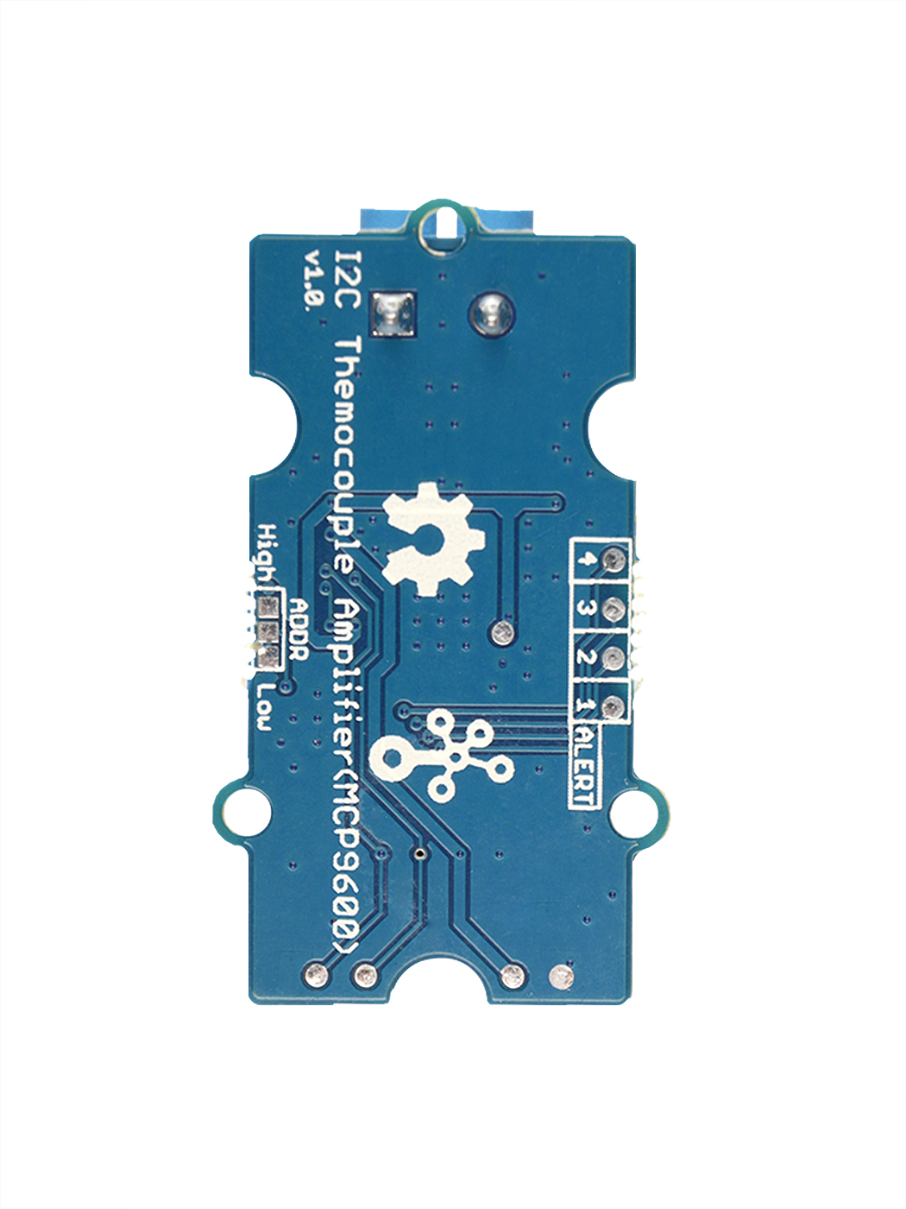
I2C Address
Alert Pad 4
Alert Pad 3
Alert Pad 2
0x60
Default
0x67
Alert Pad 1

Slide 3
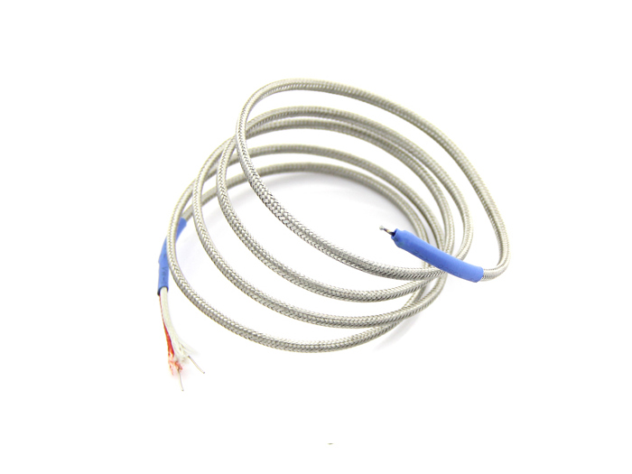
+
•
Chromel
•
Hot Junction
-
•
Alumel

Slide 4
GND: 将这个模块的GND和系统的GND相连
VCC: 您可以使用5V或者3.3V
SDA: I²C 数据线
SCL: I²C 时钟线
T+: 热电偶信号输入端, 正端
T -: 热电偶信号输入端, 负端

Slide 5
I2C 地址
中断焊盘 4
中断焊盘 3
中断焊盘 2
0x60
默认
0x67
中断焊盘 1

Slide 6
+
Chromel(镍铬合金)
•
•
Hot Junction(热端)
-
•
Alumel(铝)

Slide 7


Temperature Up
Alert pin trigger
Alert pin3 trigger
Alert pin2 trigger
Alert pin1 trigger
Alert pin0 trigger
28℃
29℃
30℃
31℃
Temperature Down
Alert pin release
Alert pin2 release
Alert pin3 release
Alert pin1 release
Alert pin0 release
26℃
27℃
28℃
29℃

