Slide 1

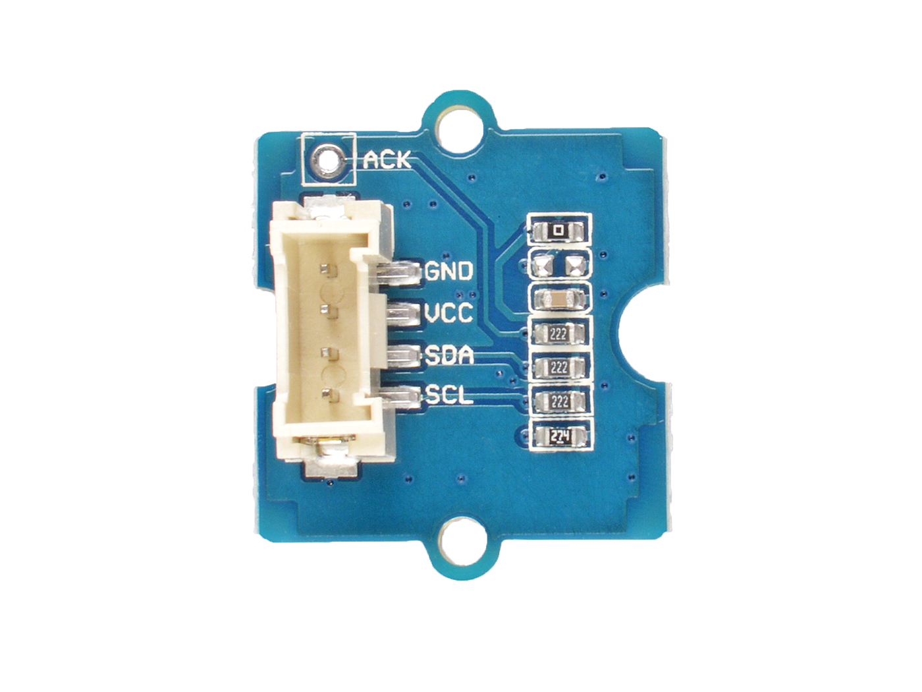




ACK: interrupt pin, default low level,
exceeding the threshold to become high
GND: connect this module to the system GND
VCC: you can use 5V or 3.3V for this module
SDA: I²C serial data
SCL: I²C serial clock

Slide 2
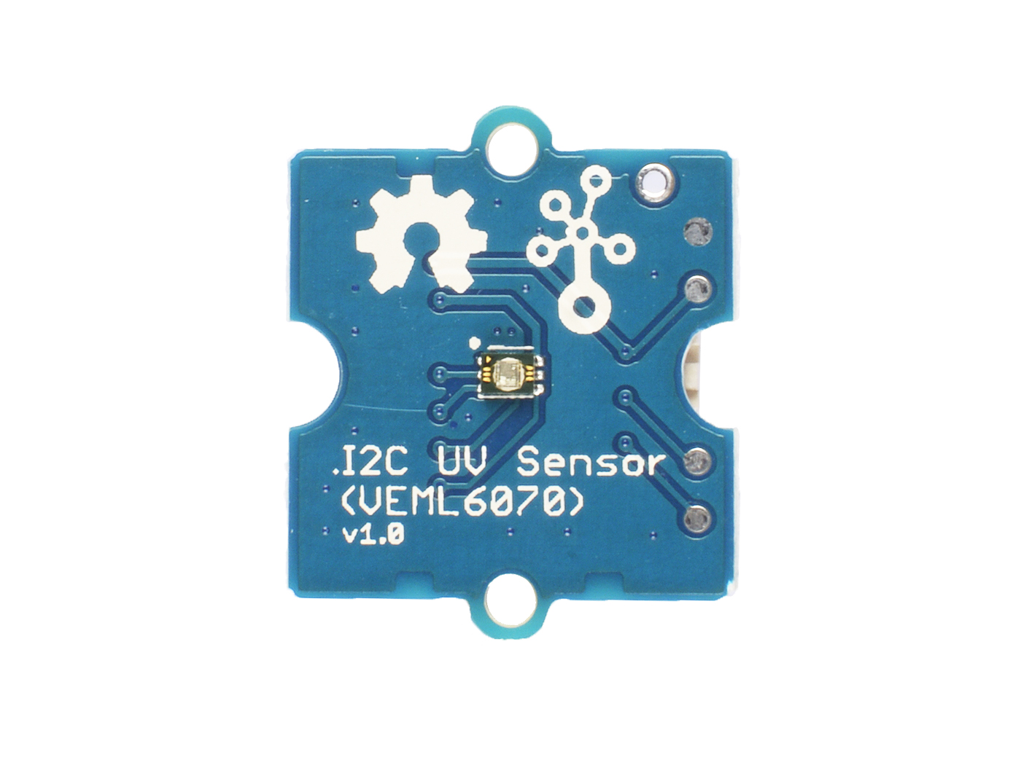
The UV Detect Module

