Slide 1
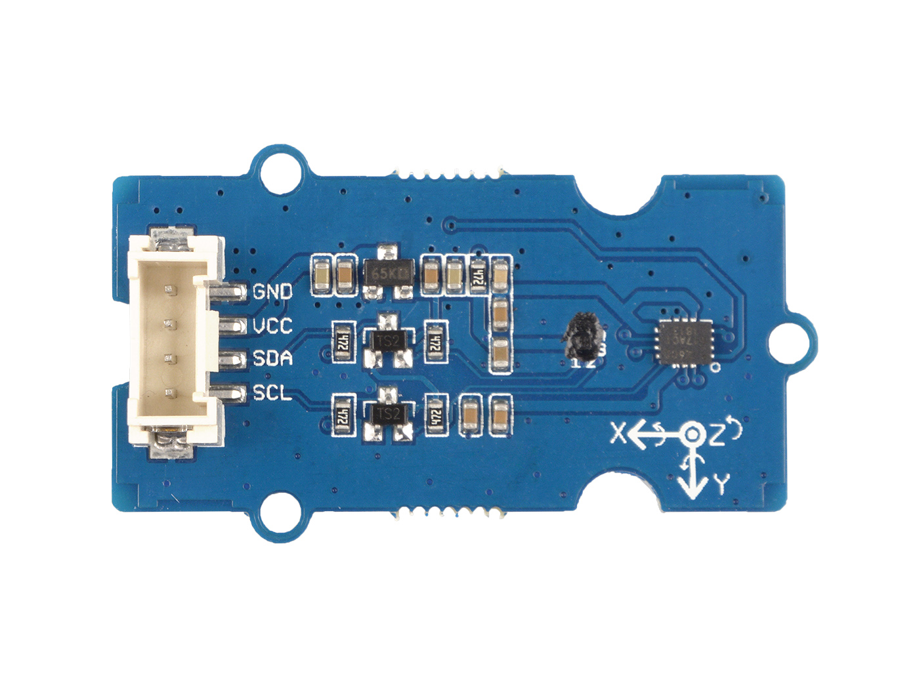




GND: connect this module to the system GND
VCC: you can use 5V or 3.3V for this module
SDA: I²C serial data
SCL: I²C serial clock

Slide 2
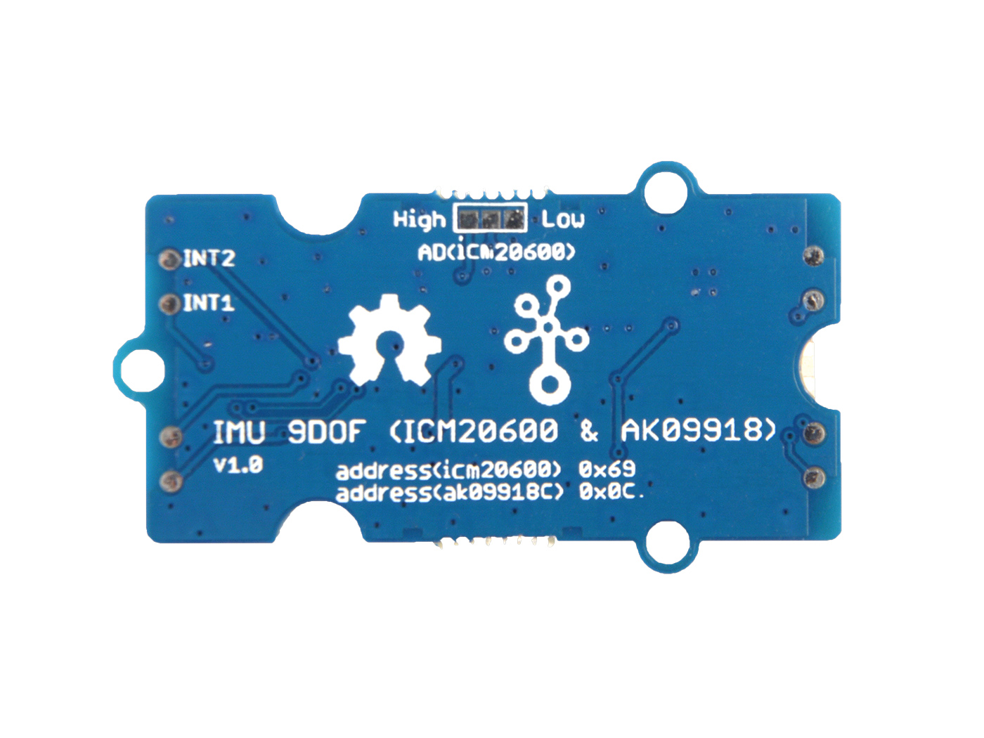




ICM Address
0x68
0x69 Default
0x69 Default
INT2: Interrupt digital output (totem pole or open-drain)
INT1: Interrupt digital output (totem pole or open-drain)
FSYNC: Frame synchronization digital input or No Connect
VCC_1.8V: Provide 1.8V for ICM20600 and AK09918

