Slide 1
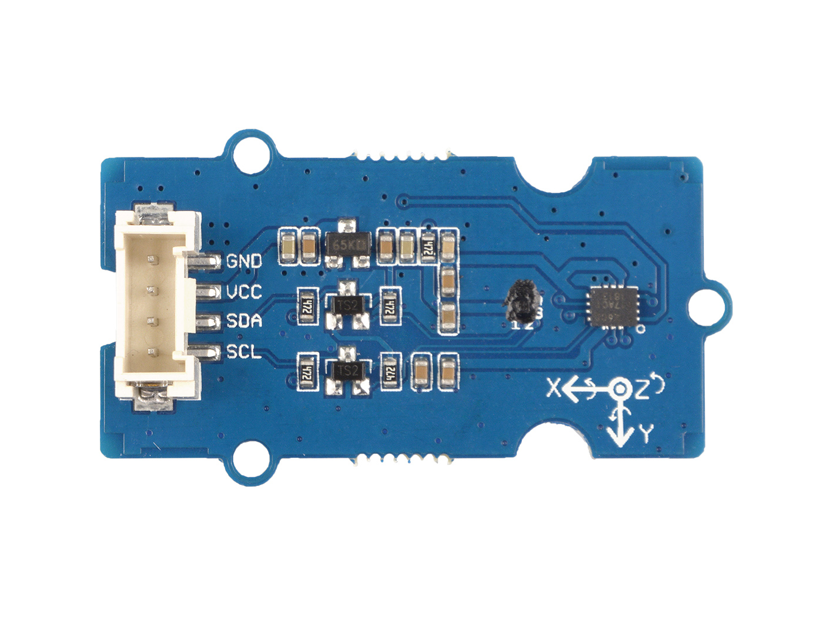




GND: connect this module to the system GND
VCC: you can use 5V or 3.3V for this module
SDA: I²C serial data
SCL: I²C serial clock

Slide 2
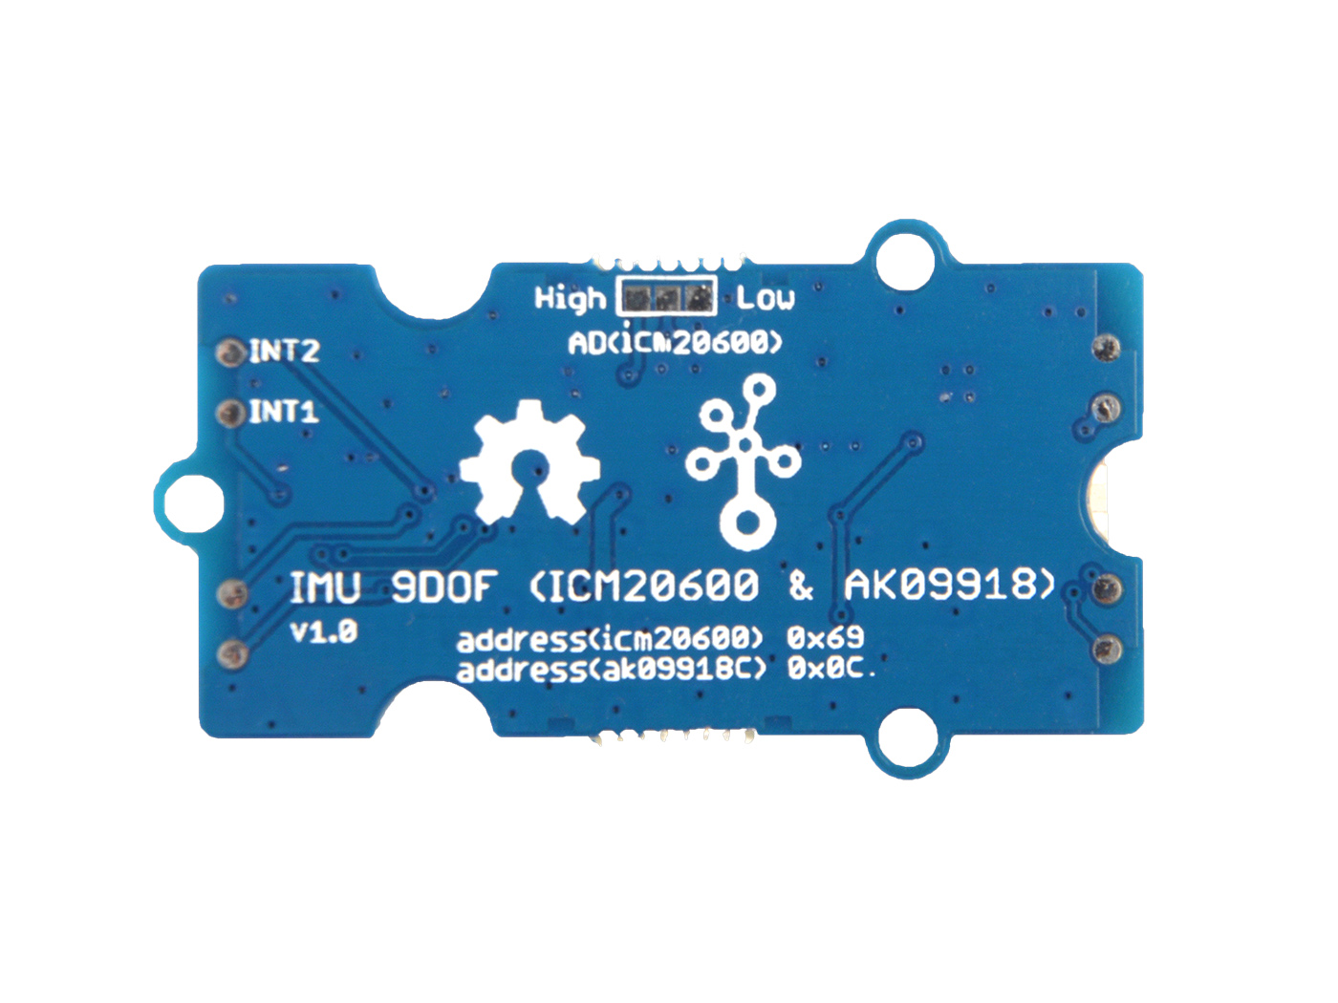
SPI
I2C
Default
0x76
Default
0x77
SPI

