Slide 1
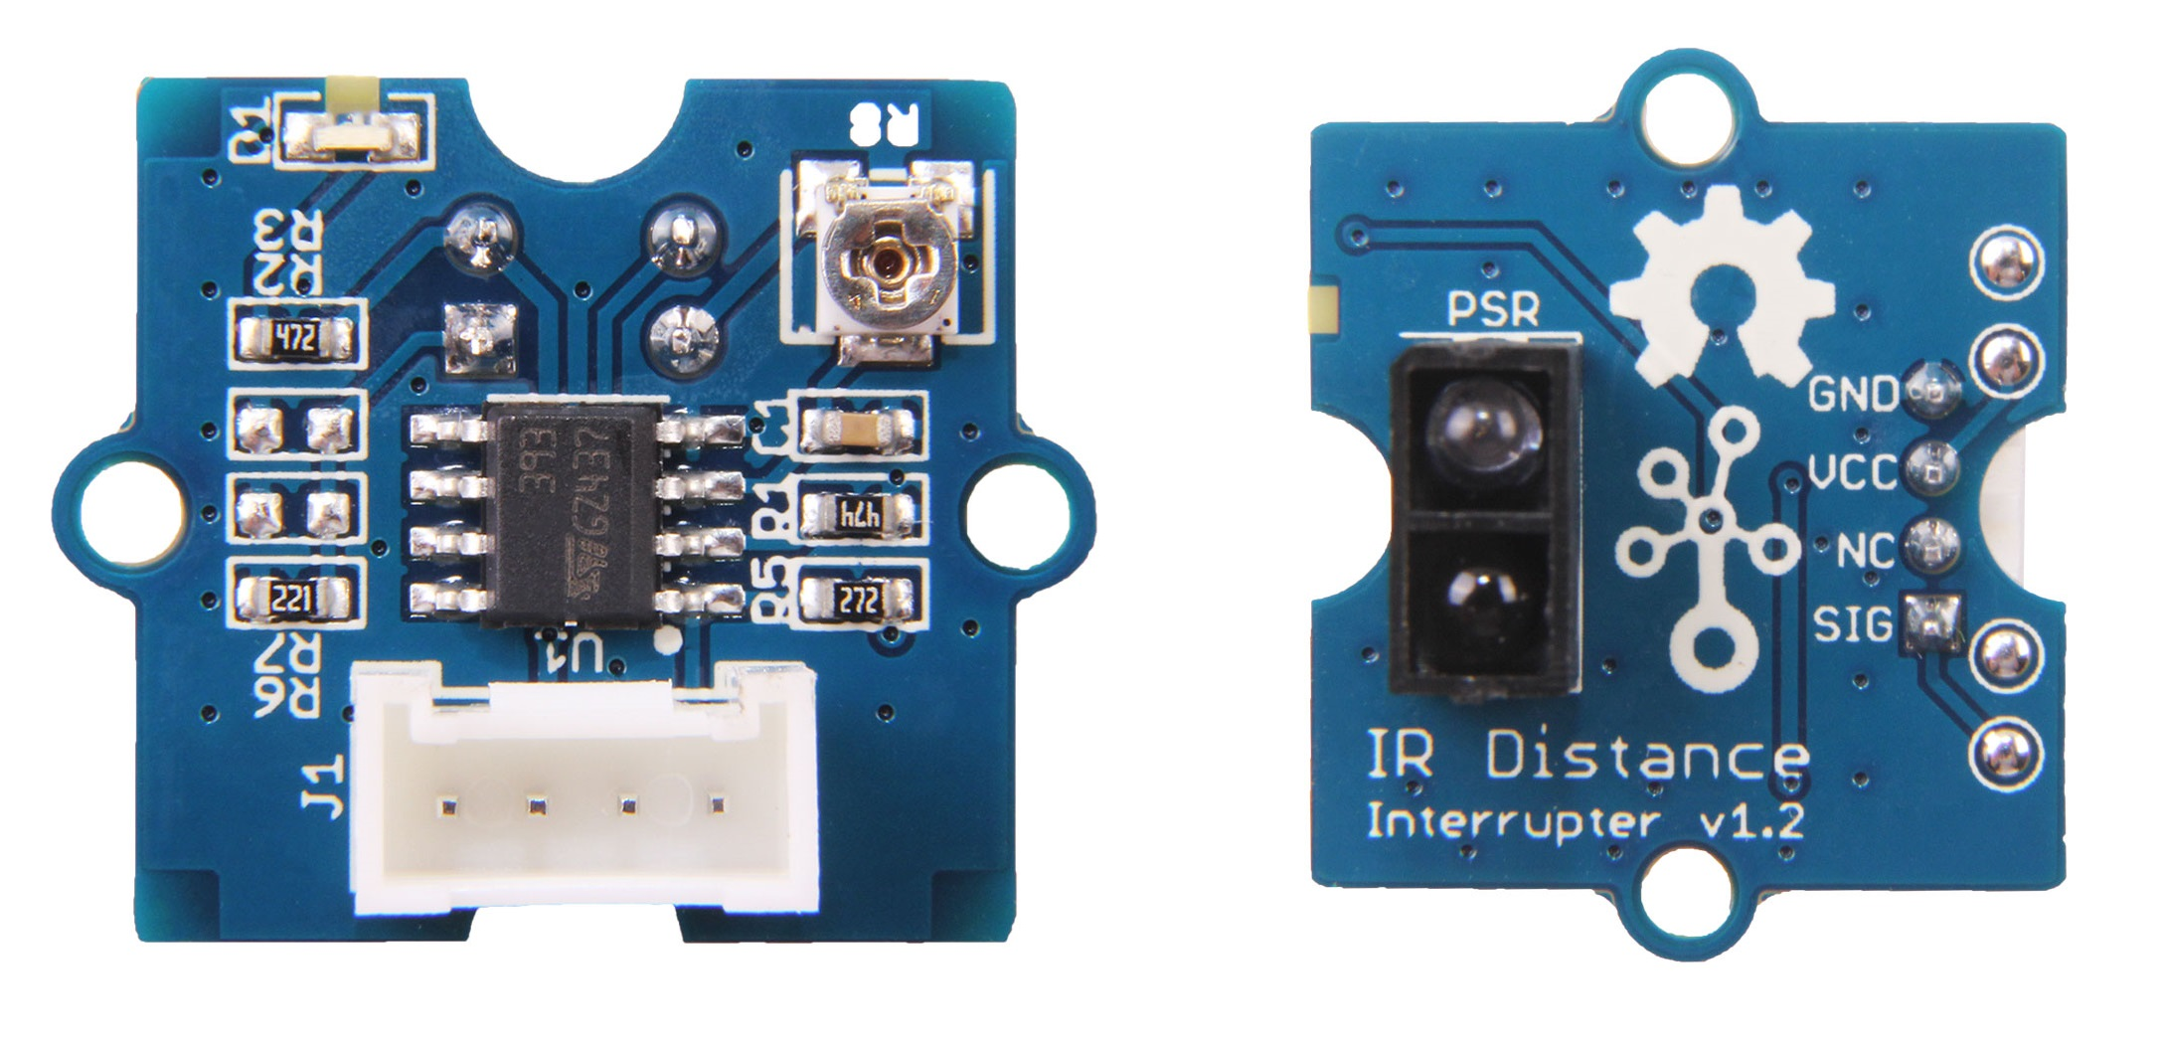
Light sensitivity adjusting potentiometer
LED Indicator
LM393 operational amplifier
ITR9909 Reflective photosensor

