Slide 1
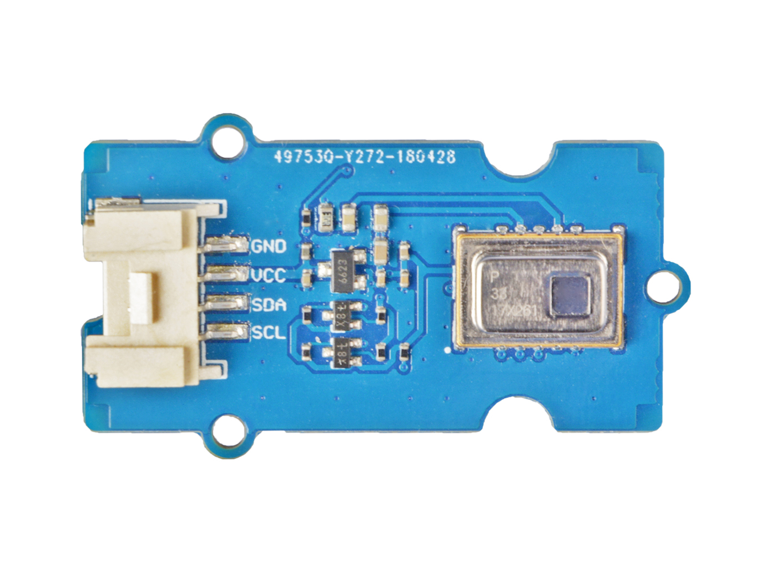





GND: connect this module to the system GND
VCC: you can use 5V or 3.3V for this module
SDA: I²C serial data
SCL: I²C serial clock
the AMG8833 module

Slide 2
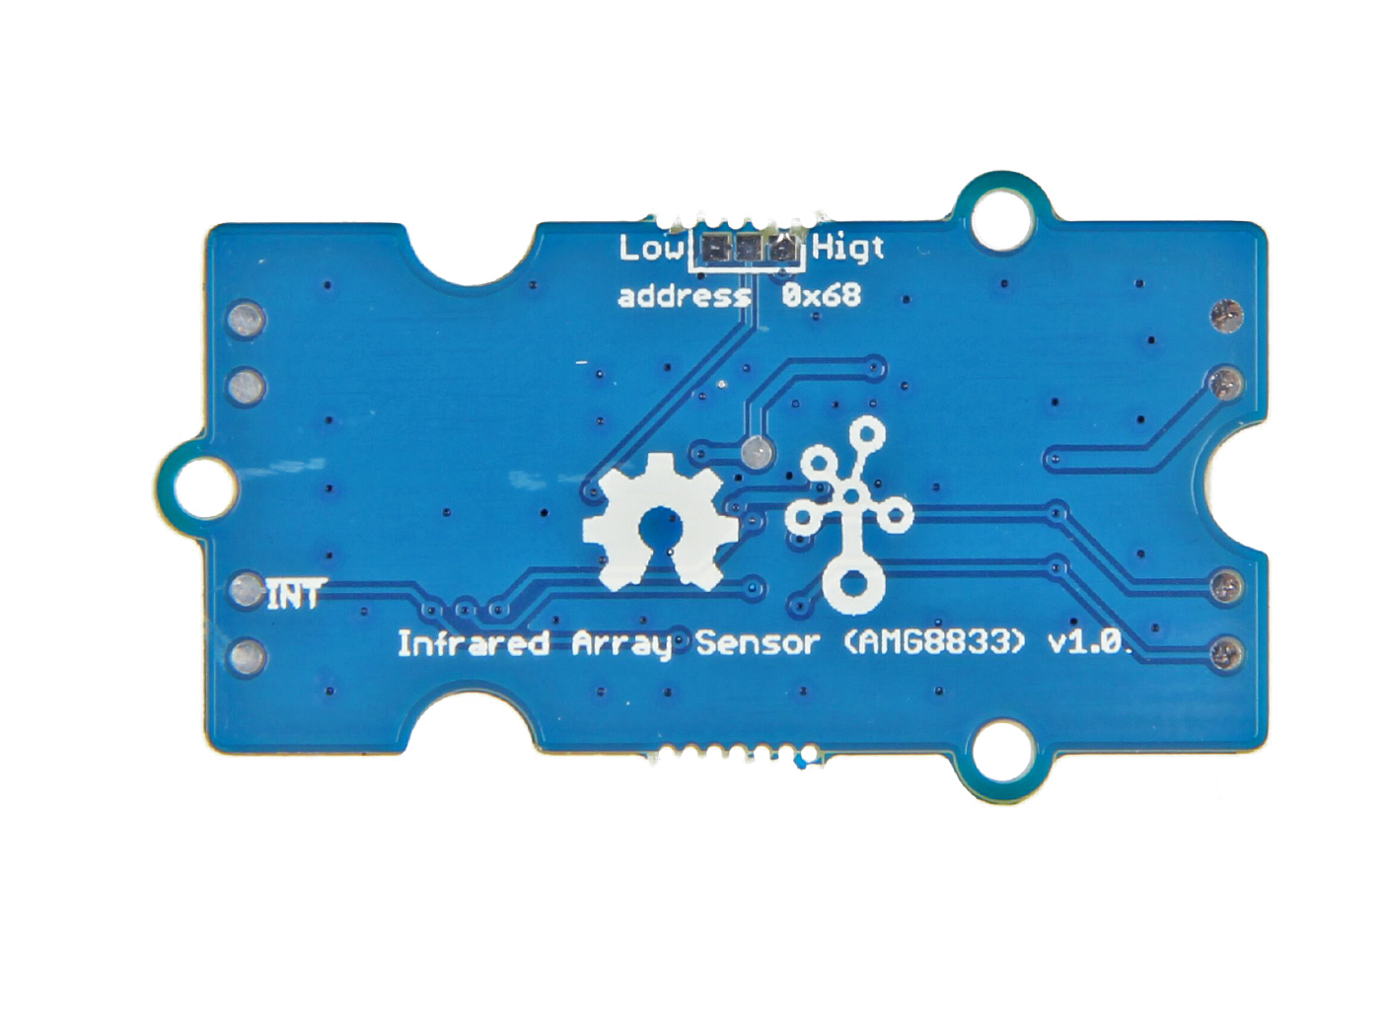
0x69
Optional Address
0x68
Defaut Address
INT Pin
normally has same voltage as VDD, when interrupting, same as GND (0V)

