Slide 1
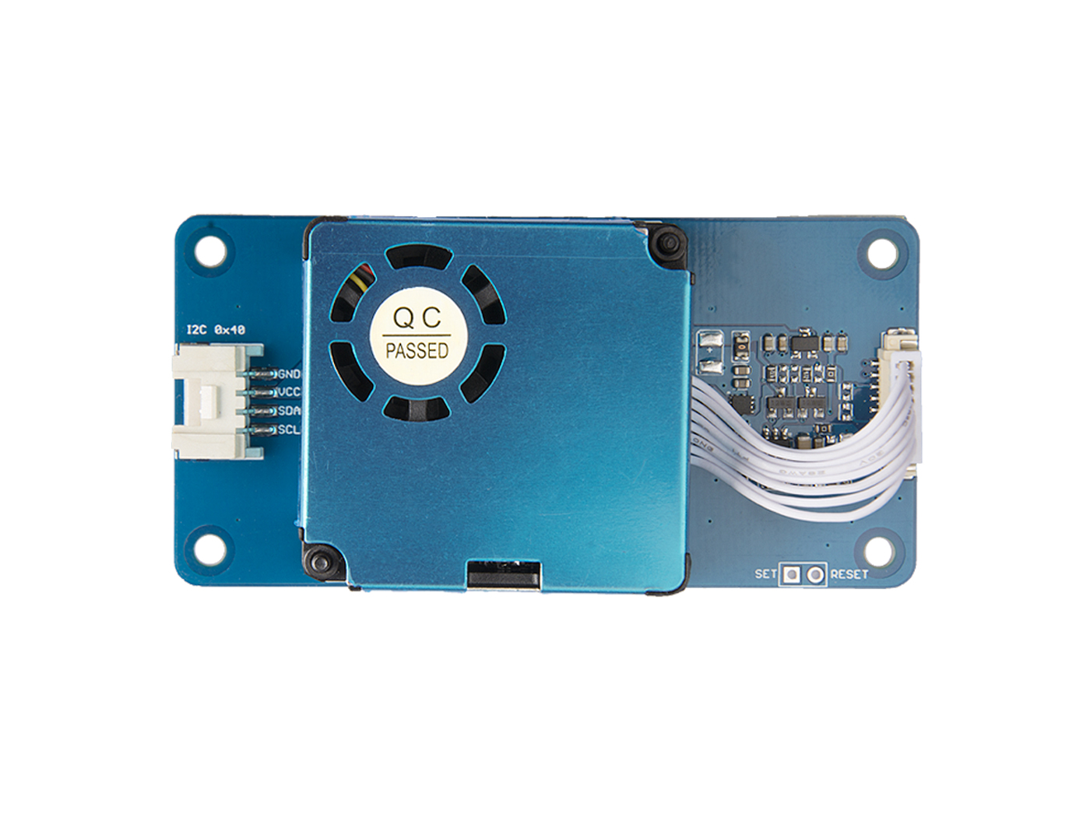




HM3301
RESET
SET
GND: connect this module to the system GND
VCC: you can use 5V or 3.3V for this module
SDA: I²C serial data
SCL: I²C serial clock
SET
Set the pin/TTL level @3.3V, high or floating for normal operation mode, low level for sleep mode
RESET
Module reset signal / TTL level @3.3V, low reset

