Slide 1
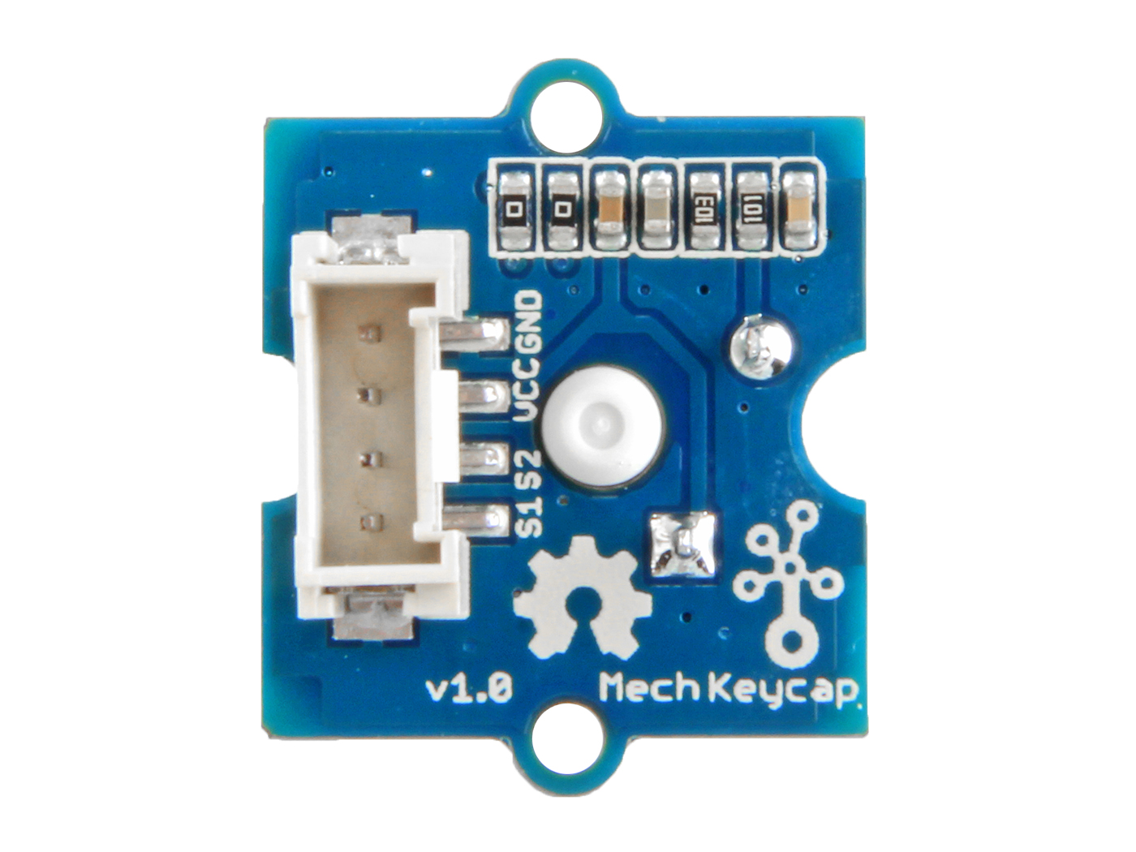




GND: connect this module to the system GND
VCC: you can use 5V or 3.3V for this module
S2: input control signal for LED
S1: output signal for button

