Slide 1
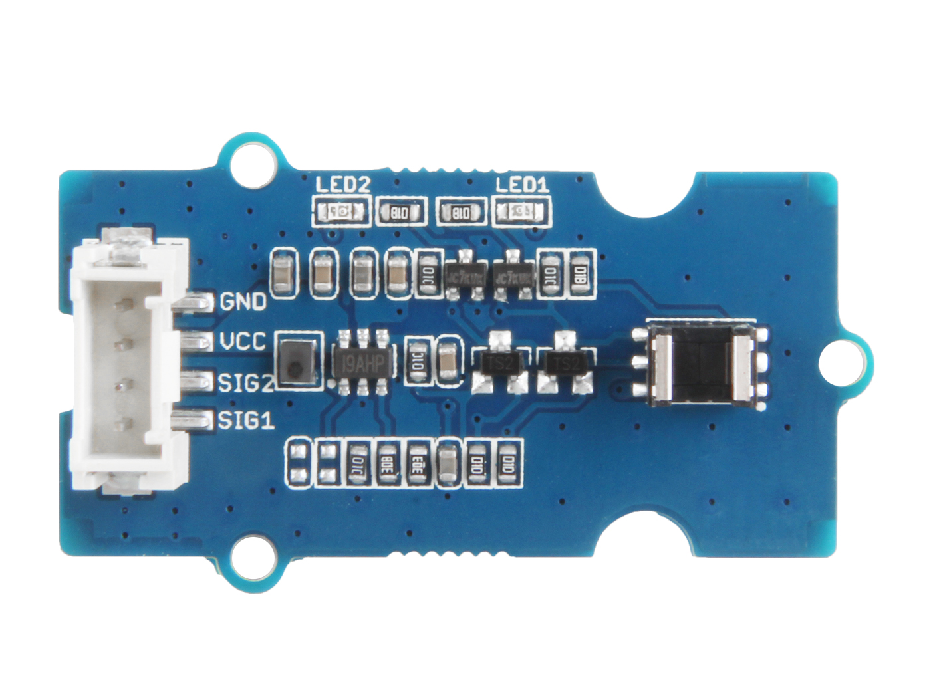


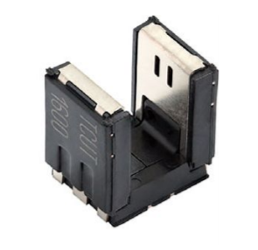




Out1: output of detector 1, default High
Out2: output of detector 2, default High
GND: connect this module to the system GND
VCC: you can use 5V or 3.3V for this module
SIG2: default High, output of channel 2, which connect to phototransistor detector 2
SIG1: default High, output of channel 1, which connect to phototransistor detector 1

Slide 2
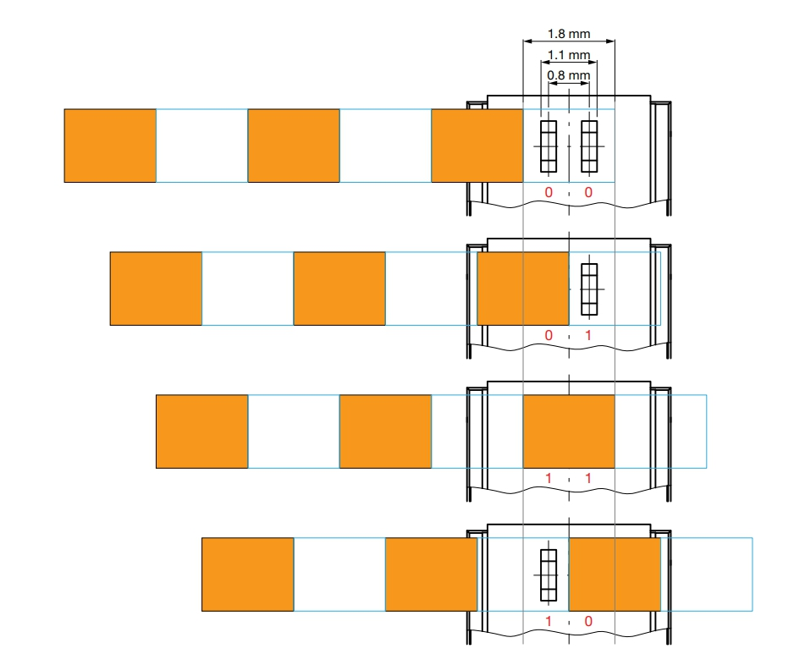
1
1
0
1
0
0
1
0

Slide 3
