Slide 1
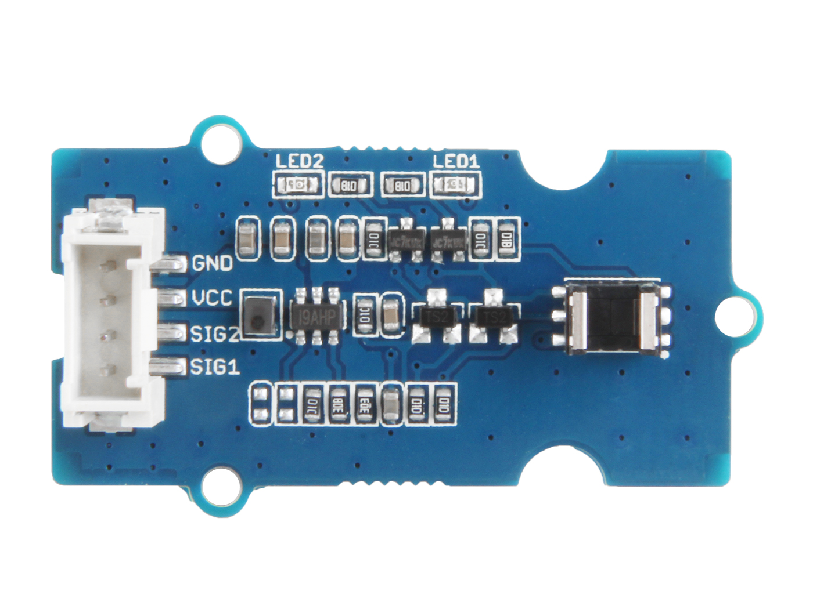


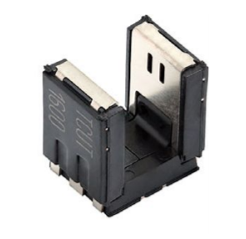




Out1: output of detector 1, default High
Out2: output of detector 2, default High
GND: connect this module to the system GND
VCC: you can use 5V or 3.3V for this module
SIG2: default High, output of channel 2, which connect to phototransistor detector 2
SIG1: default High, output of channel 1, which connect to phototransistor detector 1

Slide 2
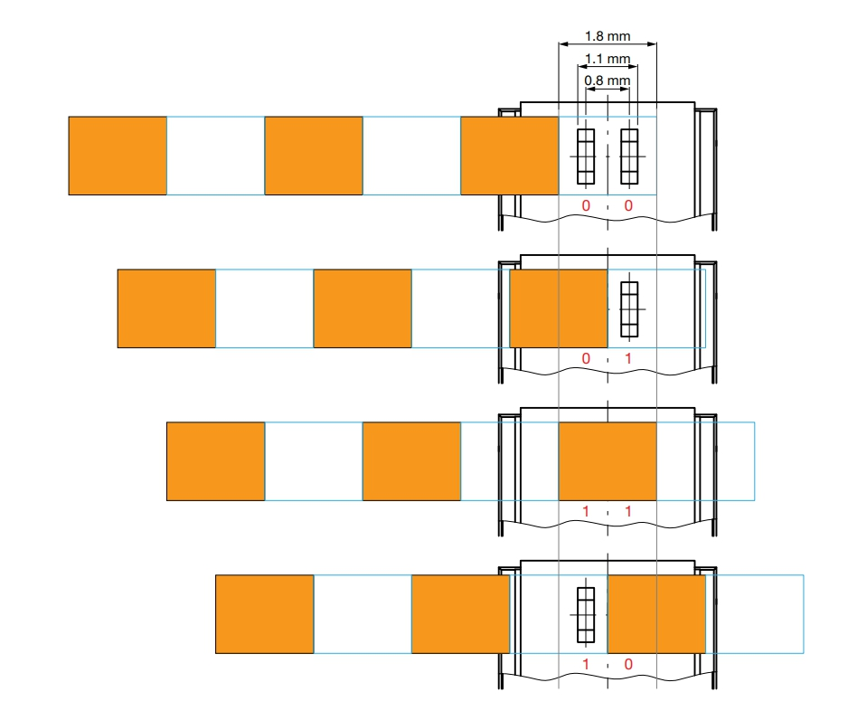
1
1
0
1
0
0
1
0

Slide 3
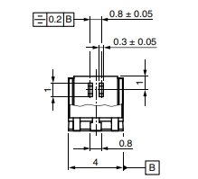


Slide 4
输出1: 探测器1的输出，默认为高
输出2: 探测器2的输出，默认为高
GND: 将此模块的 GND 连接到系统的 GND 上
VCC: 您可使用 5V 或 3.3V 电压
SIG2: 默认为高电平，通道2的输出，通道2连接到光电晶体管探测器2
SIG1: 默认为高电平，通道1的输出，通道1连接到光电晶体管探测器1

