Slide 1
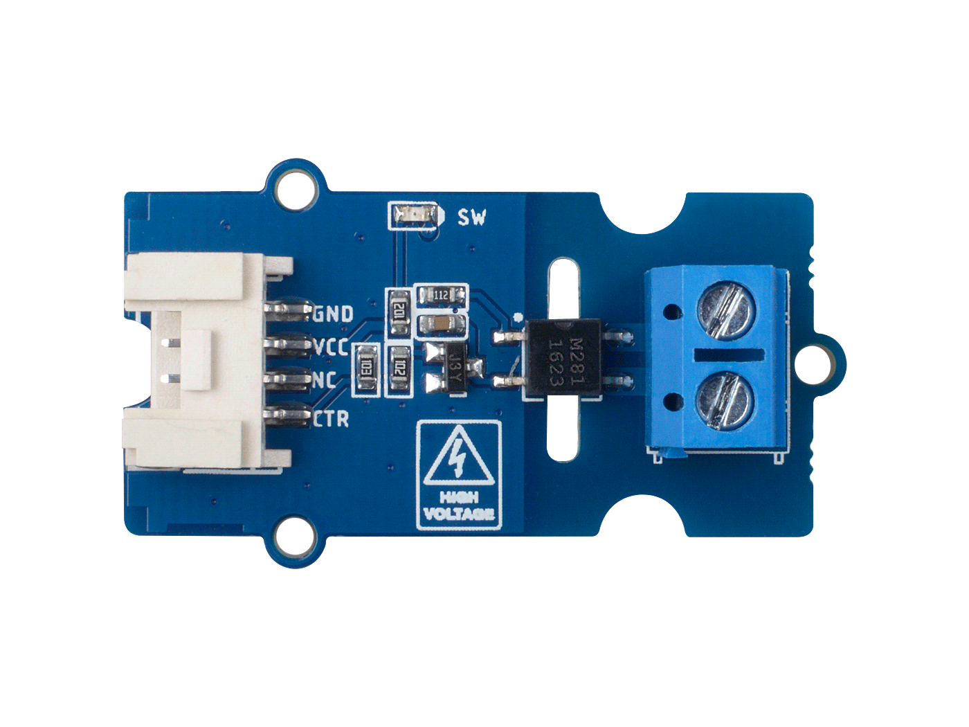





M281 Optocoupler Relay Module
GND: connect this module to the system GND
VCC: you can use 5V or 3.3V for this module
NC: not connected
CTR: control signal, high-close/low open
Load Screw Interface, normally open

