Slide 1
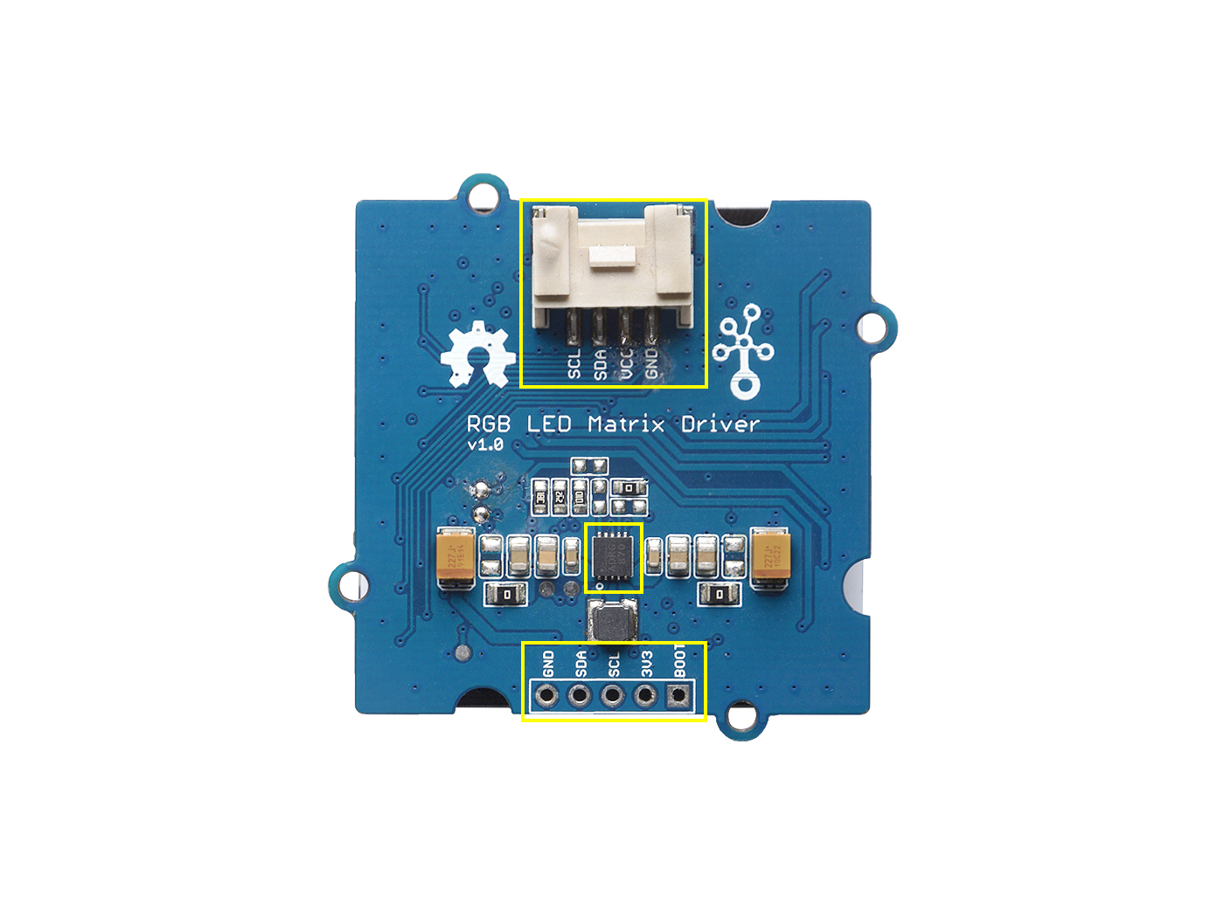
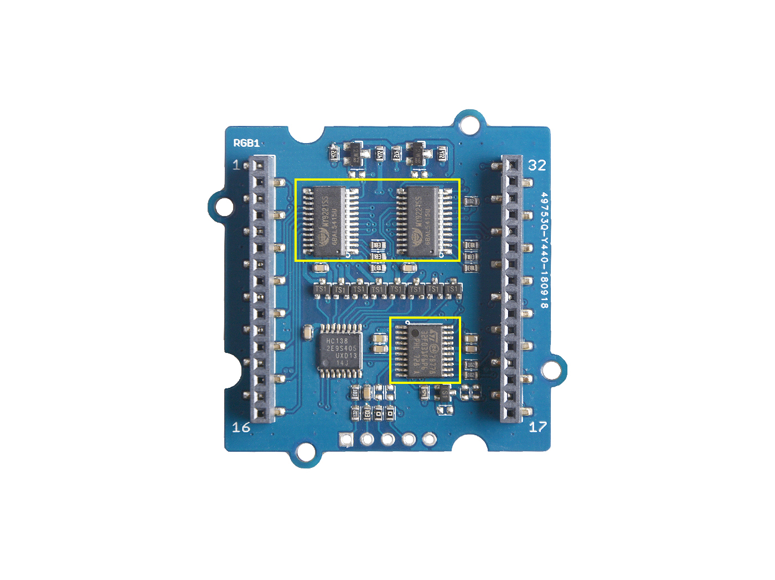
Grove Interface
LED Driver- -MY9221
I2C
DCDC
MP2155
MCU--
STM32F031
Firmware Download Interface

Slide 2
