Slide 1
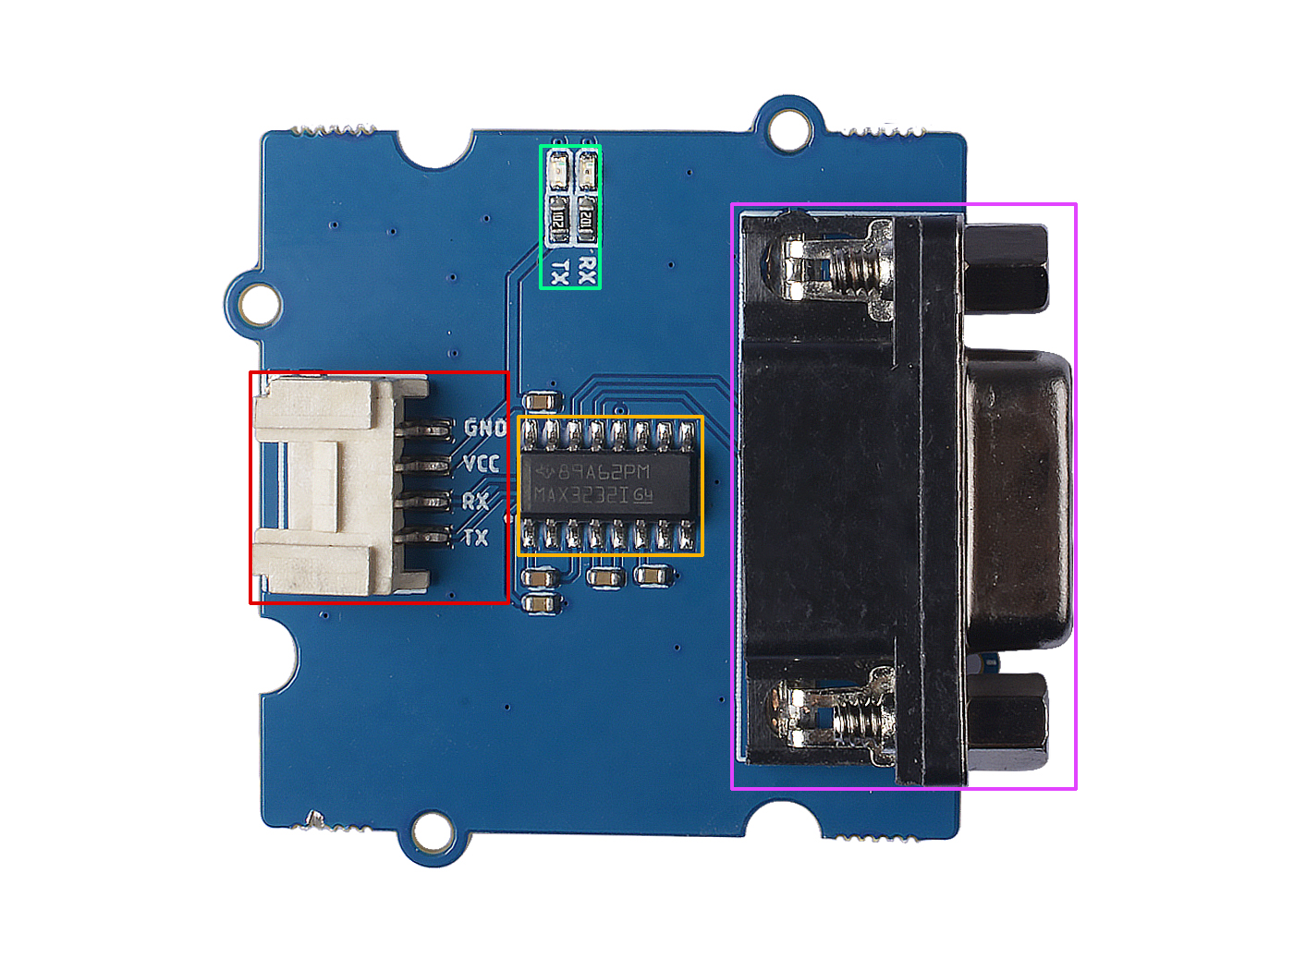







LED indicator
Max3232 chip
DB9 Port
GND: connect this module to the system GND
VCC: you can use 5V or 3.3V for this module
RX: connect to the device TX
TX: connect to the device RX

Slide 2
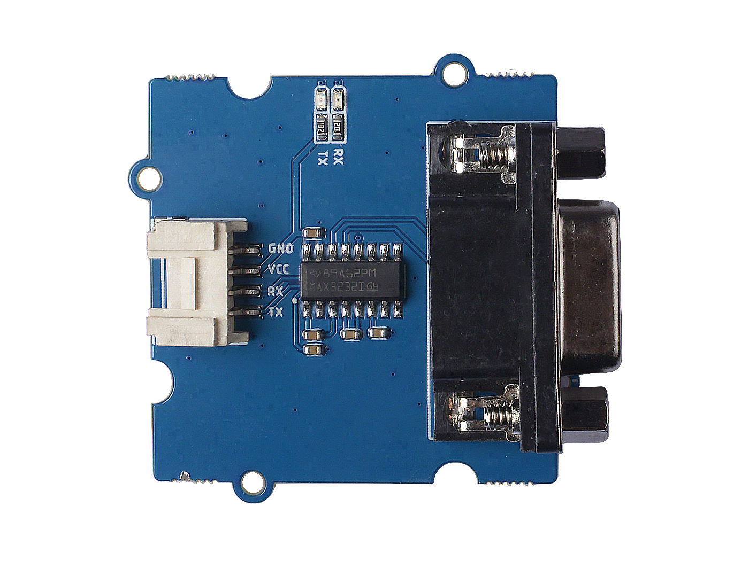
TTL Device
RS232 Device
GND
VCC
TX
RX

