Slide 1
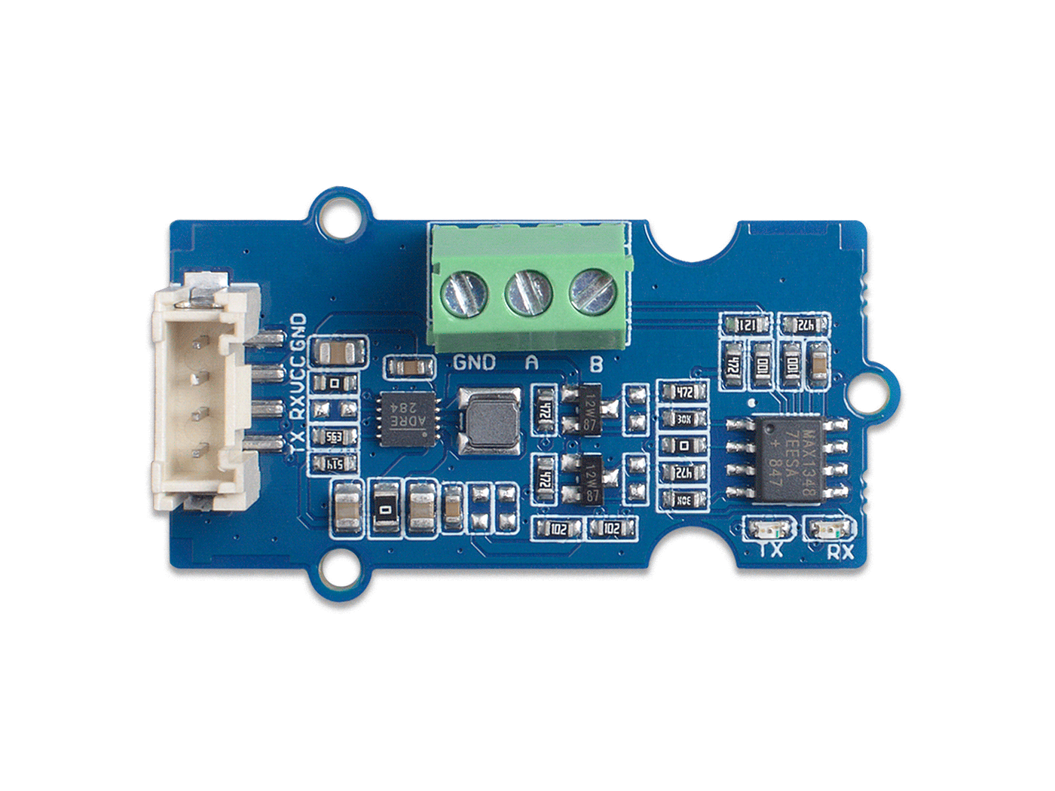






GND: connect this module to the system GND
VCC: you can use 5V or 3.3V for this module
RX: UART data reception
TX: UART data UART transmission
Max13487E IC
RS-485 Screw Terminal Interface

Slide 2
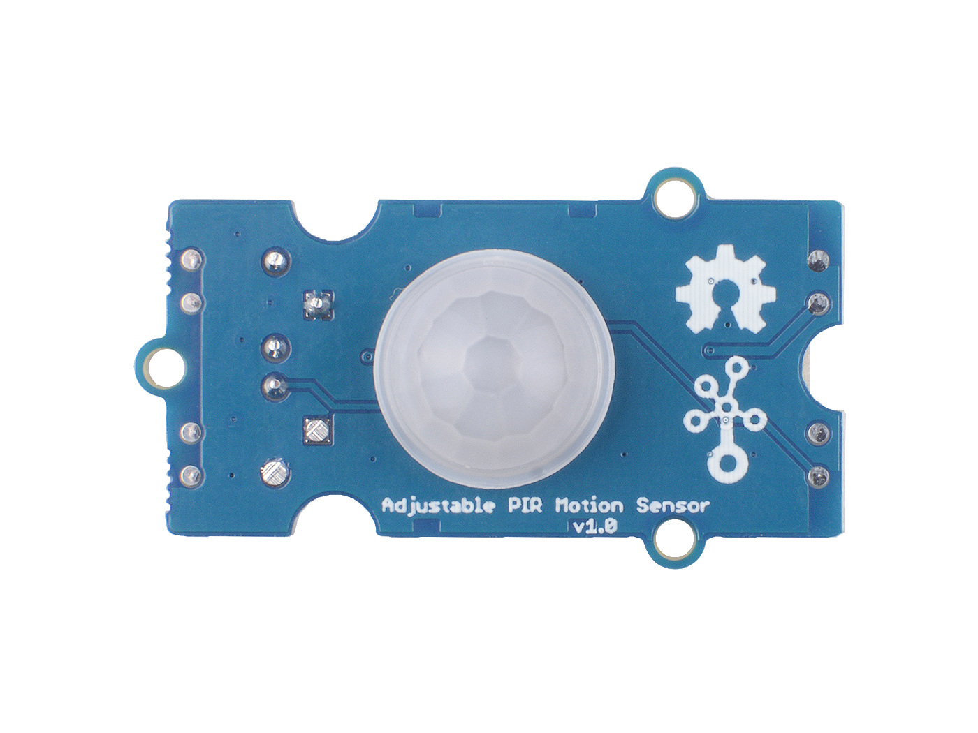
Pyroelectric Infrared Sensors
and Fresnel lens

