Slide 1
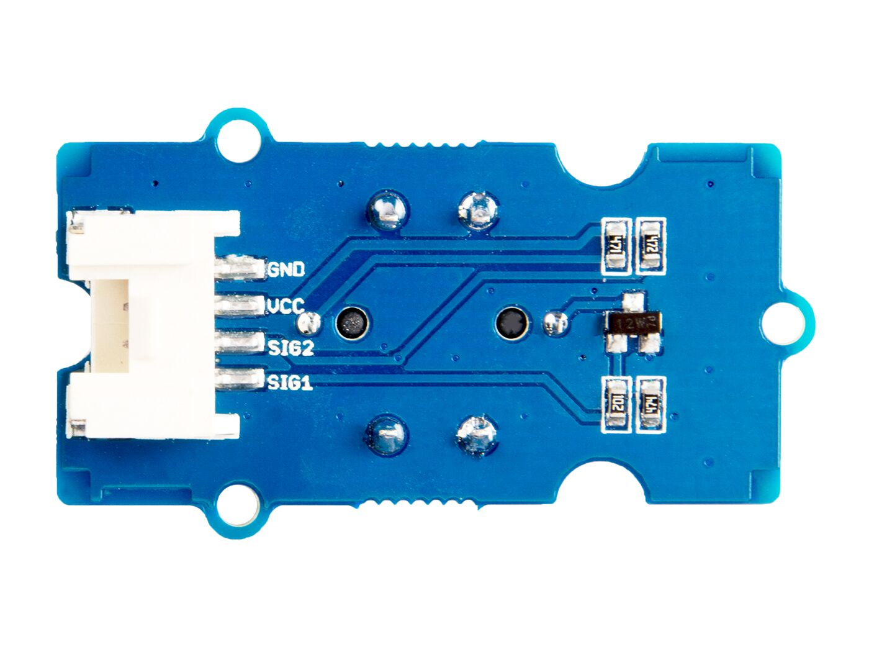




GND: connect this module to the system GND
VCC: you can use 5V or 3.3V for this module
SIG2: output the button status, default high
SIG1: input the LED control signal, default low

Slide 2
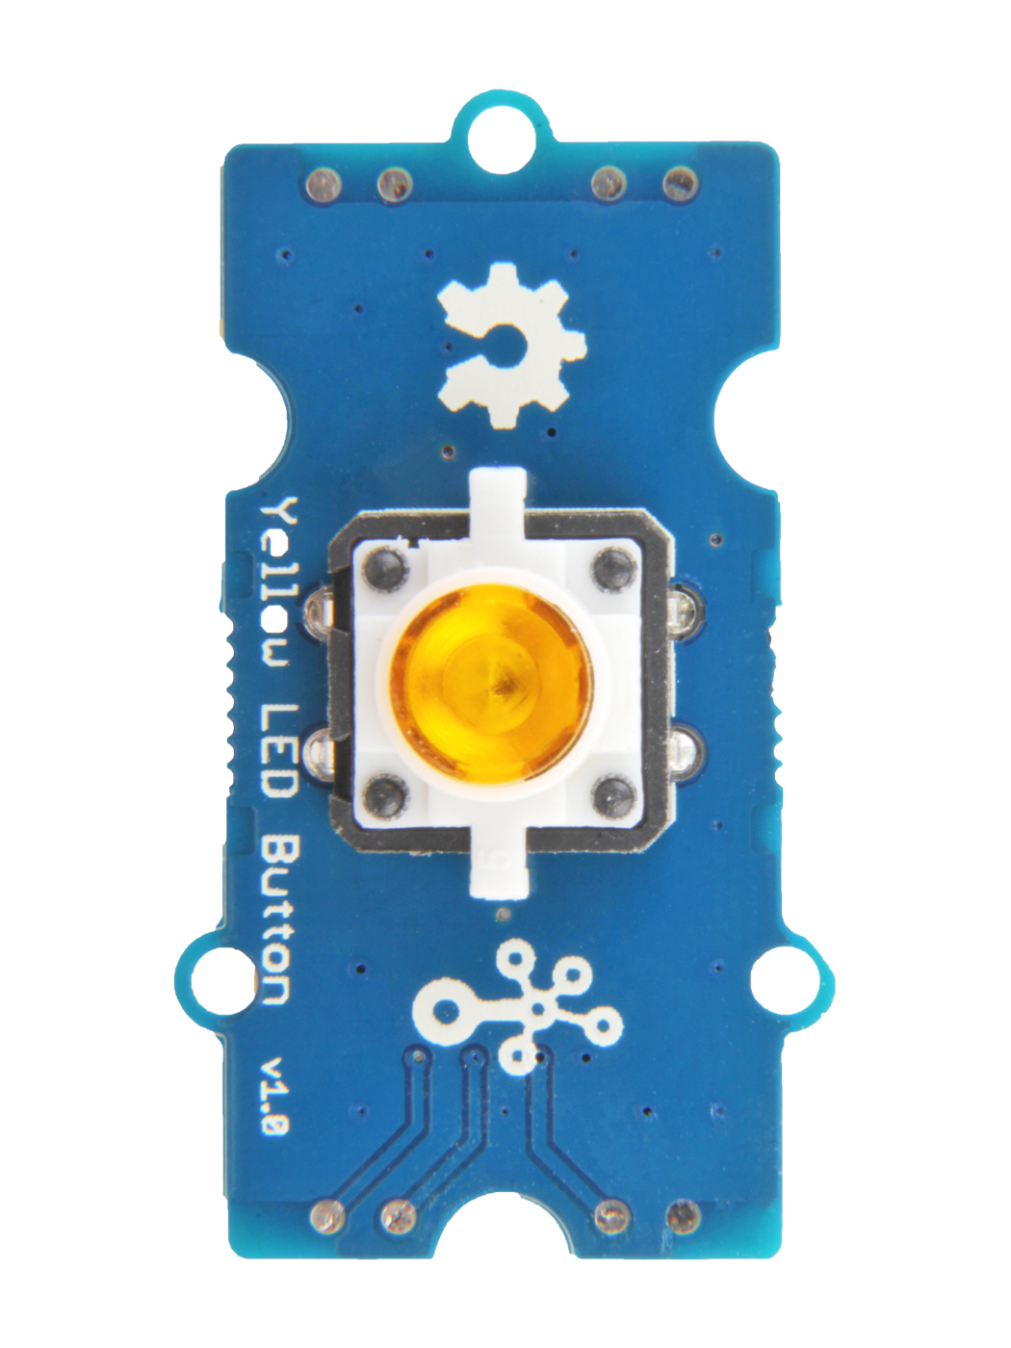
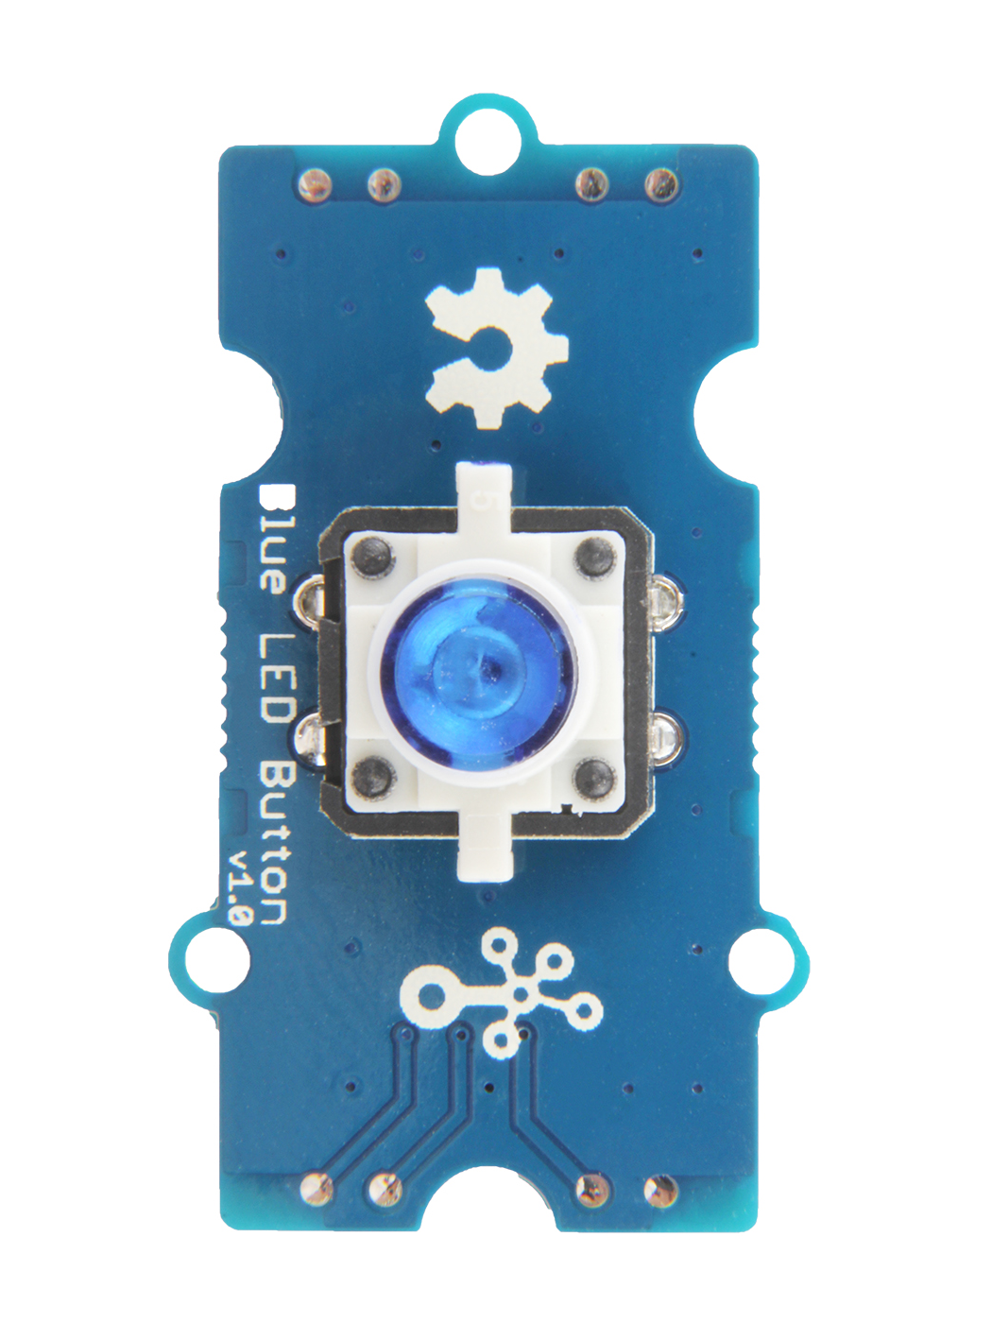
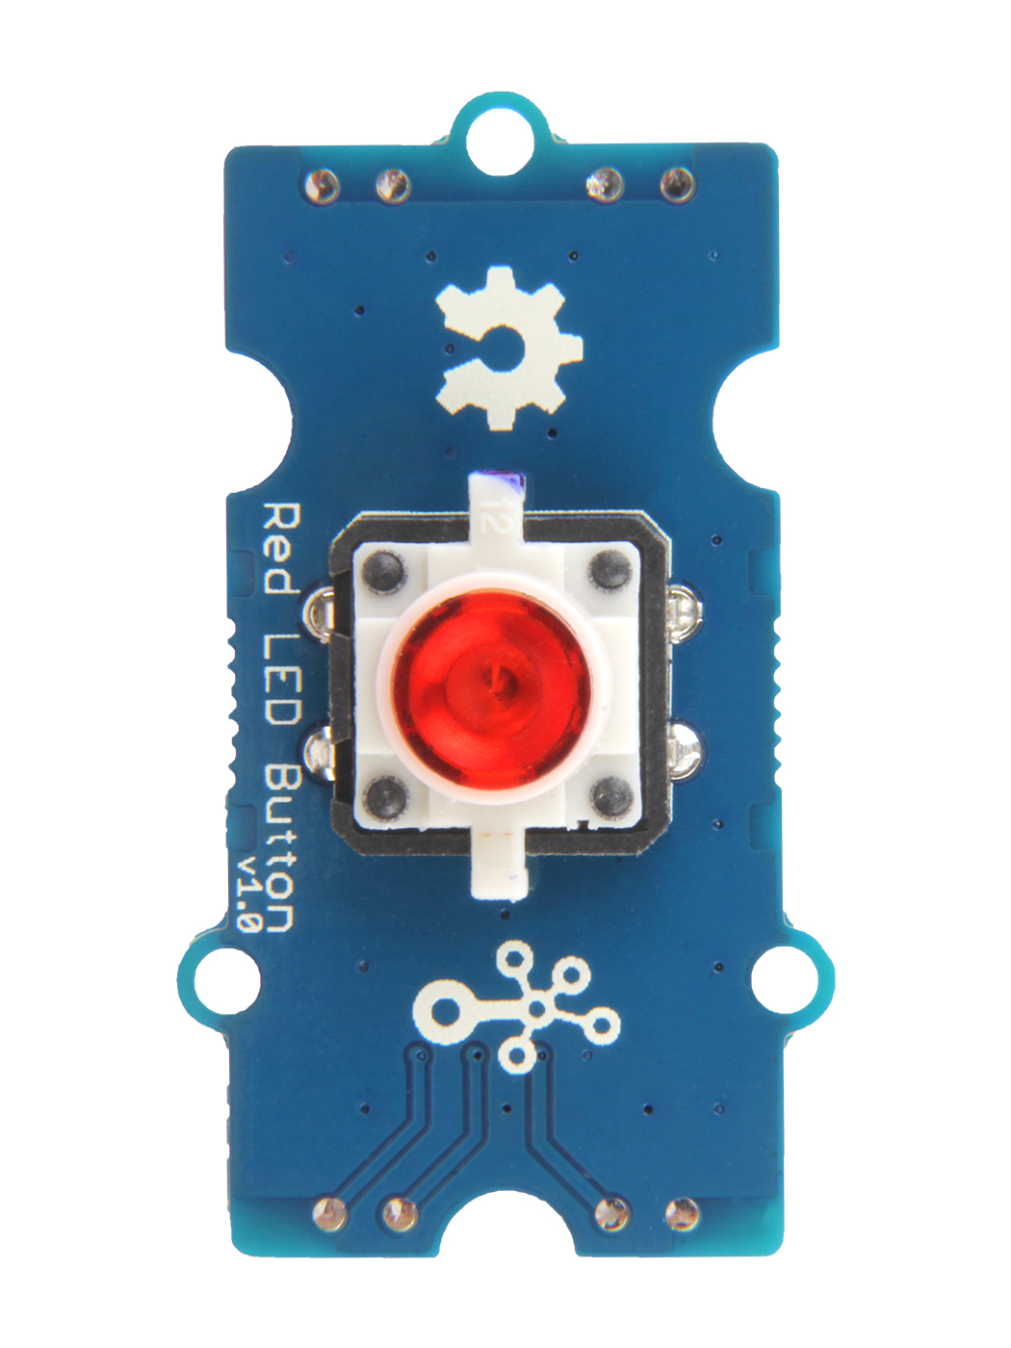

Slide 3
GND: connect this module to the system GND
VCC: you can use 5V or 3.3V for this module
NC: none connected in this module
OUT: output the Vout voltage signal

