Slide 1
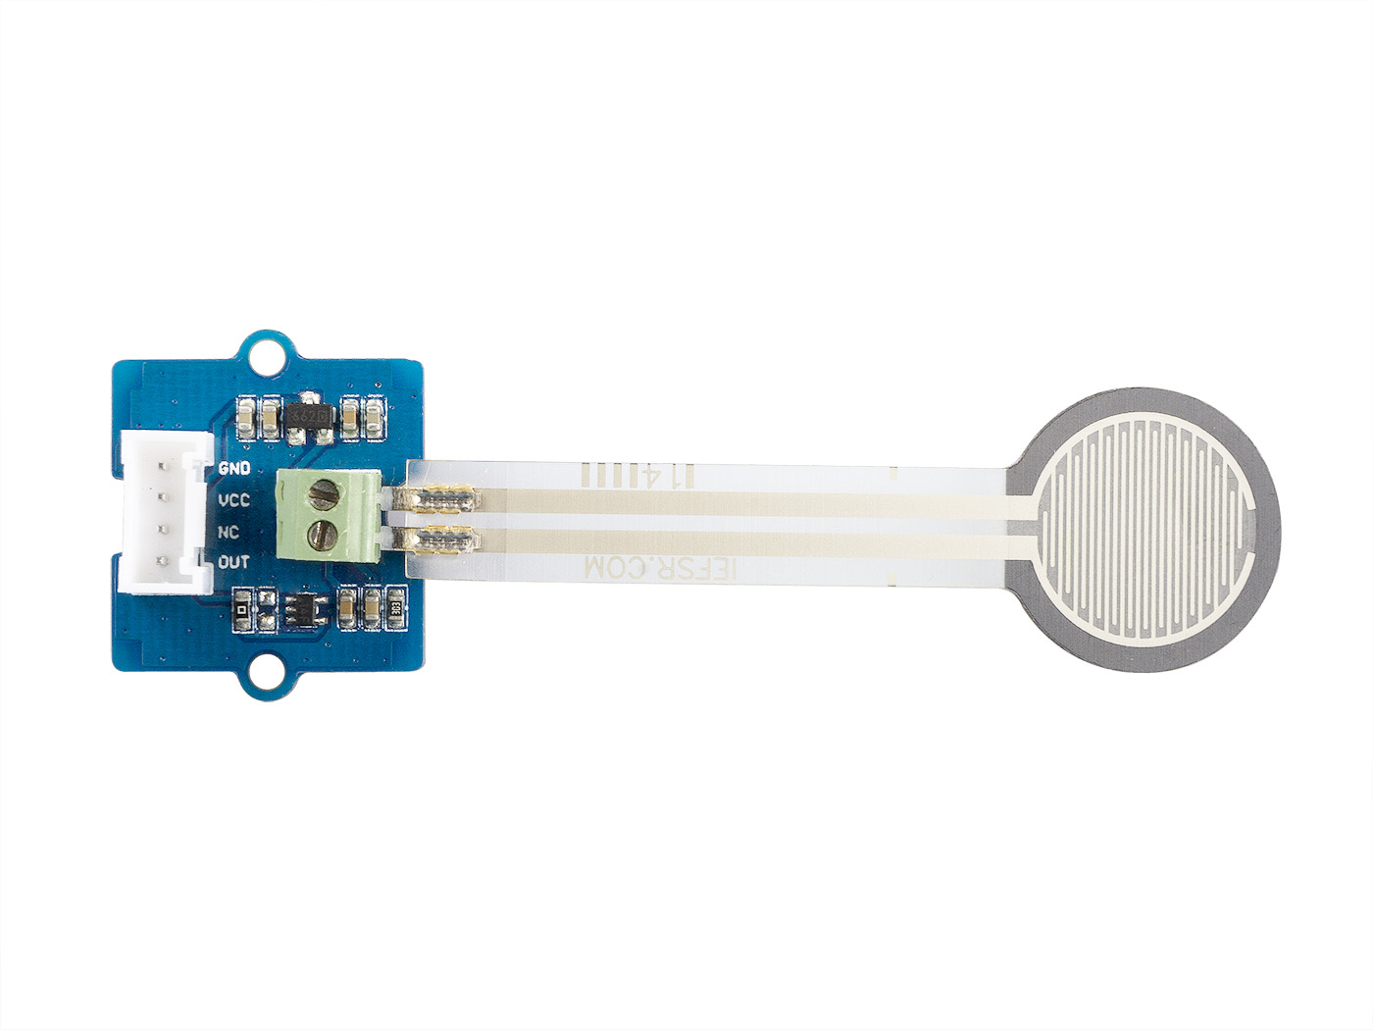




GND: connect the system GND with this module
VCC: you can use 5V or 3.3V for this module
NC: none connected in this module
OUT: output the Vout voltage signal

