Slide 1
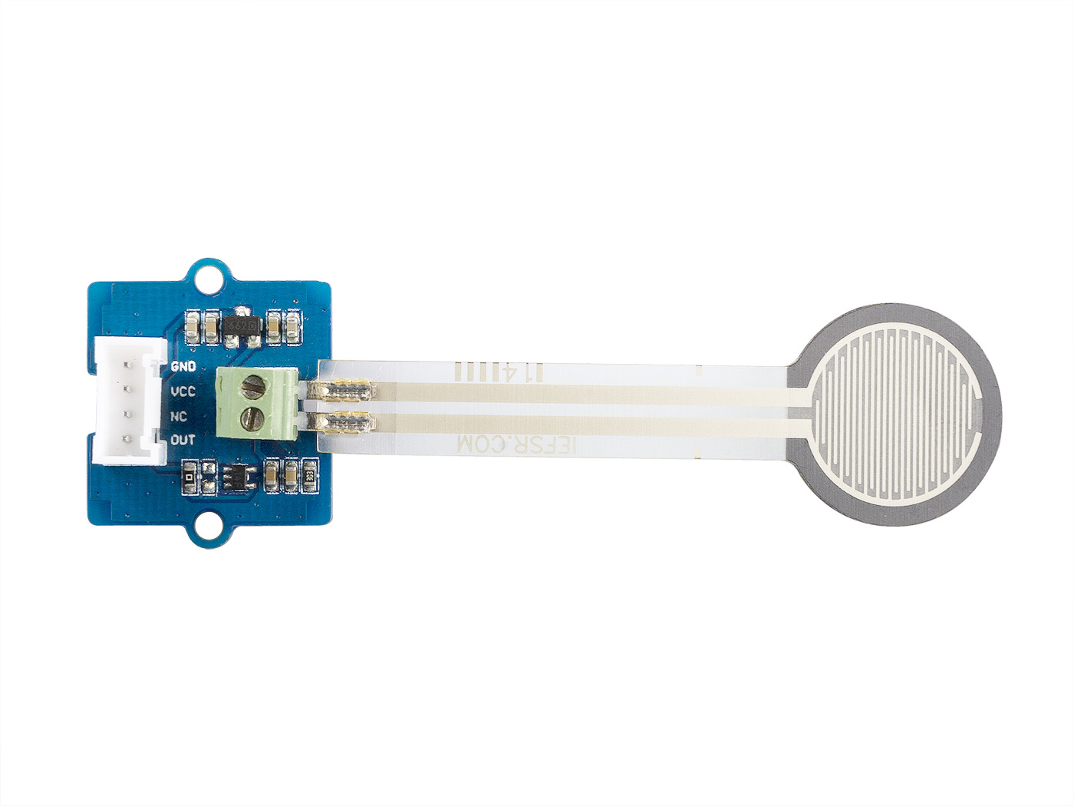




GND: connect this module to the system GND
VCC: you can use 5V or 3.3V for this module
SDA: serial data
SCL: serial clock

